Slide 1
What’s new in Rolls-Royce SMS Solution v2019.1
An explanation of the enhancements included in V2019.1
Document ID: RRNZ-1395612623-467
Revision: 3.0
© 2019 Rolls-Royce plc and/or its subsidiaries
The information in this document is the property of Rolls-Royce plc and/or its subsidiaries and may not be copied or communicated to a third party, or used for any purpose other than that for which it is supplied without the express written consent of Rolls-Royce plc and/or its subsidiaries.
This information is given in good faith based upon the latest information available to Rolls-Royce plc and/or its subsidiaries, no warranty or representation is given concerning such information, which must not be taken as establishing any contractual or other commitment binding upon Rolls-Royce plc and/or its subsidiaries.

Slide 2
Document Information
 | Name | Date
Author | Margaret Gascoine | 24 Jul 2020
Reviewed by | Stuart Gould | 24 Jul 2020
Editorial check by | Stuart Gould | 24 Jul 2020
Approved by | Ross Thomas | 27 Jul 2020
Liability Disclaimer This information is given in good faith based upon the latest information available to Rolls-Royce Controls and Data Services (NZ) Limited, no warranty or representation is given concerning such information, which must not be taken as establishing any contractual or other commitment binding upon Rolls-Royce Controls and Data Services (NZ) Limited or any of its subsidiary or associated companies.
Confidentiality The information in this document is the property of Rolls-Royce Controls and Data Services (NZ) Limited and may not be copied, or communicated to a third party, or used for any purpose other than that for which it is supplied, without the express written consent of Rolls-Royce Controls and Data Services (NZ) Limited.
Revision History
Date | Revision No. | Description of Revision
30 Jul 2019 | 1 | Approved
11 Nov 2019 | 2 | Approved for release with 2019.1 SR2
24 Jul 2020 | 2.1 | Updated for 2019.1 SR4 (added slides 68-72)
24 Jul 2020 | 2.2 | Reviewed & Editorial Check by Stuart Gould
27 Jul 2020 | 3.0 | Approved for release with 2019.1 SR4

Slide 3
01
What’s new
The following presentation gives an overview of what’s new in v2019.1

Slide 4
01
Release Summary
Release Number: v2019.1
Release Date: 5 August 2019
Release Type: Major release
Contains: Bug fixes, enhancements, and changes
- Service Release 1 released 27th September, 2019
Service Release 2 released 11th November, 2019
Service Release 3 released 4th February, 2020
Service Release 4 released 3rd August, 2020

Slide 5
The enhancements in v2019.1 are focussed on improvements to the FCA module, which includes implementing the new wide-screen user interface. Specific enhancements include:
Enhancements - Overview
Cause and Action Requests – Use these to let the Finding responder know what kind of response is required.
Approvals – Choose when approval is needed before a Finding or Action moves to the next state.
Search & Reporting – The Findings, Causes & Actions Reporting page has been combined with the Search pages. This allows you to use any available search criteria for each Report.
Grid Improvements – All grids in FCA now have filtering functionality and allow users to customise and save their grid settings.

Slide 6
The following icons on each slide indicate the approximate size of each enhancement/change.
Impact icons
Major (has a large impact)
Medium (has a medium impact)
Small (mostly aesthetic)

Slide 7
The following icons on each slide indicate whether any work is required when upgrading to this version.
Action icons
Information only
no work required when upgrading
Optional action
work only required if you want to make use of the enhancement
Mandatory action
work must be undertaken when upgrading
i
a
a

Slide 8
02
What’s new in Administration?

Slide 9
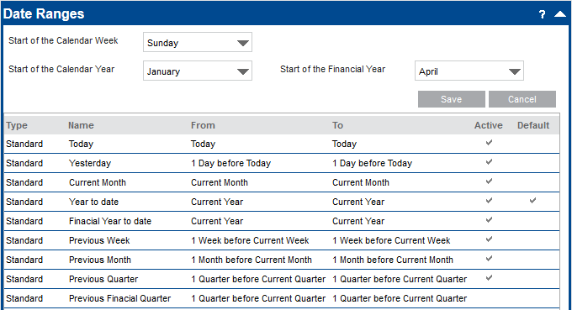
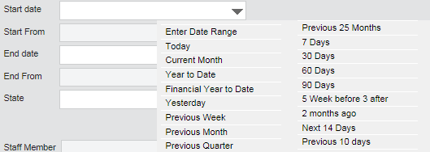
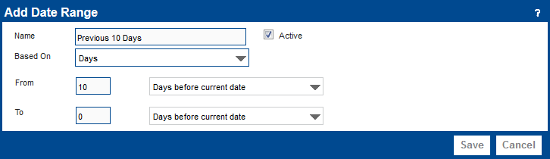
What’s new in Administration?
Date Ranges (21026, 29736, 29738, 33545)
Administrators can customise the list of Date Ranges available in Analysis and Search pages.
Preview the date range based on today’s date to make sure it calculates as you expect it to.

Slide 10
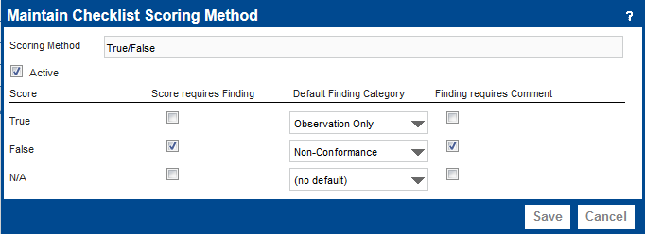
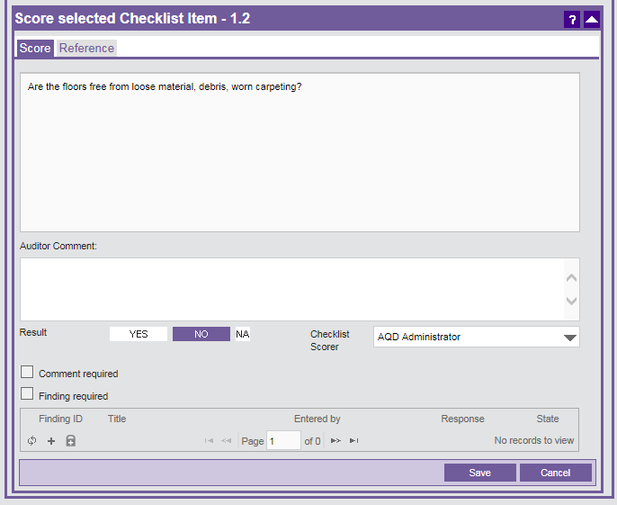
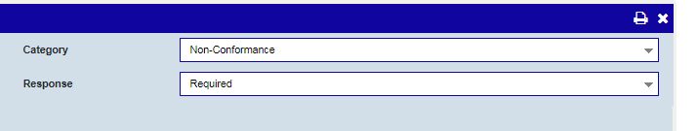
What’s new in Administration?
Default Finding Category based on the Score (26106)
Each Checklist score can have a default Finding Category associated with it. If a Finding is raised from a scored Checklist item, the Category is automatically set.
To set these defaults go to Audit Administration > Checklist Scoring > Maintain Checklist Scoring Method

Slide 11
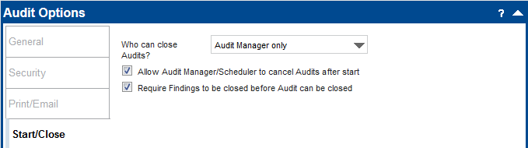
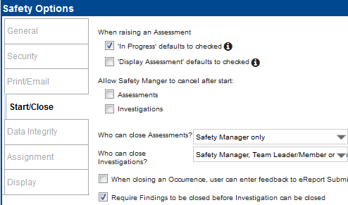
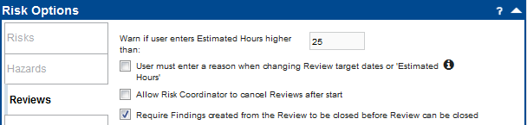
What’s new in Administration?
Require Findings to be closed before the source can be closed
There are three new settings (one each for Audits, Investigations, and Reviews) to determine if Findings need to be closed before the source record can be closed.

Slide 12
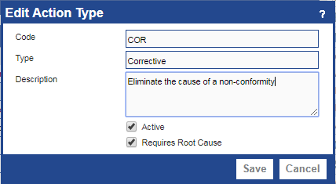
What’s new in Administration?
Customisable Action Types
Create and maintain custom Action Types.
Specify whether a Cause is mandatory for that type of Action. This means that some Action Types (such as Corrections) can apply directly to the Finding, while other Action Types (such as Correctives or Preventives) must be linked to a specific Cause.

Slide 13
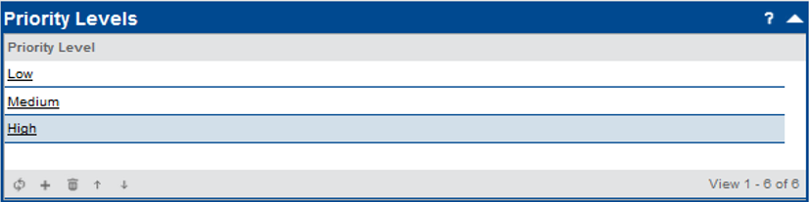
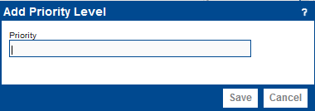
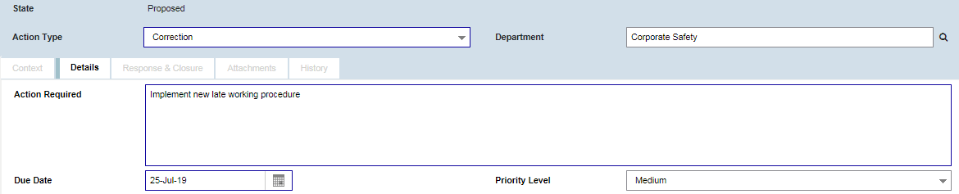
What’s new in Administration?
Priority Levels for Actions (31182)
Set up Priority Levels so that Actions can be prioritised.
Choose the order priority levels will appear in the list.

Slide 14
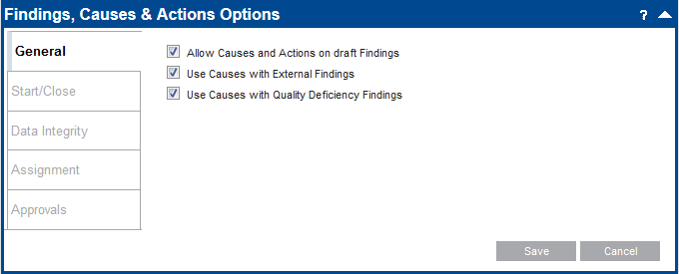
What’s new in Administration?
New FCA General Options
It is now possible to specify if Causes can be used with External and Quality Deficiency Findings.

Slide 15
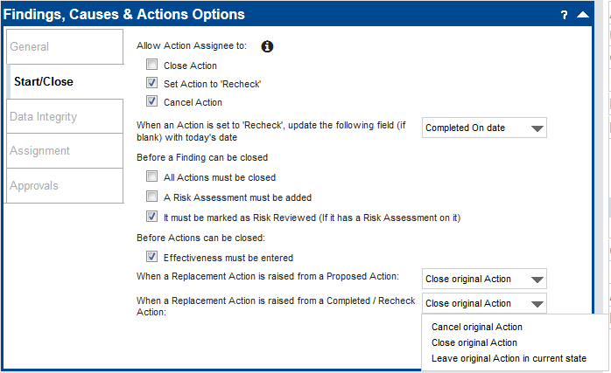
What’s new in Administration?
New FCA Start/Close Options (5054, 6792, 32757)
Determine what is mandatory before closing a Finding.
Specify whether ‘Effectiveness’ must be entered before an Action is closed.
Specify whether the original Action should be closed or cancelled when creating a replacement.

Slide 16
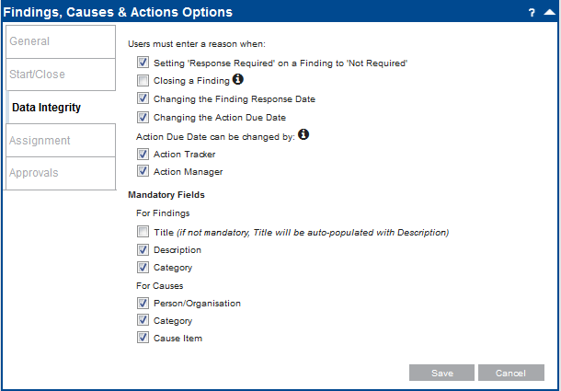
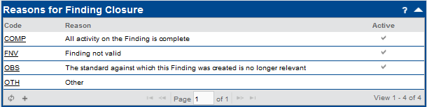
What’s new in Administration?
If you enable this setting, ensure you have at least one active ‘Reason for Finding Closure’ value.
New FCA Data Integrity Options (4094, 9329, 18374)
Specify which changes users must enter a reason for.
Create Reasons for Finding Closure, for users to select when closing a Finding.
Allow Action Tracker and/or Action Manager to change the Action Due Date.
Determine what fields are mandatory for Causes.

Slide 17
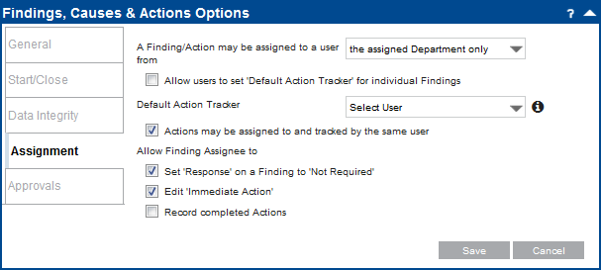
What’s new in Administration?
New FCA Assignment Options (17291, 18368)
Choose whether Actions can be assigned to and tracked by the same person.
Allow Finding Assignee to edit ‘Immediate Action’ on a Finding.

Slide 18
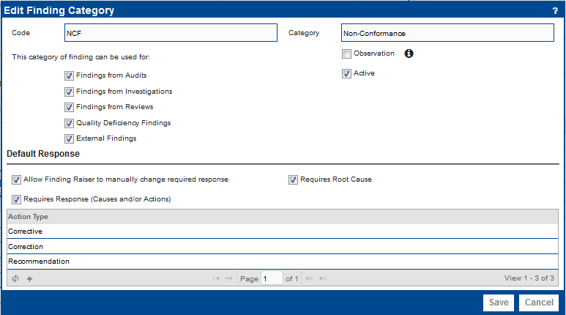
What’s new in Administration?
Options for Finding Categories (6297)
  Make a Category inactive.
  Mark a Category as an ‘Observation’. Findings categorised as observations display the ‘Observation’ flag, are considered Observations in the IOSA Conformance Report.
  Specify which kind of Findings a Category can be used on
  Specify default response requirements and whether Finding Raiser can change these requirements manually.

Slide 19
Finding Approvals
What’s new in Administration?
1
Approval to Publish Finding
Approval required before Finding state changes to Open
APPROVALS
Approval Definitions
Six approval definitions are available to define additional approval steps on Findings and Actions.
2
Approval to Finalise Response
Approval required before Finding state changes to Response Finalised
3
Approval to Close Finding
Approval required before Finding state changes to Closed
Action Approvals
4
Approval to Publish Action
Approval required before Action state changes to Assigned
5
Approval required before Action state changes to Completed
Verify a Completed Action
6
Approval to Close Action
Approval required before Action state
changes to Closed

Slide 20
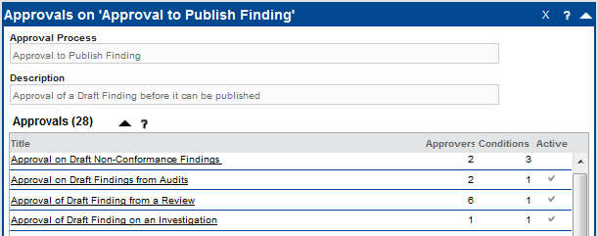

What’s new in Administration?
APPROVALS
Approval Templates
On each approval definition, you can create and maintain any number of different approval templates.
A Finding or Action may meet the conditions of more than one active template. You can move your approvals into the order which you’d like them to take place.

Slide 21
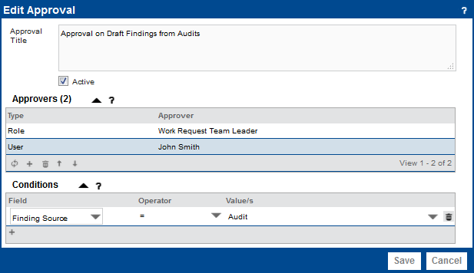
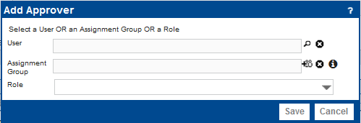
Use the arrows to change the order of approvers. For example, you may want a senior staff member’s approval to happen last.
What’s new in Administration?
APPROVALS
Approvers
On each approval template, you can specify any number of approvers.
Your approver can be a specific User, an Assignment Group, or a Role relative to the record (e.g. the Audit Team Leader).
If more than one approver is available (e.g. for an assignment group) only one of the users will need to give approval.

Slide 22
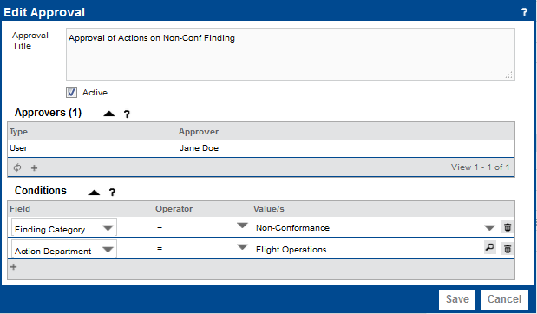
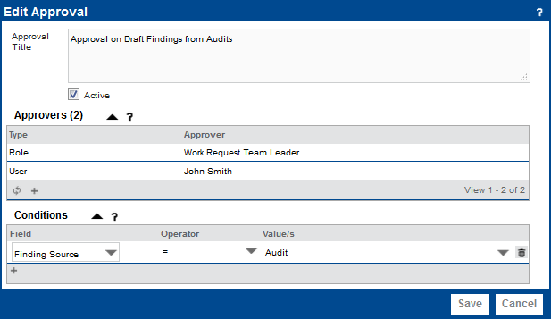
On approval templates for Actions, you can add Conditions based on:
Action Department
Action Type
Finding Category
Finding Department
Finding Source
Source Work Request Type
In this example – Jane Doe will need to approve all Actions on ‘Flight Operations’ Department which are on a ‘Non-Conformance’ Finding
What’s new in Administration?
APPROVALS
Conditions
On each approval template, you can specify any number of Conditions for when it should be applied.
On approval templates for Findings, you can add Conditions based on:
Finding Category
Finding Department
Finding Source
Source Work Request Type
In this example – a Work Request Team Leader and John Smith will need to approve all Draft Findings from Audits

Slide 23
What’s new in ASAP?

Slide 24
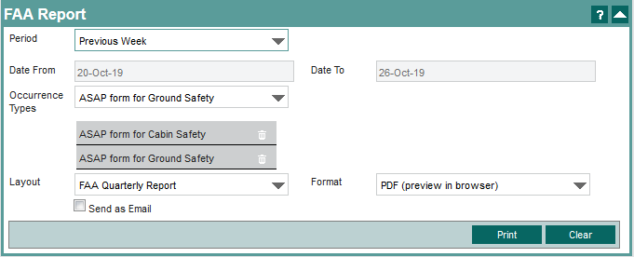
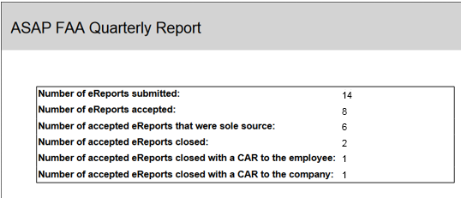
What’s new in ASAP?
(Service Release 2)
FAA Report (42620)
There is a new page for ‘ASAP Reports’ which has a section for generating an ‘FAA Report’.
The report can be filtered by date range and by Occurrence Type.
Users need the new ASAP Report Viewer security role to access this page.

Slide 25
03
What’s new in FCA?

Slide 26
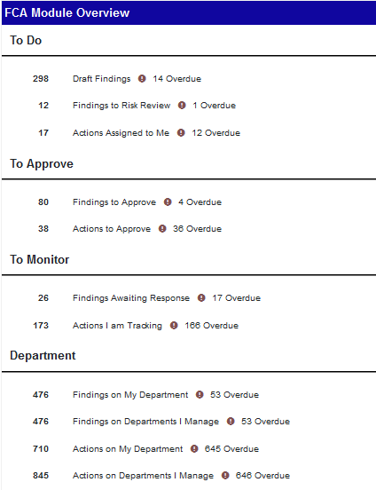
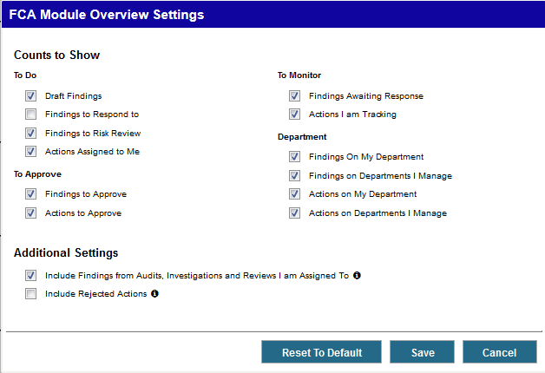
What’s new in FCA?
FCA Module Overview
The FCA module landing page has been refreshed and can be customised by selecting which counts to show in the FCA Module Overview Settings.

Slide 27
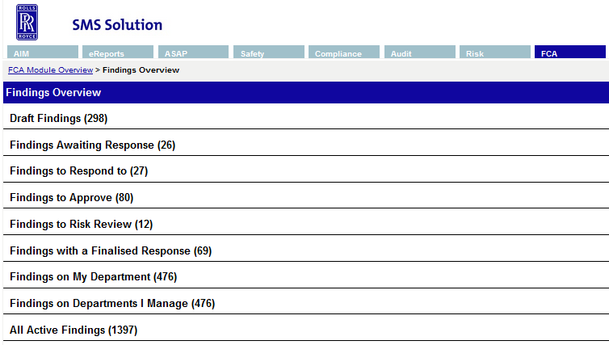
What’s new in FCA?
Findings Overview page
There is a landing page especially for Findings. There are new grids for:
Findings to Approve
Findings on Departments I Manage (only displayed for managers of a Department)
Completed Findings
All Active Findings

Slide 28
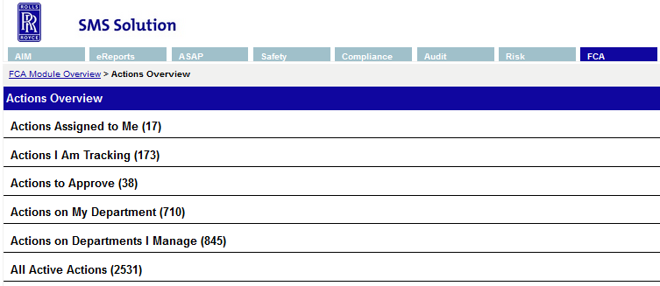
What’s new in FCA?
Actions Overview page
There is now a landing page especially for Actions. There are new grids for:
Actions to Approve
Actions on Departments I Manage (only displayed for managers of a Department)
All Active Actions

Slide 29
Draft
Open
Closed
Creating the Finding
Recording any further comment and a reason for closure
No further work required on the Finding
What’s new in FCA?
New Finding Workflow
Findings now have a ‘State’ which replaces the ‘Response State’ field. ‘Response’ is a separate field which can be either ‘Required’ or ‘Not Required’.
Findings now always begin as draft.
Findings can now be closed.
Basic Finding Workflow, where no response is required and no approvals are necessary

Slide 30
Draft
Open
Closed
Creating the Finding
Responding to the Finding
No further work required on the Finding
Response Finalised
Waiting for Actions to be closed (if mandatory)
Recording any further comment and a reason for closure
What’s new in FCA?
New Finding Workflow
When a response is required, Causes and Actions are entered when the Finding is Open (or Draft if your settings allow).
Finalising the response also changes any ‘Proposed’ Actions to ‘Assigned’.
Basic Finding Workflow where a response is required. No approval necessary on the Finding or proposed Actions.

Slide 31
Draft
Open
Closed
Creating the Finding
Responding to the Finding
No further work required on the Finding
Response Finalised
Waiting for Actions to be closed (if mandatory)
Recording any further comment and a reason for closure
Approval to
Publish Finding
Approval of the
entire response
to the Finding
Approval to
Close Finding
What’s new in FCA?
New Finding Workflow
You can add up to 3 additional Approval Steps to the Finding workflow.
Finding Workflow where a response is required, with up to 3 additional approvals on the Finding. No approval necessary on proposed Actions.

Slide 32
Draft
Open
Closed
Creating the Finding
Responding to the Finding
Finding has been closed
Response Finalised
Waiting for Actions to be closed (if mandatory)
Recording any further comment and a reason for closure
Response Submitted
Awaiting approval on any proposed Actions
Approval to
Publish Finding
Approval of the
entire response
to the Finding
Approval to
Close Finding
What’s new in FCA?
New Finding Workflow
All Proposed Actions requiring approval must be approved before the Finding response can be finalised.
Additional ‘Response Submitted’ state if Approval on Proposed Actions is outstanding.
Finding Workflow where a response is required, with up to 3 additional approvals on the Finding. Approval also required on proposed Actions before the response can be finalised.

Slide 33
Assigned
In Progress
Starting work on the Action
Published Action waiting for work to start
Recording the response and action taken
Completed
Recording the effectiveness and any further comments
Closed
No further work required on the Action
Proposed
Creating the Action
What’s new in FCA?
New Action Workflow
The workflow of Actions has been improved to make the standard process more defined, guiding users through states in a more sequential order.
Basic Action Workflow, where no approvals are necessary and recheck is not required

Slide 34
Assigned
In Progress
Starting work on the Action
Published Action waiting for work to start
Recording the response and action taken
Completed
Recording the effectiveness and any further comments
Closed
No further work required on the Action
Proposed
Creating the Action
What’s new in FCA?
Approval to
Publish Action
Approval to verify completion
Approval to
Close Action
New Action Workflow
Up to 3 additional Approval Steps
‘Rejected’ is no longer a State. If approval is rejected, the Action simply remains in its current state.
Action Workflow with up to 3 additional approvals, no recheck required

Slide 35
Assigned
In Progress
Starting work on the Action
Published Action waiting for work to start
Recording the response and action taken
Completed
No further work required on the Action
Proposed
Creating the Action
Specifying a date for rechecking
Closed
Recording the effectiveness and any further comments
Recheck
Approval to
Publish Action
Approval to verify completion
Approval to
Close Action
What’s new in FCA?
New Action Workflow
If a Recheck Due Date is specified, the Action changes to the ‘Recheck’ state before closure.
Action Workflow with up to 3 additional approvals, recheck required.

Slide 36
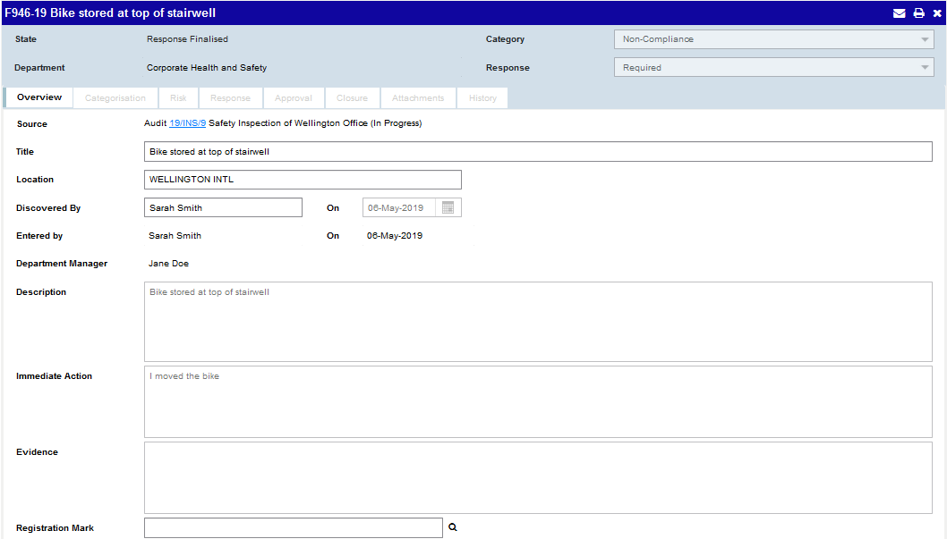
What’s new in FCA?
The Source information on a Finding is displayed consistently for all types of Findings.
Findings - Overview
Finding Title can now contain up to 100 characters.
The ‘Response State’ field has been replaced by two separate fields – ‘State’ and ‘Response’
It is possible to record ‘Location’ on a Finding.
New fields for ‘Entered By’ and ‘Entered On’ so that ‘Discovered By’ and ‘Discovered On’ can be different if the Finding Raiser is entering the Finding on behalf of someone else.
Department Managers are displayed on the Finding.

Slide 37
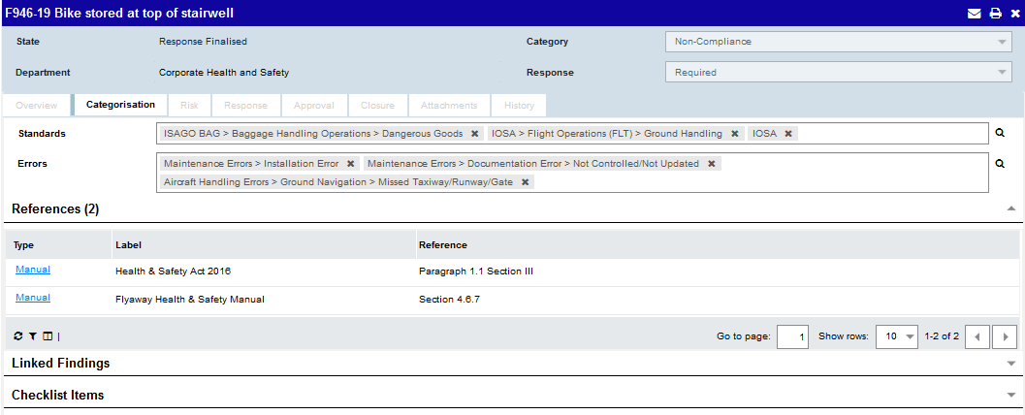
What’s new in FCA?
Findings - Categorisation
You can add multiple Standards and Errors to a single Finding.
You can create multiple Rule and Manual References on a Finding. These can also be labelled.
The character limit for References has been increased to 250.

Slide 38
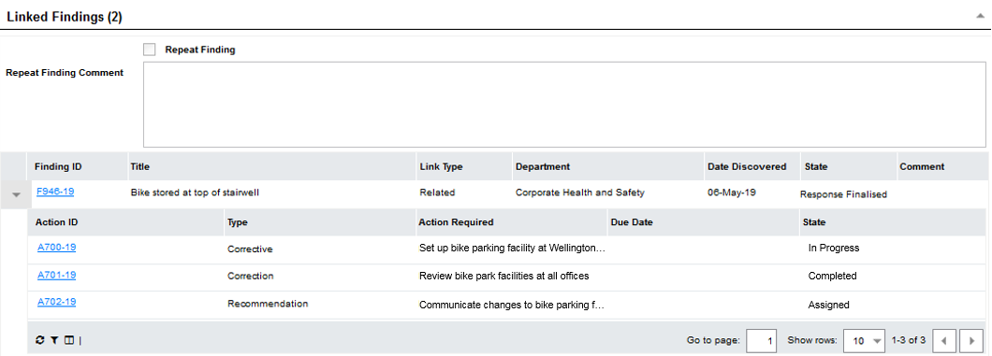
What’s new in FCA?
Linked Findings
Other Findings can be linked/unlinked and accessed from a Finding.
Linked Findings can be marked as ‘Duplicate’, ‘Related’, or ‘Repeat’.
You can view any Actions on the linked Findings from the grid.

Slide 39
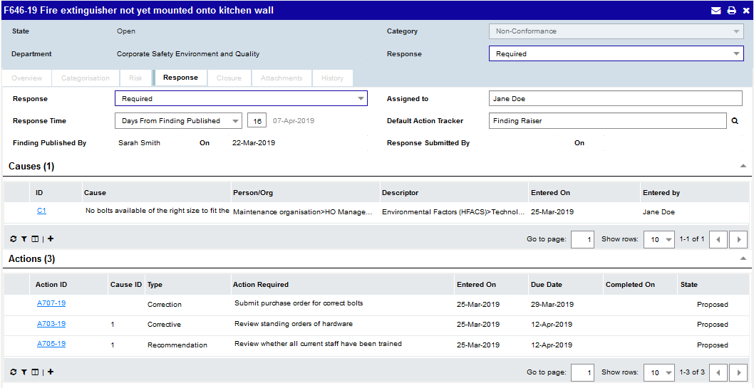
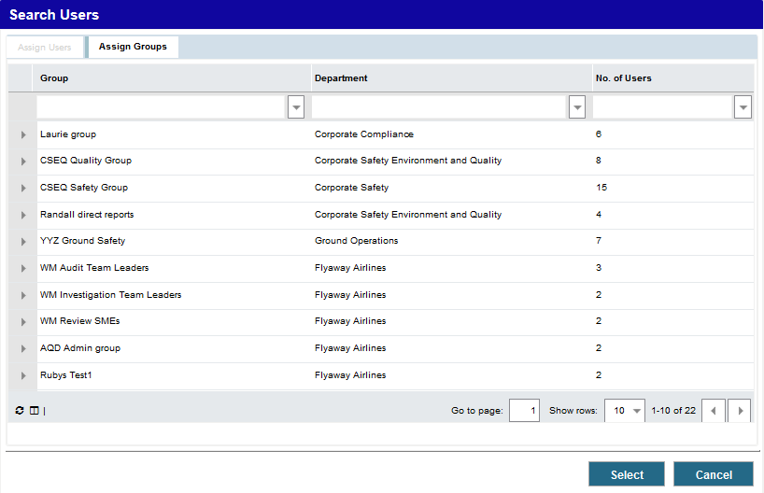
What’s new in FCA?
Findings - Response
Assignment Groups can be assigned to Findings.
If necessary, you can change which Cause an Action is linked to.

Slide 40
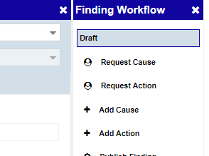
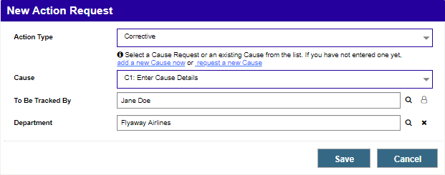
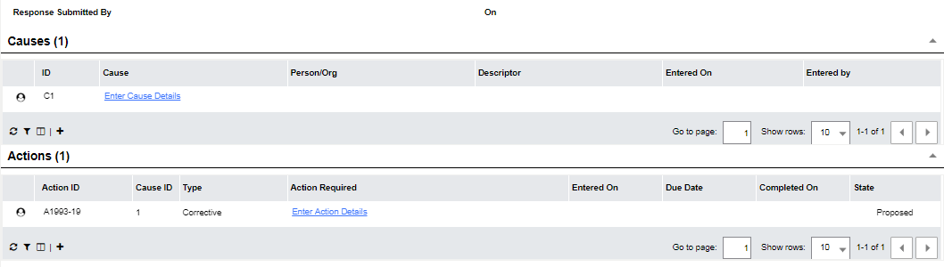
What’s new in FCA?
Cause and Action Requests
Create Cause and Action Requests on a Finding to let the Finding Assignee know what kind of response they need to enter
On an Action Request you can specify:
  a Cause (or Cause request) to link the Action to
  Who should track the Action to completion
  Which Department you want the Action to be on.
Cause and Action Requests can be created automatically based on the selected Finding Category.

Slide 41
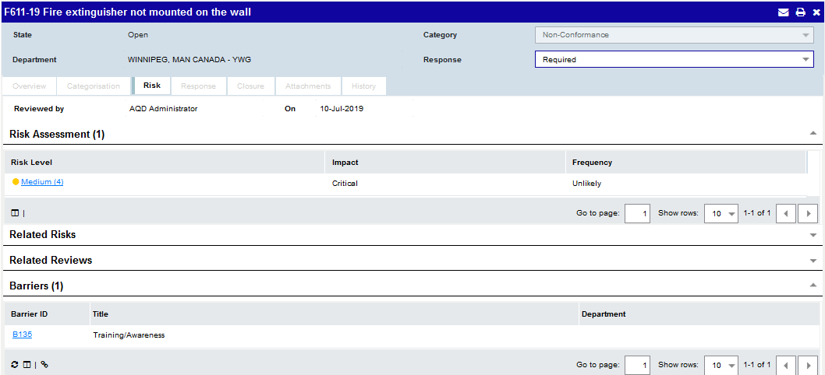
What’s new in FCA?
Findings - Risk
You can create a Risk Assessment on a Finding prior to saving it.
The user and date is recorded on the Finding when marked as risk reviewed.
Barriers can be manually linked to a Finding.

Slide 42
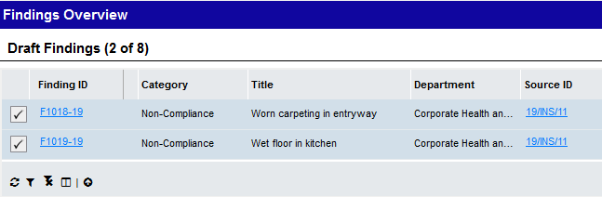
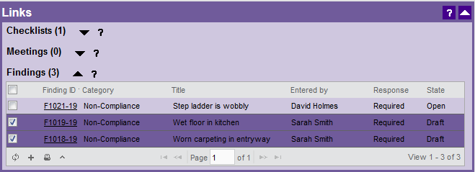
What’s new in FCA?
Publish multiple Findings at once
Publish multiple Findings from the Draft Findings grid, or from the Findings grid on the source Work Request.
Confirmation is required before the Findings will be published.
If any Findings need approval before being published, the approval process will be started when you try to publish them.

Slide 43
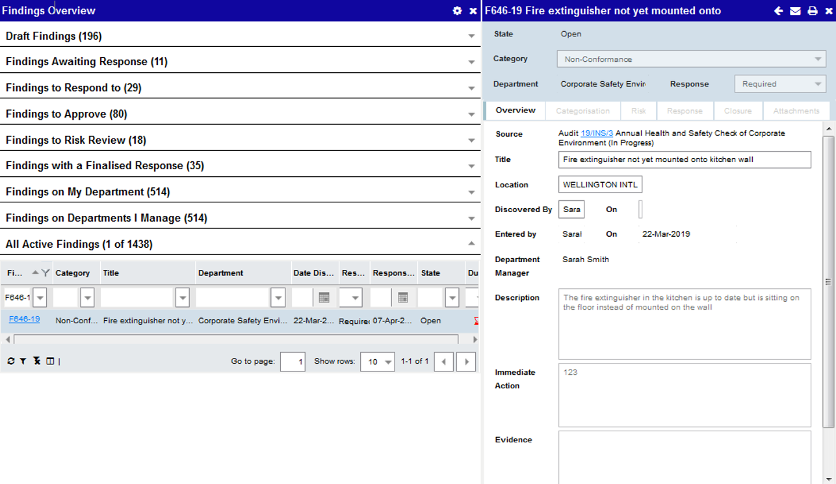
What’s new in FCA?
Preview Findings in the Secondary Panel
Findings can be now be previewed in the secondary panel on the Findings Overview page, and on Actions, Barriers, Findings, Reviews, and Risks.

Slide 44
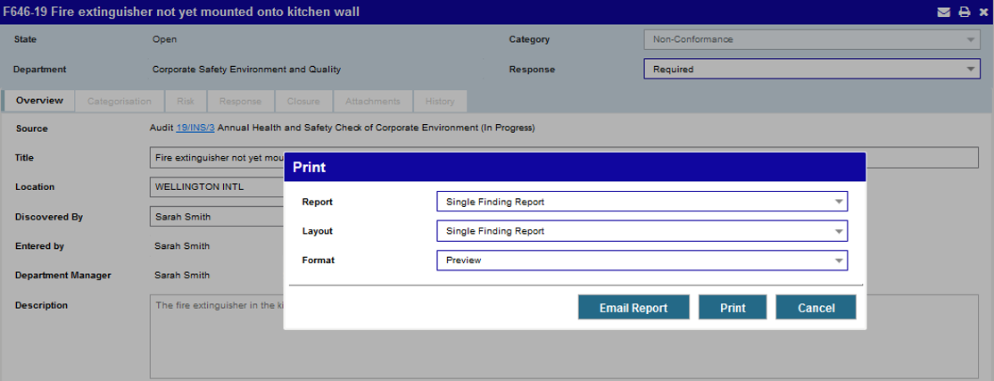
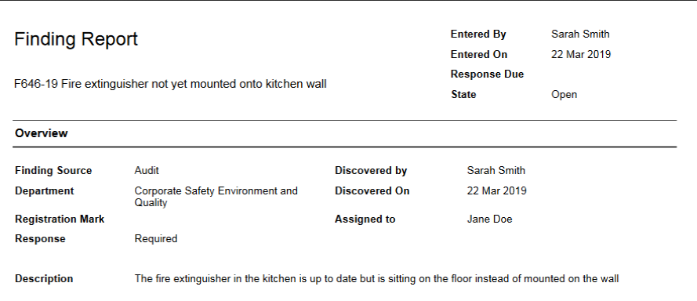
What’s new in FCA?
Print Findings (8921)
Individual Findings can be printed.

Slide 45
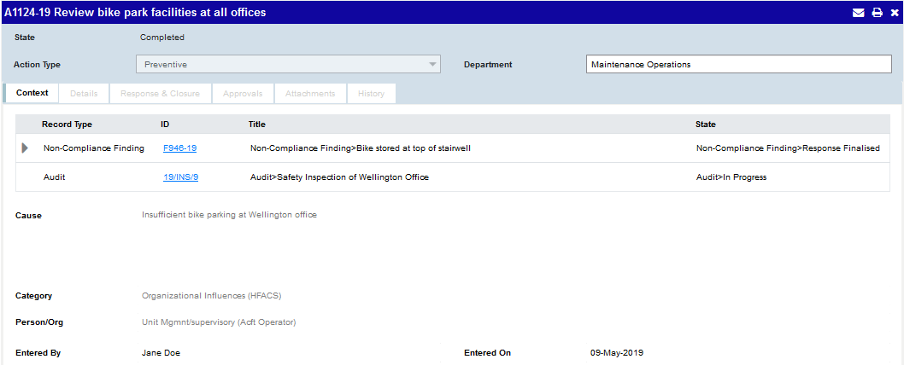
What’s new in FCA?
Action Context
View the Finding Description on an Action by expanding the section.
All Cause fields are now displayed on the Action, with a much larger field for the Cause Description
Click on the expand icon to reveal the Finding Description below.

Slide 46
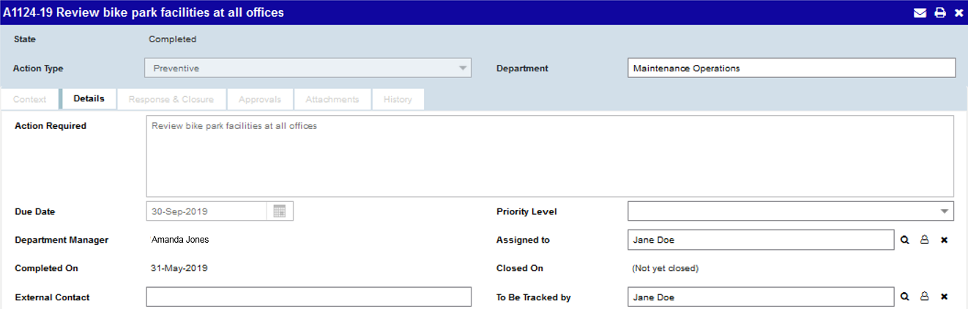
What’s new in FCA?
Action Details
The ‘Action Required’ field on an Action is bigger.
Department Manager(s) are displayed on the Action.
Assignment Groups can be assigned to Actions as Action Assignee or Action Tracker.

Slide 47
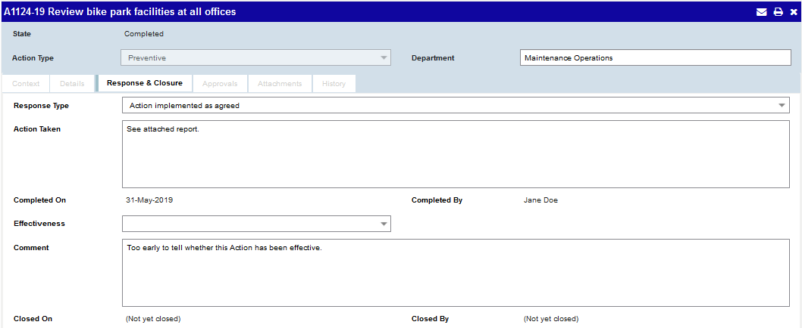
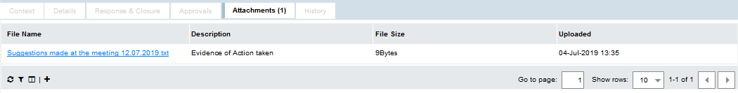
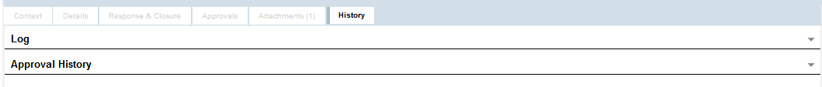
What’s new in FCA?
Action Response & Closure, Attachments and History
Attachments can now be added to Actions which are in state ‘Completed’ or ‘Recheck’.
Action Managers and Action Trackers can add attachments to an Action.

Slide 48
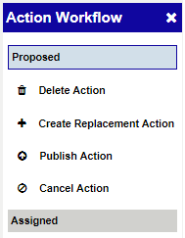



Whether the original Action is closed, cancelled, or left in its current state, depends on how your system is configured. A warning is displayed first.
What’s new in FCA?
Replacement Actions
Replacement Actions can be raised from Proposed Actions which have been rejected, or Completed or Recheck Actions which have been found ineffective.
There is a link on the replacement Action to navigate to the original Action
Actions which have been replaced now have a link to navigate to the replacement Action.

Slide 49

What’s new in FCA?
Preview Actions in the Secondary Panel
Actions can be previewed in the secondary panel on Findings and Risks.

Slide 50

What’s new in FCA?
Search and Reporting (31906, 32677)
Findings, Causes & Actions Reporting has been combined with the Search Findings and Search Actions pages. Reports can now be filtered as required using any of the additional search criteria options.

Slide 51


What’s new in FCA?
Search Findings
You can now search for Findings by:
  State
  Response
  Location
  Entered By and On
  Rejected On
  External Finding Reference
  Source Sub-Type
  Manual / Rule Reference
  Linked Findings
  Reason for Closure
  First Cause Entered Date
Causes and Actions can be added to the Finding Search Results report.

Slide 52


What’s new in FCA?
Search Findings by Risk using the Risk Matrix
Select any version of the Primary Risk Matrix to search on one or more Risk Values from it.
Click on any Risk Level in the Key to select all the cells that have that level.

Slide 53

What’s new in FCA?
Search Actions
You can now search for an Action by:
  External Finding Reference
  Source Sub-type
  the date it was Assigned, Started or Rejected.
  External Reference fields

Slide 54


What’s new in FCA?
Search Findings and Actions by Aircraft
The Aircraft Search tool has been redesigned.
You can view a complete list of aircraft which will be included in the search.
You can search Actions by Aircraft. Results return Actions where the Registration Mark on the parent Finding matches the criteria specified.

Slide 55
04
What’s new in Analysis?

Slide 56

What’s new in Analysis?
Updates to Finding Criteria (26702, 27510, 30056)
‘Response’ and ‘State’ fields have replaced the ‘Response State’ field.
Draft is now a State, which makes it possible to search for Draft Findings.
‘Location’ has been added.

Slide 57

What’s new in Analysis?
Updates to Action Criteria (29353, 30106, 32419)
‘Action Effectiveness’ has been added
The ‘Overdue’ option now includes Actions of any state where the ‘Completed On’ date is blank or after the Action Due Date.
Other fields have been updated for changes made in this release.

Slide 58
05
What’s new in Email?

Slide 59

What’s new in Email?
Email Findings from any Source (9687)
You can email a Quality Deficiency Finding.
You can email a Finding even if there are no Actions on it.

Slide 60

What’s new in Email?
New data tags and filters for Finding Alerts
  You can filter Finding Alerts by:
  Parent Work Request Owner
  Source Sub-Type
  Data tags are also available for these.

Slide 61

What’s new in Email?
New data tags and filters for Action Alerts
  You can filter Action Alerts by:
    Action Source
    Finding Source
    Finding State
    Finding Category
  Data Tags are available to include in Action Alerts for all of the above, as well as:
    Finding Source ID
    Action Source ID
    Finding Title
    Finding Description
    Cause fields

Slide 62

What’s new in Email?
Source Type Selection
When Source Type is selected as a template filter on Finding Alerts, values can be selected from a dialog.

Slide 63
New Alerts
Alert Title | Description
Action Not Closed | An Action has remained in a state of Completed for X days..
Finding Assigned (Assignment Group) | An Assignment Group has been assigned to an Action.
Finding State Changed | The state of a Finding has changed.
Finding Awaiting Approval | The Finding is now awaiting approval from another user..
Finding Linked to Finding | A Finding is linked to another Finding.
Action Assigned (Assignment Group) | An Assignment Group has been assigned to an Action.
Action State Changed | The state of an Action has changed.
Action Awaiting Approval | The Action is now awaiting approval from another user.
Action Approved | The Action has been reviewed and approved by all Approvers.
All Actions Completed | All Actions under a Finding have been completed.
All Actions Closed | All Actions under a Finding have been closed.
Action Required Changed | The Action Required field on an Action has been changed.
What’s new in Email?
Alerts for FCA
12 new Alerts available
Existing Alerts have been updated
Work Completed Alerts are no longer triggered when Actions are rejected.

Slide 64
06
What’s new generally?

Slide 65


What’s new generally?
Print the Log (9687)
The Log on records in the Risk and FCA modules can now be printed.

Slide 66



What’s new generally?
Save grid changes
Save your changes to any grid in FCA
If you make any changes to the columns or page size on a grid, you can now save the changes so that the grid stays that way next time you view it.
Changes to grids are saved as preferences for you only, no other users.
Undo grid changes
There’s now an option on the Column Selector to revert back to the default settings for the grid when the grid has been altered.
Reset all grids in the entire module back to the default settings, from the Module Overview page.

Slide 67


What’s new generally?
(Service Release 2)
Export for IDX
A new Export Option is available for ‘Incident Data Exchange (IDX)’ which exports data in the required format to comply with the IATA IDX XML standard.
You can specify mappings for Event Descriptors in the configuration wizard.
Any data in records that do not match the IDX requirements are displayed with a message to tell you why

Slide 68

What’s new generally?
(Service Release 4)
Announcements
The ability to create Announcements is now provided as a way for you to increase communication with your teams.
Some examples of what you could use an Announcement for are:
Communicate changes in response to a major event (such as the Covid-19 pandemic)
Encourage reporting, responses or completion of actions
Share news, updates on safety notices and new advisories with your team
Raise awareness of any emerging trends
Communicate any configuration changes or adoption of new features
Provide additional guidance to increase accuracy of information or ensure procedures are being followed

Slide 69

What’s new generally?
(Service Release 4)
Create Announcements
Users with the ‘Announcer’ role can create Announcements.
Announcements can be set up to display in SMS Solution, Mobile eReports or both.
Send to all users or users in specific Departments and/or Security Groups.
The number of users it would be sent to if sent at the current time is displayed, however the actual list of recipients is calculated at the time the Announcement is sent.

Slide 70

What’s new generally?
(Service Release 4)
Notifications can be marked as read individually or you can click on this link to mark all as read.
Notifications Menu
A new ‘Notifications’ menu is available for all users.
A red badge is shown next to the bell icon if there is one or more unread Notifications.
The menu has two sections – one for Notifications received today and the other for earlier Notifications.
The menu displays the amount of time passed or the Date/Time of the Notification, based on the user’s Local Time.

Slide 71


What’s new generally?
(Service Release 4)
Manage Announcements
A link to ‘Manage Announcements’ is available within the Notifications menu for users with the Announcer or Announcement Manager role. The link opens the ‘Manage Announcements’ dialog which displays all of the Announcements the user has access to.
The Announcement can be edited or deleted any time before it is sent.
The Date/Time of the Announcement is the Announcer’s Local Time.
The grid shows whether the Announcements have been sent and the number of users who have read it out of the total number of recipients.

Slide 72


What’s new generally?
(Service Release 4)
New Security Roles
Two new Security Roles are available to support the Announcements feature:
The ‘Announcer’ Role grants users access to create and manage Announcements.
The ‘Announcement Manager’ Role grants users access to view and edit Announcements created by any other user. It gives someone overall control of Announcements in case an Announcer becomes absent (e.g. they take unexpected leave) and should only be given to a very limited number of users.
Departmental Authorisation is required to determine which departments an Announcer is allowed to send the Announcements to. Announcers can only edit and view their own Announcements.

Slide 73
Thank you

