Slide 1
What’s new in Rolls-Royce SMS Solution v2020.1
An explanation of the enhancements included in V2020.1
Document ID: RRNZ-1395612623-467
Revision: 3.0
© 2020 Rolls-Royce plc and/or its subsidiaries
The information in this document is the property of Rolls-Royce plc and/or its subsidiaries and may not be copied or communicated to a third party, or used for any purpose other than that for which it is supplied without the express written consent of Rolls-Royce plc and/or its subsidiaries.
This information is given in good faith based upon the latest information available to Rolls-Royce plc and/or its subsidiaries, no warranty or representation is given concerning such information, which must not be taken as establishing any contractual or other commitment binding upon Rolls-Royce plc and/or its subsidiaries.

Slide 2
Document Information
 | Name | Date
Author | Margaret Gascoine | 24 Jul 2020
Reviewed by | Stuart Gould | 24 Jul 2020
Editorial check by | Stuart Gould | 24 Jul 2020
Approved by | Ross Thomas | 27 Jul 2020
Liability Disclaimer This information is given in good faith based upon the latest information available to Rolls-Royce Controls and Data Services (NZ) Limited, no warranty or representation is given concerning such information, which must not be taken as establishing any contractual or other commitment binding upon Rolls-Royce Controls and Data Services (NZ) Limited or any of its subsidiary or associated companies.
Confidentiality The information in this document is the property of Rolls-Royce Controls and Data Services (NZ) Limited and may not be copied, or communicated to a third party, or used for any purpose other than that for which it is supplied, without the express written consent of Rolls-Royce Controls and Data Services (NZ) Limited.
Revision History
Date | Revision No. | Description of Revision
12 May 2020 | 1.0 | Approved for release with 2020.1
19 May 2020 | 2.0 | Approved for release with 2020.1
24 Jul 2020 | 2.1 | Updated for 2020.1 SR1 (added slides 41-46)
24 Jul 2020 | 2.2 | Reviewed & Editorial Check by Stuart Gould
27 Jul 2020 | 3.0 | Approved for release with 2020.1 SR1

Slide 3
01
What’s new
The following presentation gives an overview of what’s new in v2020.1

Slide 4
01
Release Summary
Release Number: v2020.1
Release Date: May 2020
Release Type: Major release
Contains:
4 themes that address 6 specific problems
Bug fixes that address 9 specific customer issues
- Service Release 1 released 3rd August, 2020

Slide 5
There are 4 themes to the v2020.1 release, each addressing at least one specific problem:
Themes - Overview
Search and Report on Risks, Hazards, Barriers & Reviews
  It is now possible to search for Risks, Hazards, Barriers or Reviews by specifying criteria, and to produce reports based on the results.
Export Risk data to BowTieXP
  You can now enter your risk data in a way that is compatible with a BowTie and download a file suitable for importing into the BowTieXP Scrapbook. This includes extensive changes to Threats & Errors, Consequences and Barrier linking.
Compare Risks across your Organisation
  With Quantitative Consequences, you can record the impact of a Risk as a quantity, enabling more precise comparison.
  Severity and Likelihood can now be automatically set based on the Probability and the highest-severity Consequence on a Risk Assessment.
Link Risk Records to each other and to Occurrences
  Some extra linking capabilities have been added to Occurrences, Hazards, Barriers and Reviews to improve some of the connections that were previously only one-way, and allow a number of new linkages.

Slide 6
The following icons on each slide indicate the approximate size of each enhancement/change.
Impact icons
Major (has a large impact)
Medium (has a medium impact)
Small (mostly aesthetic)

Slide 7
The following icons on each slide indicate whether any work is required when upgrading to this version.
Action icons
Information only
no work required when upgrading
Optional action
work only required if you want to make use of the enhancement
Mandatory action
work must be undertaken when upgrading
i
a
a

Slide 8
02
Search and Report on Risks, Hazards, Barriers & Reviews

Slide 9
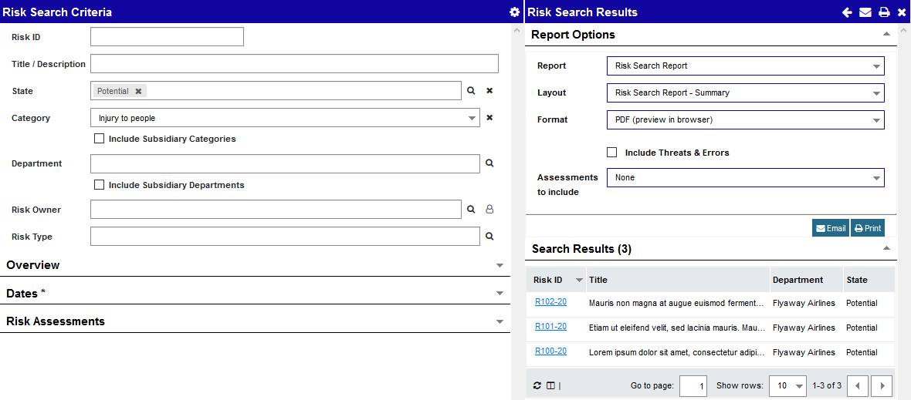
Search and Reporting combined
Reporting has been combined with new Search pages for Risks, Hazards, Reviews and Barriers.
Reports can be customised as required using any of the additional Report Options.

Slide 10
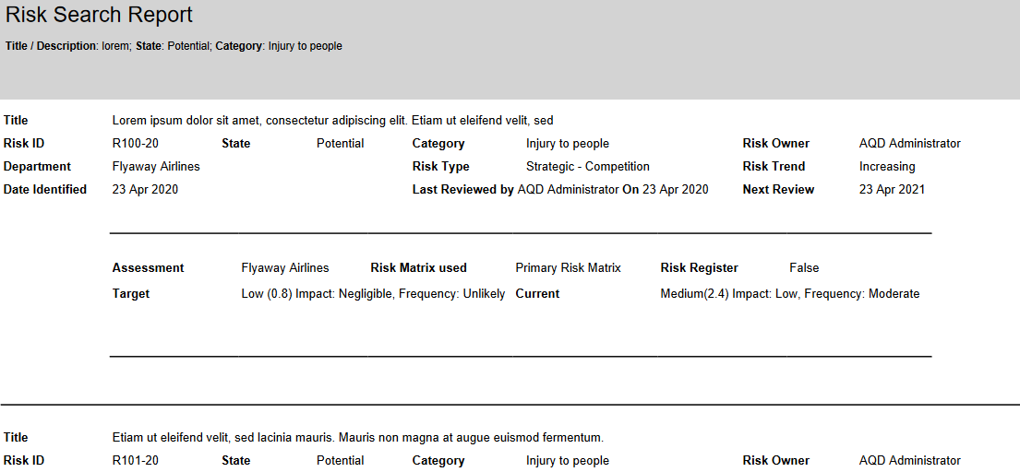
Search and Report on Risks
  Search for Risks which match the criteria you specify.
  You can print or email the results of your search.
  There are options to include Threats & Errors and Risk Assessments on the report.
  You can also print the Risk Register Report from this page.

Slide 11
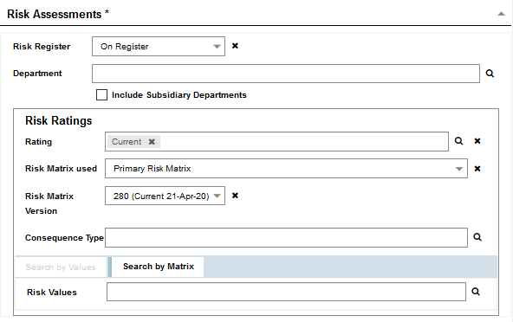
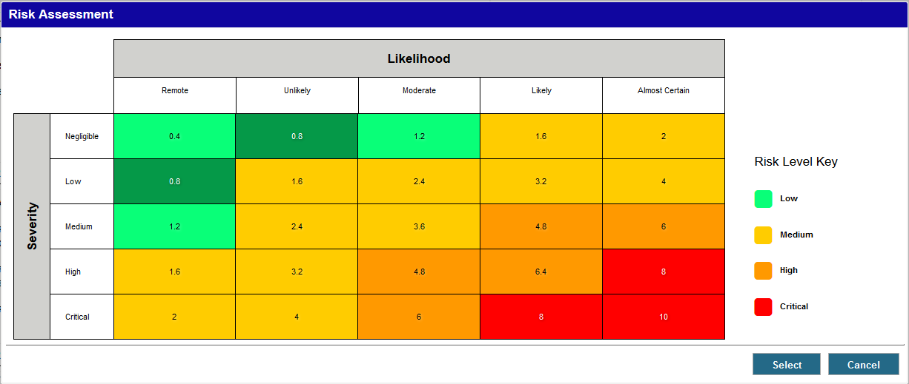
Search Risks by Risk Assessment details
Search using criteria such as the Risk Rating, whether the assessment is on the Risk Register or not, the Department of the Risk Assessment, the Risk Matrix used, the Consequence Type, the Risk Level, the Severity and/or the Likelihood.
Select any version of a Risk Matrix to search on its values.
Choose individual values or specific cells on the selected Risk Matrix.

Slide 12
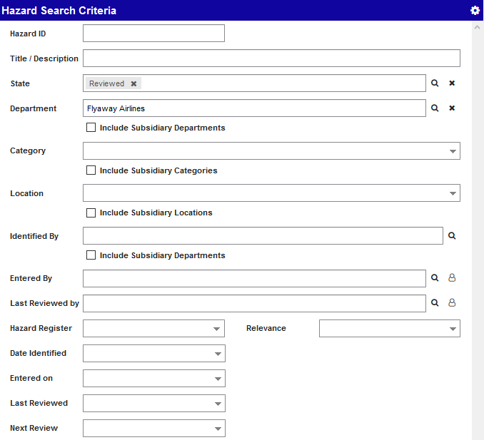
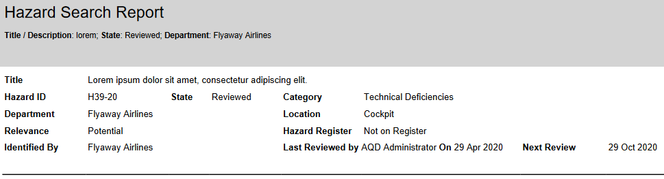
Search and Report on Hazards
  Search for Hazards which match the criteria you specify.
  You can print or email the search results.
  You can print the Hazard Register Report from this page.

Slide 13
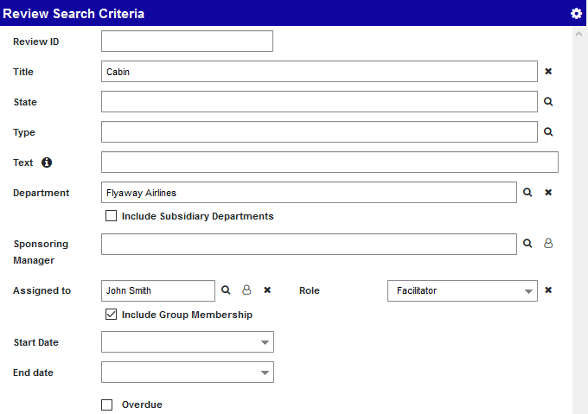
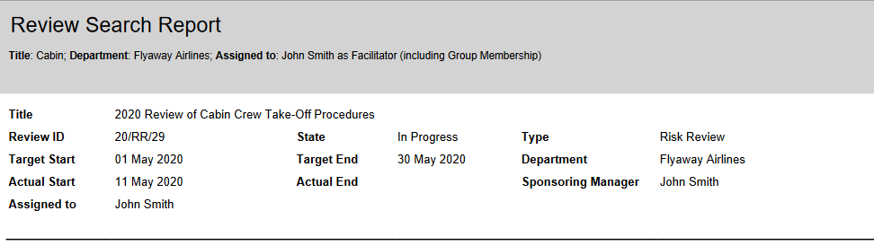
Search and Report on Reviews
  Search for Reviews which match the criteria you specify.
  You can print or email the search results.

Slide 14
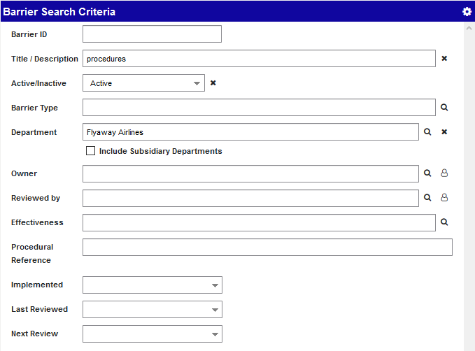
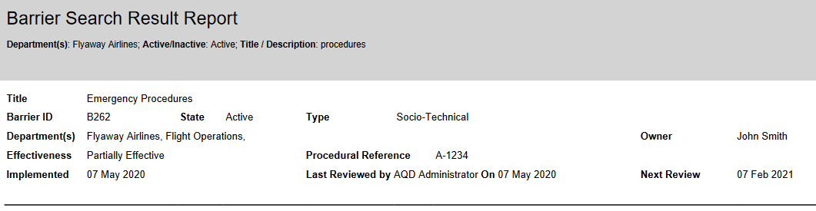
Search and Report on Barriers
  Search for Barriers which match the criteria you specify.
  You can print or email the search results.

Slide 15
Export Risk data to BowTieXP

Slide 16
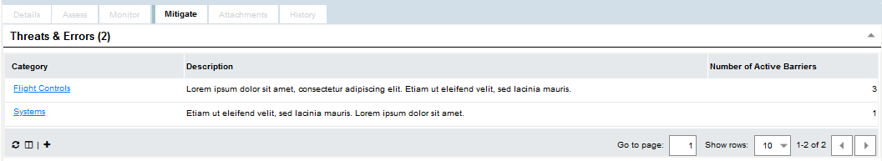
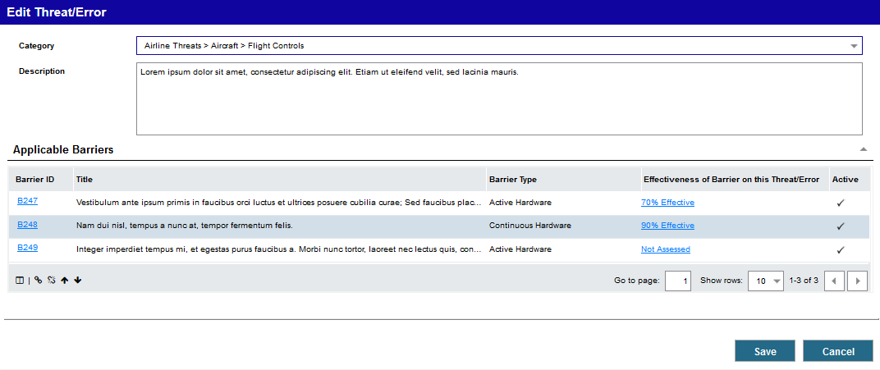
Threats & Errors
Threats & Errors are now listed in a grid on the ‘Mitigate’ tab on a Risk.
Use the new Description field to add further detail to each Threat & Error.
Each Threat/Error can be linked to relevant Barriers. You can specify how effective each Barrier is at mitigating that Threat / Error.
Once linked, Barriers can be reordered to indicate the sequence of defence against the Threat or Error.

Slide 17
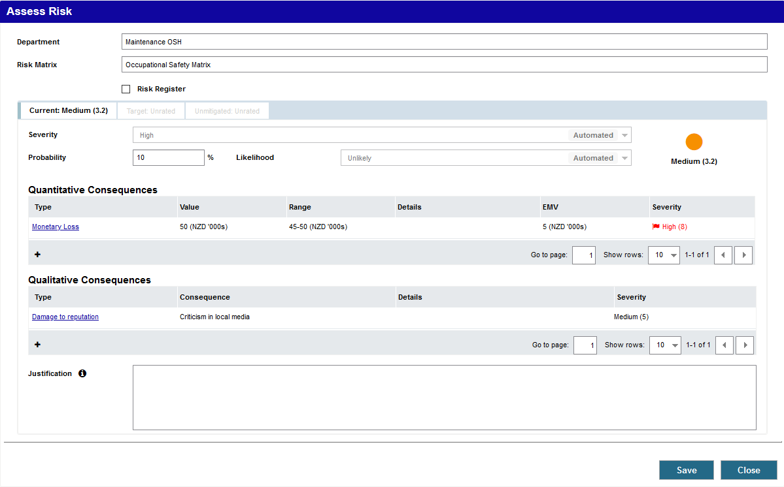
Quantitative and Qualitative Consequences on a Risk Assessment
Risk Assessments now have separate sections for Quantitative and Qualitative Consequences.
If automation is turned on, the highest Severity is automatically selected as the Severity for the Risk Rating.
The Consequence with the highest Severity is flagged.
Quantitative Consequences are a Premium feature.

Slide 18
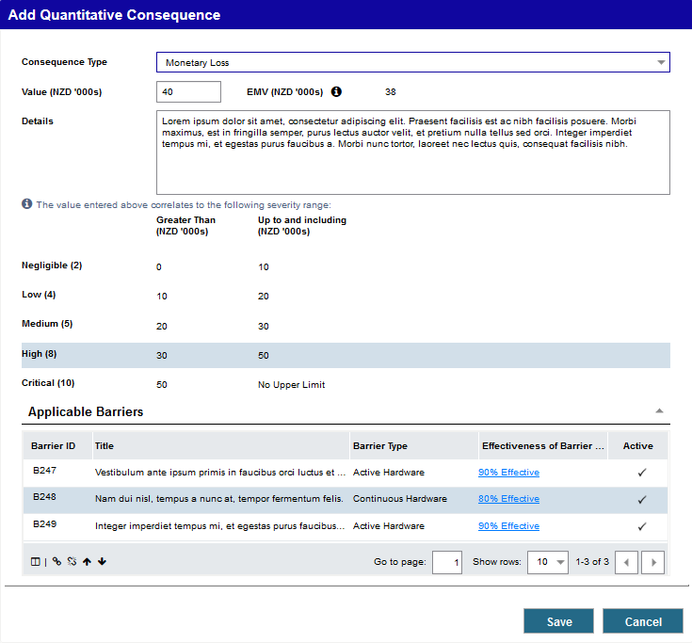
Add applicable Barriers to the Quantitative Consequences on a Risk Assessment
Link the applicable Barriers to a Consequence, and specify how effective the Barrier is at mitigating that Consequence.
Once linked, Barriers can be reordered to indicate the sequence of defence against the Consequence.
Quantitative Consequences are a Premium feature.

Slide 19
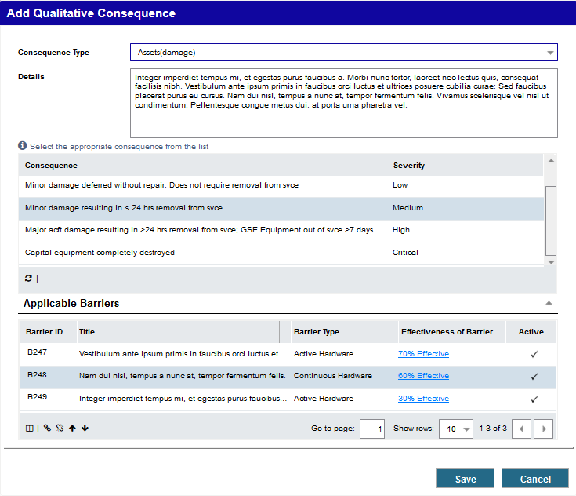
Add applicable Barriers to the Qualitative Consequences on a Risk Assessment
Link the applicable Barriers to the Consequence, and specify how effective the Barrier is at mitigating that Consequence.
Once linked, Barriers can be reordered to indicate the sequence of defence against the Consequence.

Slide 20
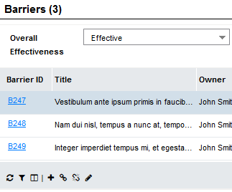
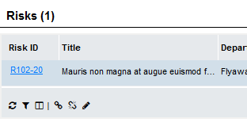
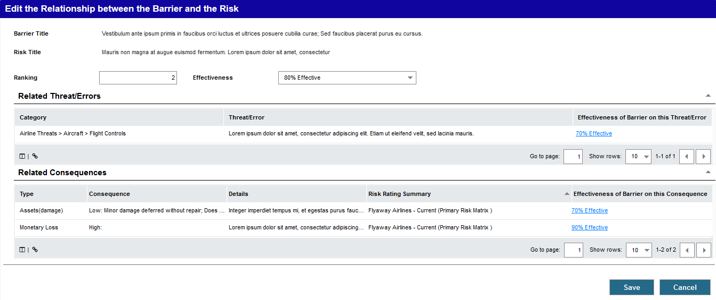
Specify which Threats & Errors and Consequences on the Risk a Barrier is mitigating
Once linked, you can specify how effective the Barrier is at mitigating that Threat / Error or Consequence.
Once a Barrier is linked to a Risk, you can link it to the Threats/Errors and Consequences that it works to mitigate or prevent.
This can be done from either the Risk or from the Barrier.

Slide 21
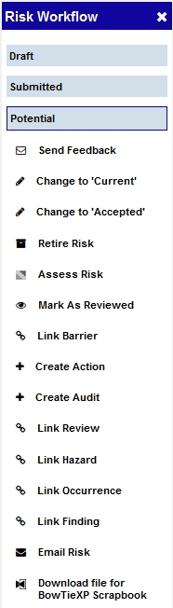
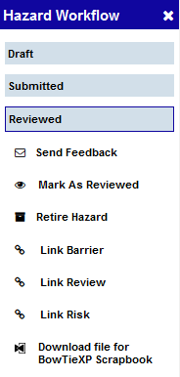
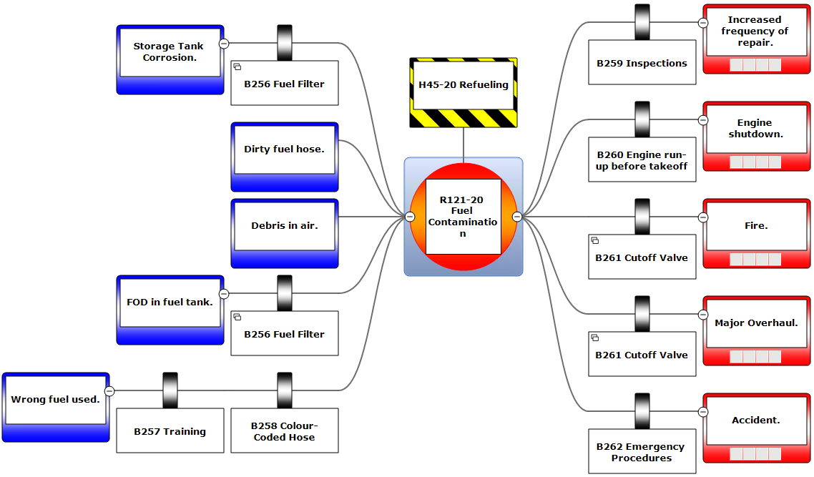
Download a BowTieXP file from a Risk or Hazard
Consequence
Threat/Error
Barrier
Hazard
Barrier
Threats & Errors and Consequences on a Risk can be exported with a supporting Hazard. This data will form a BowTie when imported the into the BowTieXP Scrapbook.
Barriers are displayed in the order specified in SMS Solution.
Users will need the new security role ‘BowTieXP Download’ to see this option in the Workflow.
Risk

Slide 22
04
Compare Risk across your organisation

Slide 23
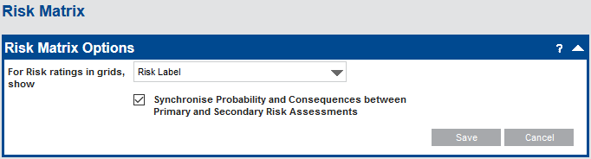
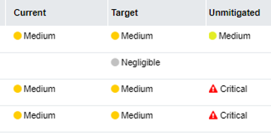
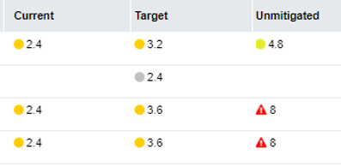
New Risk Matrix Options
Determine how Risk Ratings should be displayed in grids.
Choose to display either the Risk Label (word) or the Risk Score (number).
or ‘Risk Score’:

Slide 24
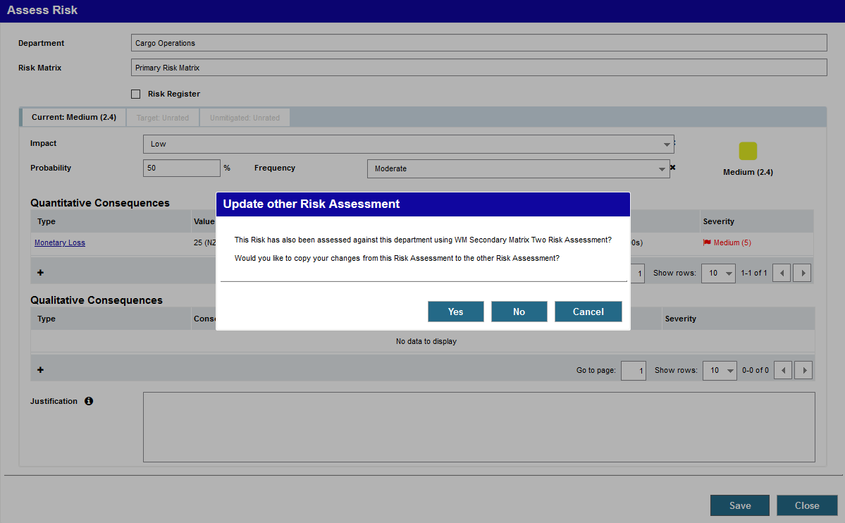
New Risk Matrix Options
When a user changes the Probability and Consequences on a Risk Assessment, you can choose to give them the option to copy their changes to another Assessment on the Risk on the same Department.

Slide 25
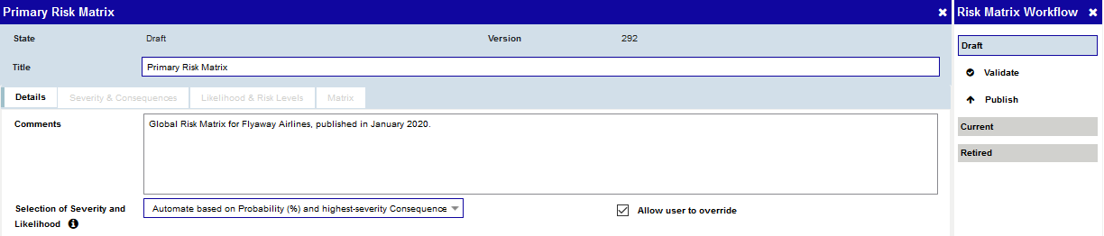
The Risk Matrix workflow indicates the State of the Risk Matrix and the actions which can be done in the current state.
New Risk Matrix screen
Primary and Secondary Matrices now open in a new, widescreen Risk Matrix screen.
There is an option to automate the selection of Severity and Likelihood based on the Probability and highest-severity Consequence.
If you choose to automate selection of Severity and Likelihood, choose whether a user can override the selection or not.

Slide 26
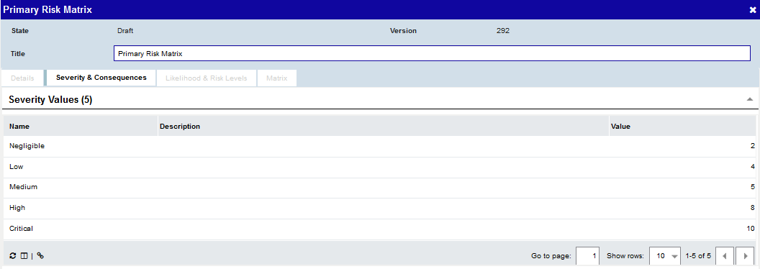
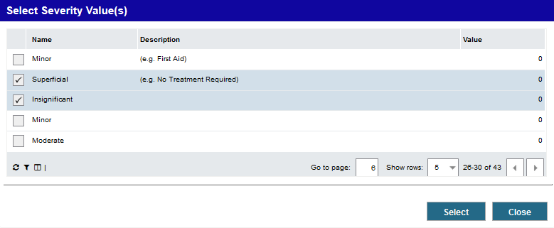
Link Severity Values to the Matrix
Link the Severity Values you want to use on the Matrix.

Slide 27
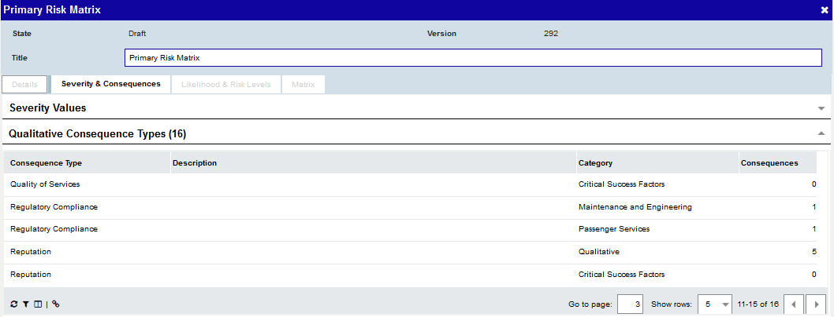
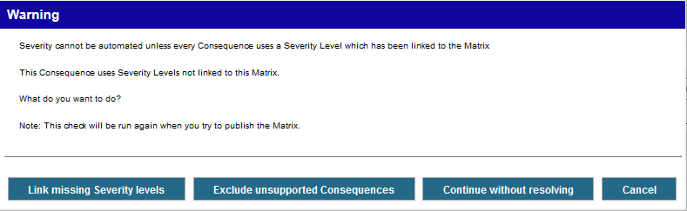
Link Qualitative Consequence Types to the Matrix
Link the Qualitative Consequence Types that apply to the Matrix.
If the Matrix is set to automatically set the Severity, but the Consequence Type uses a Severity Value which has not been linked to the Matrix, the system offers to add that Severity Value at the same time.

Slide 28
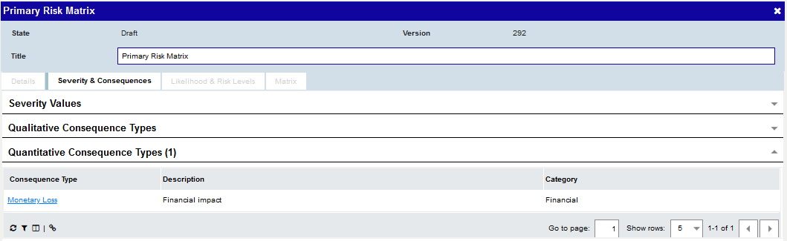
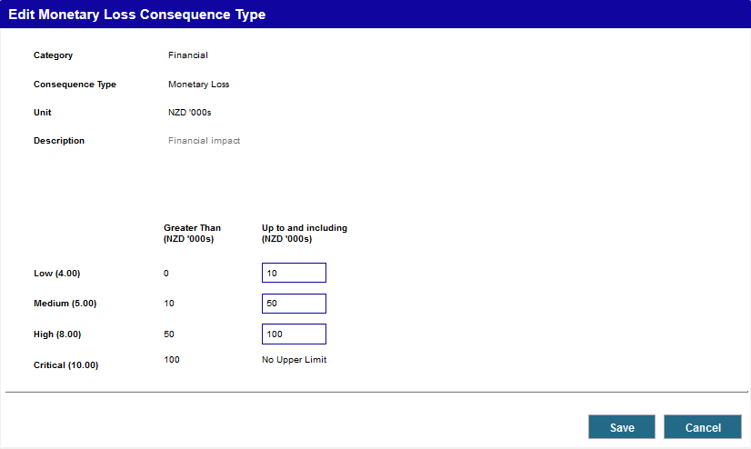
Link Quantitative Consequence Types to the Matrix
Link the Quantitative Consequence Types that apply to the Matrix.
Once linked, you can edit the value ranges for each Severity. This will enable the Severity to be automatically selected when the end user enters the value of the Consequence.
Quantitative Consequences are a Premium feature.

Slide 29
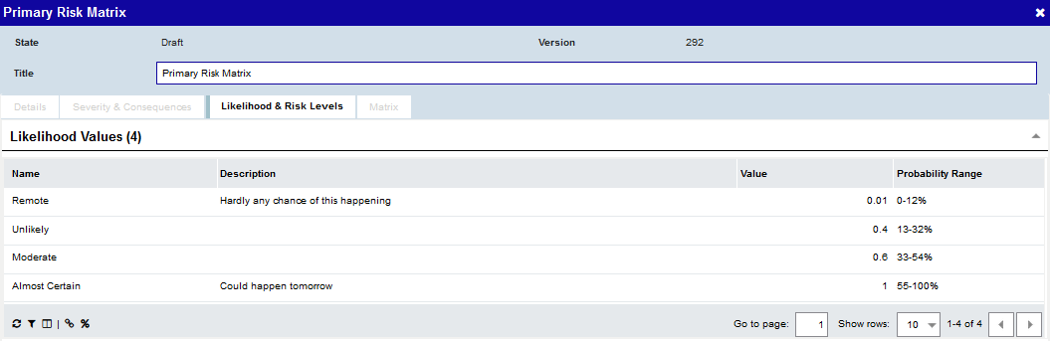
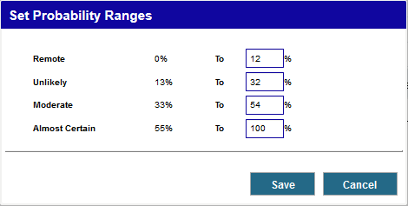
Link Likelihood Values to the Matrix
Link the Likelihood Values you want to use on the Matrix.
Once linked, you can set the probability range for each Likelihood Value on the Matrix. This will enable the Likelihood to be automatically selected based on the Probability the user enters.

Slide 30
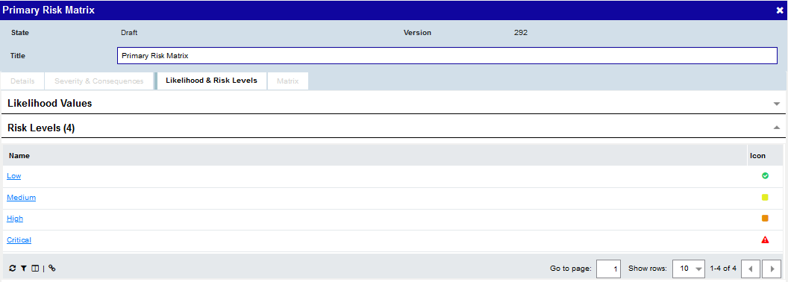
Link Risk Levels to the Matrix
Link the Risk Levels you want to use on the Matrix.
These will become available to choose on each Risk Matrix cell.

Slide 31
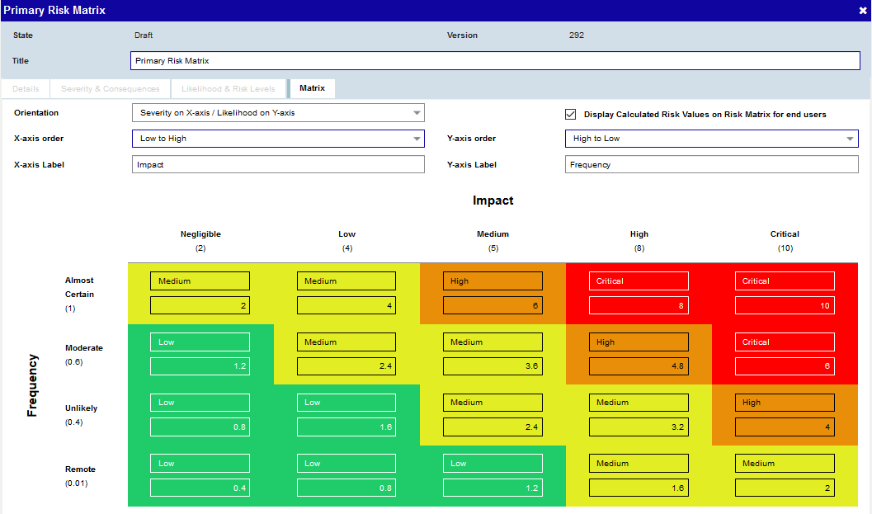
Easier Matrix Set Up
The number of columns and rows on the Matrix is automatically determined by how many Severity and Likelihood values are linked.
You can choose whether these values should be displayed on the X-axis or Y-axis, and if they should be ordered from lowest to highest or vice versa.
Select a Risk Level for each cell.
The value for each cell defaults to the x-axis value multiplied by the y-axis value, but can be manually changed.

Slide 32

Validate your Matrix Design
At any time you can validate the Matrix design from the Risk Matrix workflow to ensure there are no missing or incomplete values.
Validation is also performed when publishing the Matrix.
Any errors are clearly described.

Slide 33
Improved Risk Assessments
It is now possible to save the Risk Assessment, even when it is only partially completed.
You can now enter the probability of the Risk occurring as a percentage.
If automation is turned on, the appropriate Likelihood is automatically selected from the Probability.

Slide 34
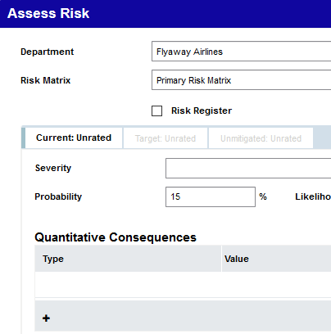
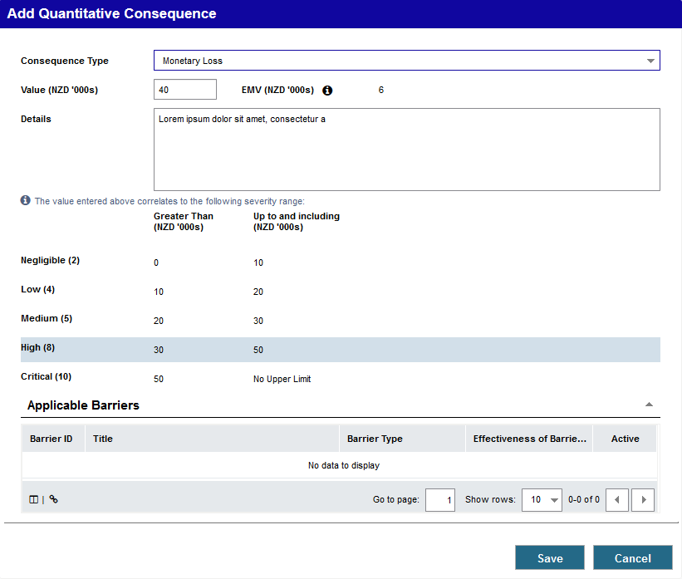
The Expected Monetary Value (EMV) is the Value multiplied by the Probability
Add Quantitative Consequences
If Quantitative Consequence Types are associated with the Matrix, you can select which ones apply and specify the impact value of each.
This value combines with the Probability to calculate the Expected Monetary Value (EMV) the organisation should allow for annually.
Further details can be added if necessary.
The range which the value falls into determines the Severity of the Consequence.
Quantitative Consequences are a Premium feature.

Slide 35
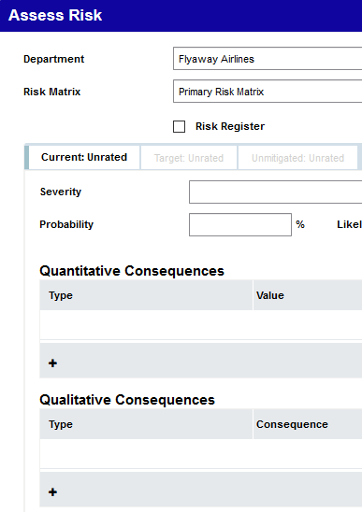
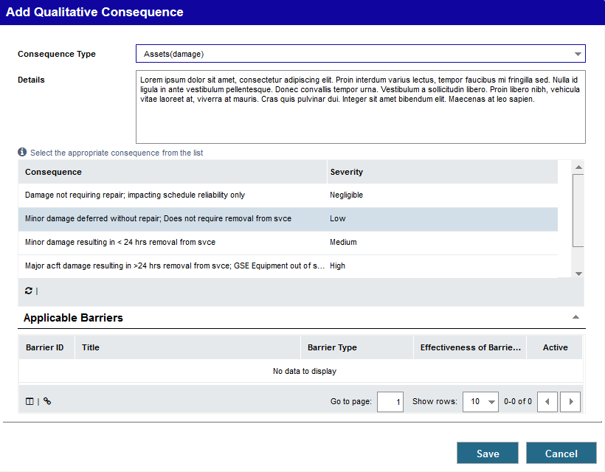
Add Qualitative Consequences
If Qualitative Consequence Types are associated with the Matrix, you can select which ones apply.
Further details can be added if necessary.

Slide 36
05
Link Risk module records to each other and to Occurrences

Slide 37
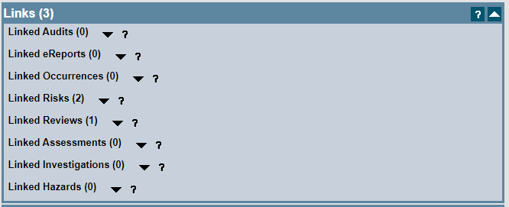
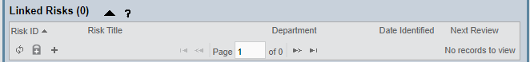
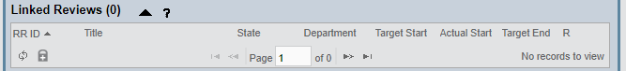

Additional linking on Occurrences
From an Occurrence you can now:
Create Risks
Link Reviews
Link Hazards
Once linked, the Reviews, Risks and Hazards can be opened from the Occurrence.

Slide 38
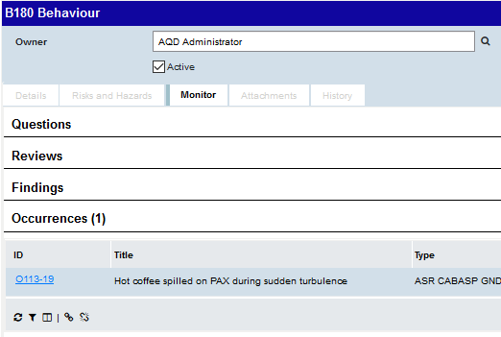
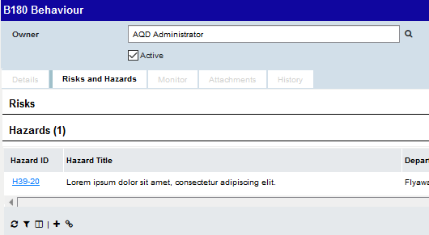
Additional linking on Barriers
You can now unlink Occurrences from a Barrier.
You can now create, link or unlink Hazards from a Barrier.
Once linked, the Hazards can be opened from the Barrier in the primary or secondary panel.

Slide 39
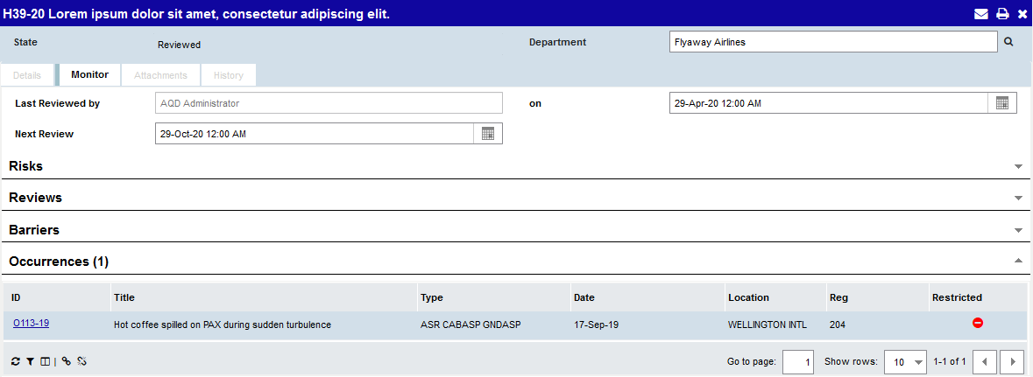
Link or Unlink Occurrences from a Hazard
You can link or unlink an Occurrence from a Hazard.
Once linked, the Occurrence can be opened from the Hazard.

Slide 40
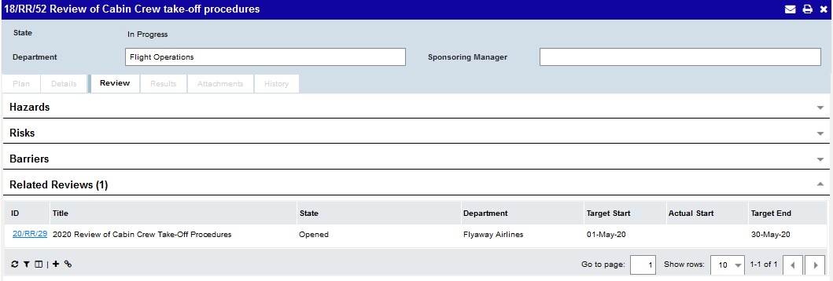
Link a Review to Related Reviews
You can add, open, link or unlink a Review from another Review.
Once linked, the Related Review can be opened from the Review in the primary or secondary panel.

Slide 41
Make Announcements to your Teams
(Available from Service Release 1)

Slide 42
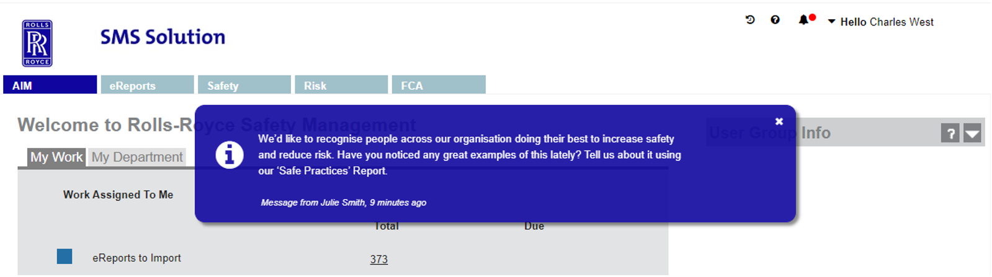
Announcements
The ability to create Announcements is now provided as a way for you to increase communication with your teams.
Some examples of what you could use an Announcement for are:
Communicate changes in response to a major event (such as the Covid-19 pandemic)
Encourage reporting, responses or completion of actions
Share news, updates on safety notices and new advisories with your team
Raise awareness of any emerging trends
Communicate any configuration changes or adoption of new features
Provide additional guidance to increase accuracy of information or ensure procedures are being followed

Slide 43
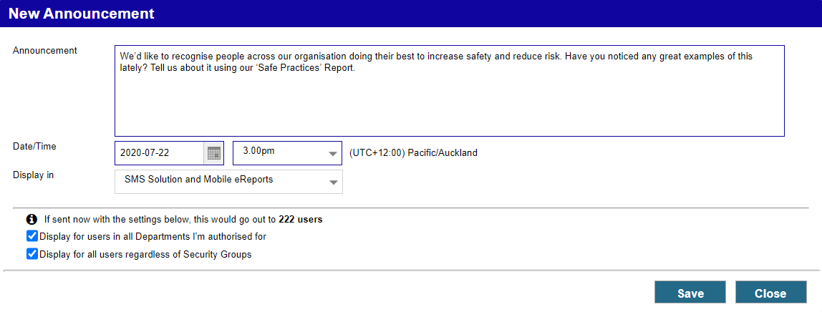
Create Announcements
Users with the ‘Announcer’ role can create Announcements.
Announcements can be set up to display in SMS Solution, Mobile eReports or both.
Send to all users or users in specific Departments and/or Security Groups.
The number of users it would be sent to if sent at the current time is displayed, however the actual list of recipients is calculated at the time the Announcement is sent.

Slide 44
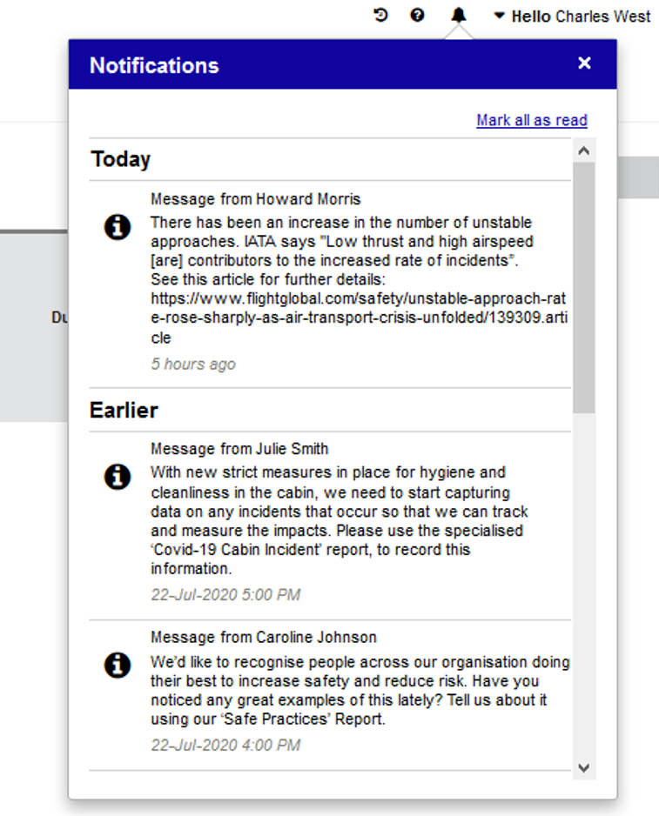
Notifications Menu
Notifications can be marked as read individually or you can click on this link to mark all as read.
A new ‘Notifications’ menu is available for all users.
A red badge is shown next to the bell icon if there is one or more unread Notifications.
The menu has two sections – one for Notifications received today and the other for earlier Notifications.
The menu displays the amount of time passed or the Date/Time of the Notification, based on the user’s Local Time.

Slide 45


Manage Announcements
A link to ‘Manage Announcements’ is available within the Notifications menu for users with the Announcer or Announcement Manager role. The link opens the ‘Manage Announcements’ dialog which displays all of the Announcements the user has access to.
The Announcement can be edited or deleted any time before it is sent.
The Date/Time of the Announcement is the Announcer’s Local Time.
The grid shows whether the Announcements have been sent and the number of users who have read it out of the total number of recipients.

Slide 46


New Security Roles
Two new Security Roles are available to support the Announcements feature:
The ‘Announcer’ Role grants users access to create and manage Announcements.
The ‘Announcement Manager’ Role grants users access to view and edit Announcements created by any other user. It gives someone overall control of Announcements in case an Announcer becomes absent (e.g. they take unexpected leave) and should only be given to a very limited number of users.
Departmental Authorisation is required to determine which departments an Announcer is allowed to send the Announcements to. Announcers can only edit and view their own Announcements.

Slide 47
Thank you

