Slide 1
RRSMS Analysis Module 2020.1
Analysis Module
Adam Rosner, Senior Consultant
October 2022
Statement

Slide 2
01
Analysis Module presentation
Discussion Topics
Welcome
Basics
Event descriptor searching + graphing
Excel outputs
Examples

Slide 3
Warning!
Analysis Module
This version does not introduce any new functionality
This presentation gets quite technical about constructing search expressions over the database and there’s a bit of math

Slide 4
Welcome and Introduction
Analysis Module
Who uses the Analysis Module?
Who finds it difficult to use, or didn’t get the expected results?
Who uses advanced features, like Query By Form, or Event Descriptor Expressions?
Fun Fact: The RRSMS analysis module was created for Version 3 in 2000 and will still work with queries saved from that version

Slide 5
The Basics
Analysis Module 101
Analysis page
To use the analysis module – ask yourself two questions:
What do I want to see? (Search criteria)
How do I want to see it? (output criteria)
Set up your query then when you’re ready, save it.

Slide 6
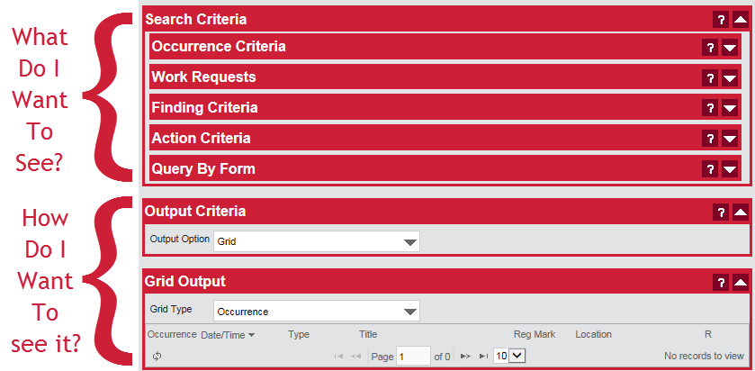
Basics, continued
Analysis Module 101

Slide 7
The Basics - Continued
Analysis Module 101
Occurrence Criteria: Same as Advanced Search in Safety Module
“Work Requests” – Assessments, Investigations, Audits
Findings, Actions search – same as advanced search in FCA module
Query By Form – Build your own queries (simple or complex) or fine-tune the criteria already entered

Slide 8
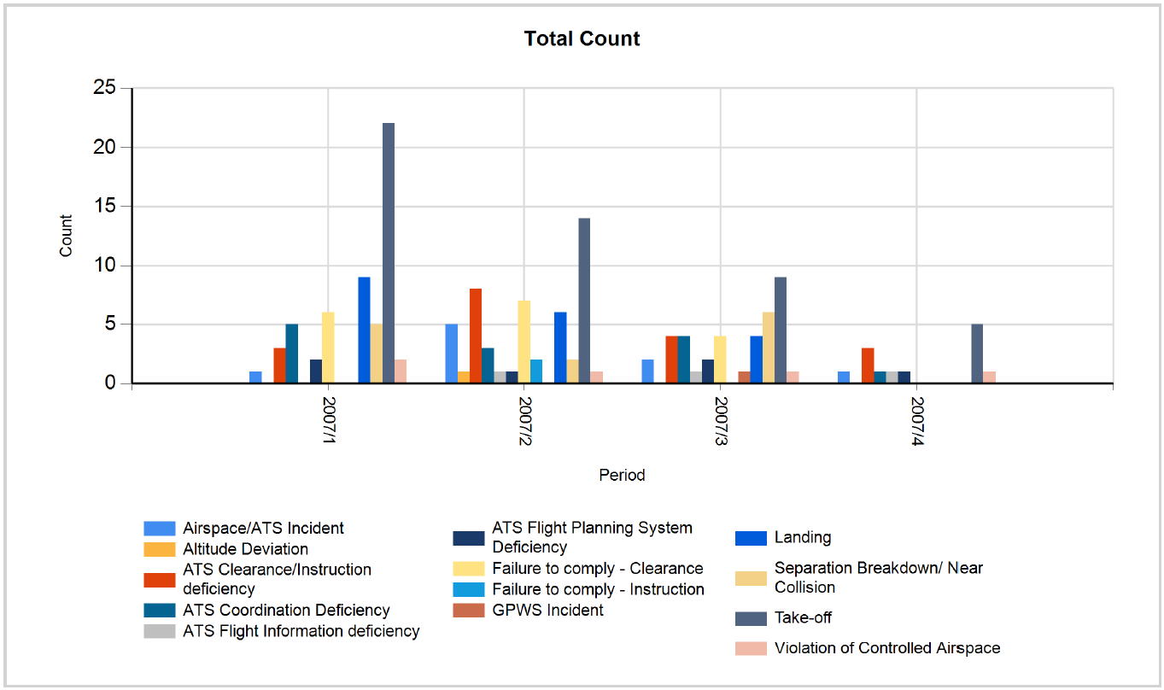
Example – ATS incidents
Analysis Module Examples

Slide 9
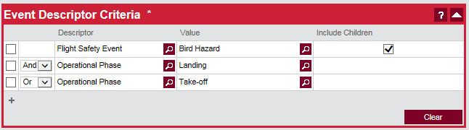
Example – Event Descriptor Expressions (1)
Analysis Module Examples
Looks OK?
But what have we really asked for?

Slide 10
Example – Event Descriptor Expressions (2)
Analysis Module Examples
Show all occurrences where:
Occurrence is recorded as a Bird Incident AND happened during Landing
— OR —
Occurrence happened during Take-off
Is this what we wanted?

Slide 11
Example – Event Descriptor Expressions (3)
Analysis Module Examples
What is the answer?
6 X 2 + 3 = ?
Seen questions like this on Facebook recently?
“Only a genius will get it right”…. “97% will fail”

Slide 12
Example – Event Descriptor Expressions (4)
Analysis Module Examples
Remember Order of operations
(6 X 2) + 3 = 15

Slide 13
Example – Event Descriptor Expressions (5)
Analysis Module Examples
Order of Expressions:
Multiplication First, then Addition
In Queries:
And First, then Or
How to remember? Alphabetical Order And (first) Or (second)

Slide 14
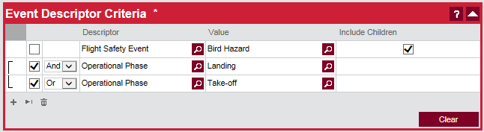
Example – Event Descriptor Expressions (6)
Analysis Module Examples
Let’s revise the query:
→ All Bird Hazard Occurrences at either Take-off or Landing

Slide 15
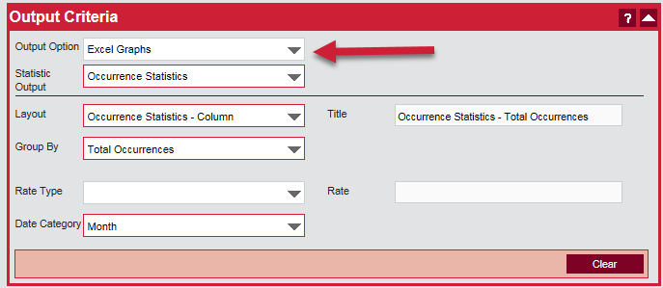
Excel Output
Analysis Module Examples
Excel Graph (editable)

Slide 16
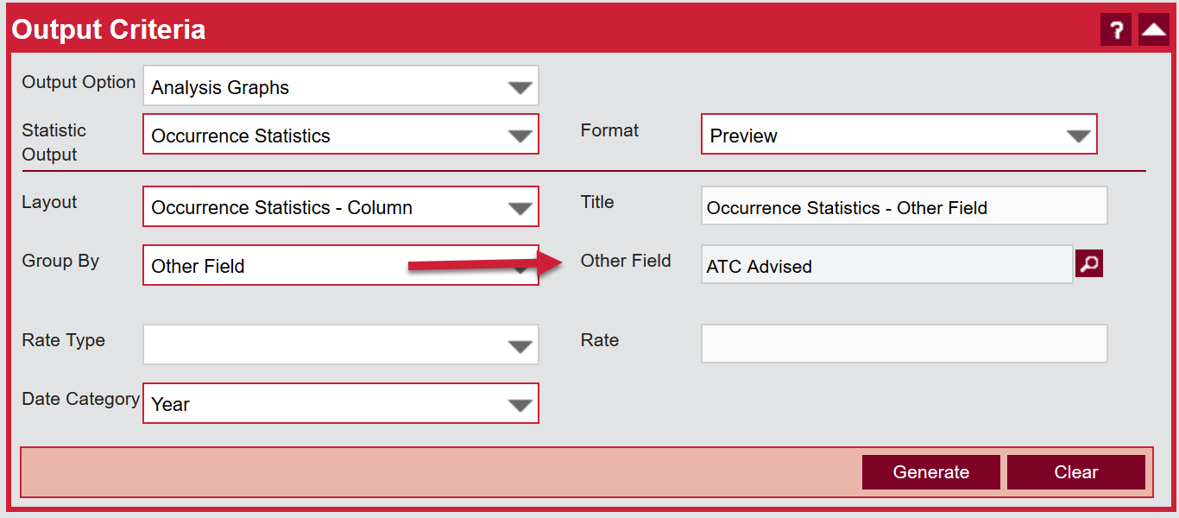
Sort By Other Field
Analysis Module Examples
Sort By ATC Advised

Slide 17
Thank you

