Slide 1
Rolls-Royce SMS
Risk Module intro
July 2022
Statement

Slide 2
01
Risk Module Introduction
Risk Module Definitions
Putting it together

Slide 3
02
Risk Module Definitions
Risks
Risk Response
Risk Assessment
Hazards
Barriers
Consequences (Qualitative and Quantitative)
Threats and Errors
Actions

Slide 4
Risk
Risk Module Definitions
Description of a potential undesired event that has loss-causing potential, which the organisation seeks to:
Understand the circumstances that may lead to occurrence
Reduce the probability of occurrence
Reduce the severity of the potential consequences.

Slide 5
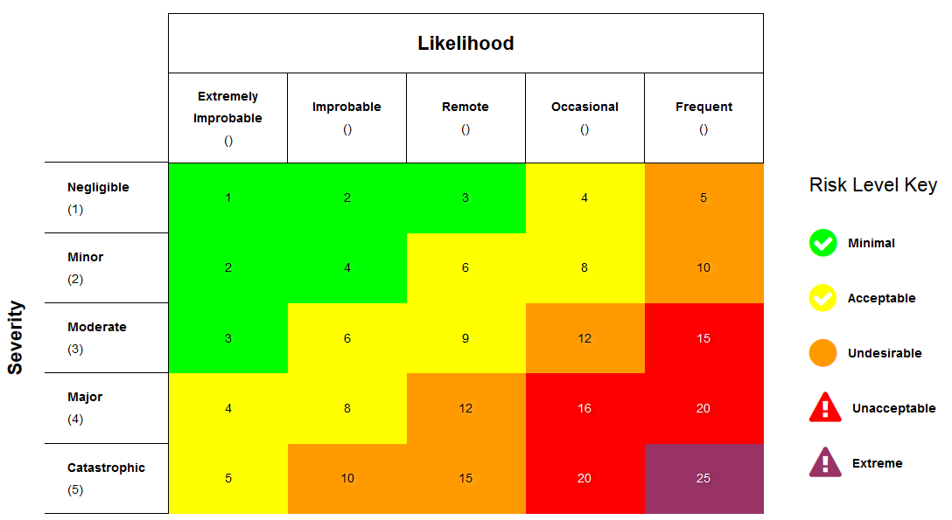
Risk Assessment
Risk Module Definitions
Numerical assessment of a Risk
Uses a matrix of probability of occurrence and severity of consequence
Identifies the Risk Level, according to pre-established rules specified in the Matrix

Slide 6
Hazard
Risk Module Definitions
Any object, situation, operation, or activity, that presents risk to the organisation.
A Hazard is not a loss-causing event in itself, but something that could lead to one.
Hazards can be Situational (eg. Terrain surrounding airport) or Episodic (eg. a typhoon) or both (eg. FOD)

Slide 7
Barrier
Risk Module Definitions
Any measure taken to mitigate a Risk.
Barriers may be
Proactive
in which they seek to prevent the risk occurring (targeting the Probability)
Reactive
in which they seek to reduce the severity of the consequences when the Risk occurs
Barriers can be arranged into a hierarchy (or “Barrier Family”)

Slide 8
Consequences
Risk Module Definitions
Results or outcomes of a Risk occurring.
Based on defined descriptions of losses, and divided into categories, they define the level of severity of the Risk.
Divided into two types
Qualitative
Based on descriptions of losses (eg environmental damage)
Quantitative
Based on measurable, quantified losses (eg. Financial loss)

Slide 9
Threats and Errors
Risk Module Definitions
Events, situations or anomalies/abnormalities that can trigger the occurrence of a Risk
Otherwise defined as situations which the defences are not effective at containing

Slide 10
Actions
Risk Module Definitions
Tracked and managed task assignments designed to improve existing barriers or create new ones

Slide 11
03
Putting it together
How the parts fit together
Risk Module Workflow

Slide 12
Putting it together
Threats/Errors
Barrier
(Proactive)
Barrier
(Reactive)
Hazard
Risk
Consequence
Assessment
Actions

Slide 13
Risk Module Workflow
Putting it together
Can be a Risks-first or Hazards-first workflow
Related items can be entered or linked in any order
Follow-up videos will be available to show how to use the system

Slide 14
Initial Risk Response Process
Putting it together
Periodic Review
Create Risk
Link Occurrences
Assess Initial Risk
Link existing Barriers
Create Actions
Assess Target Risk
RISK REGISTER
Hazard(s)
HAZARD REGISTER
Periodic Review

Slide 15
Periodic Review Process
Putting it together
Periodic Review
Open Risk
Link Occurrences
Assess Current Risk
Review Actions, Add new Barriers
Create Actions
Assess Target Risk
RISK REGISTER

Slide 16
Request
Overall Risk Process
Risk Review
Occurrence / Finding
Periodic Review
Occurrence / Finding
Risk(s)
Risk Response Process
RISK REGISTER
Hazard(s)
HAZARD REGISTER
Periodic Review

Slide 17
Thank you

