Slide 1
Mobile eReports v3.0.10
Settings Overview
© 2021 Rolls-Royce plc and/or its subsidiaries
The information in this document is the property of Rolls-Royce plc and/or its subsidiaries and may not be copied or communicated to a third party, or used for any purpose other than that for which it is supplied without the express written consent of Rolls-Royce plc and/or its subsidiaries.
This information is given in good faith based upon the latest information available to Rolls-Royce plc and/or its subsidiaries, no warranty or representation is given concerning such information, which must not be taken as establishing any contractual or other commitment binding upon Rolls-Royce plc and/or its subsidiaries.

Slide 2
Settings Overview
New Functionality
01

Slide 3
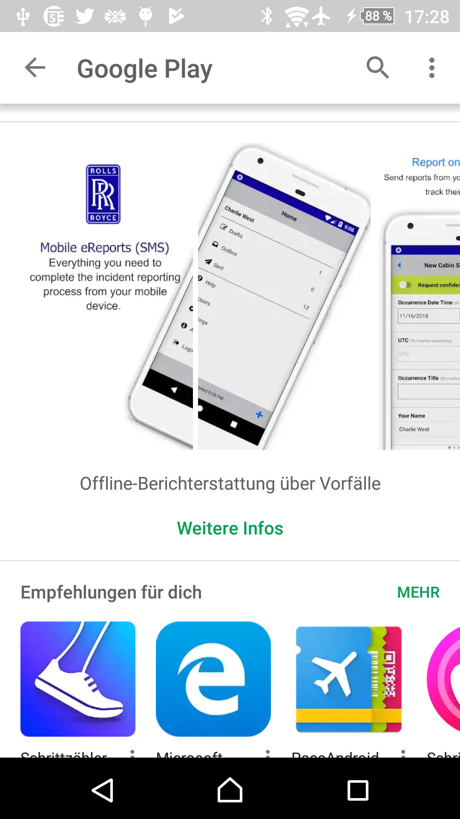
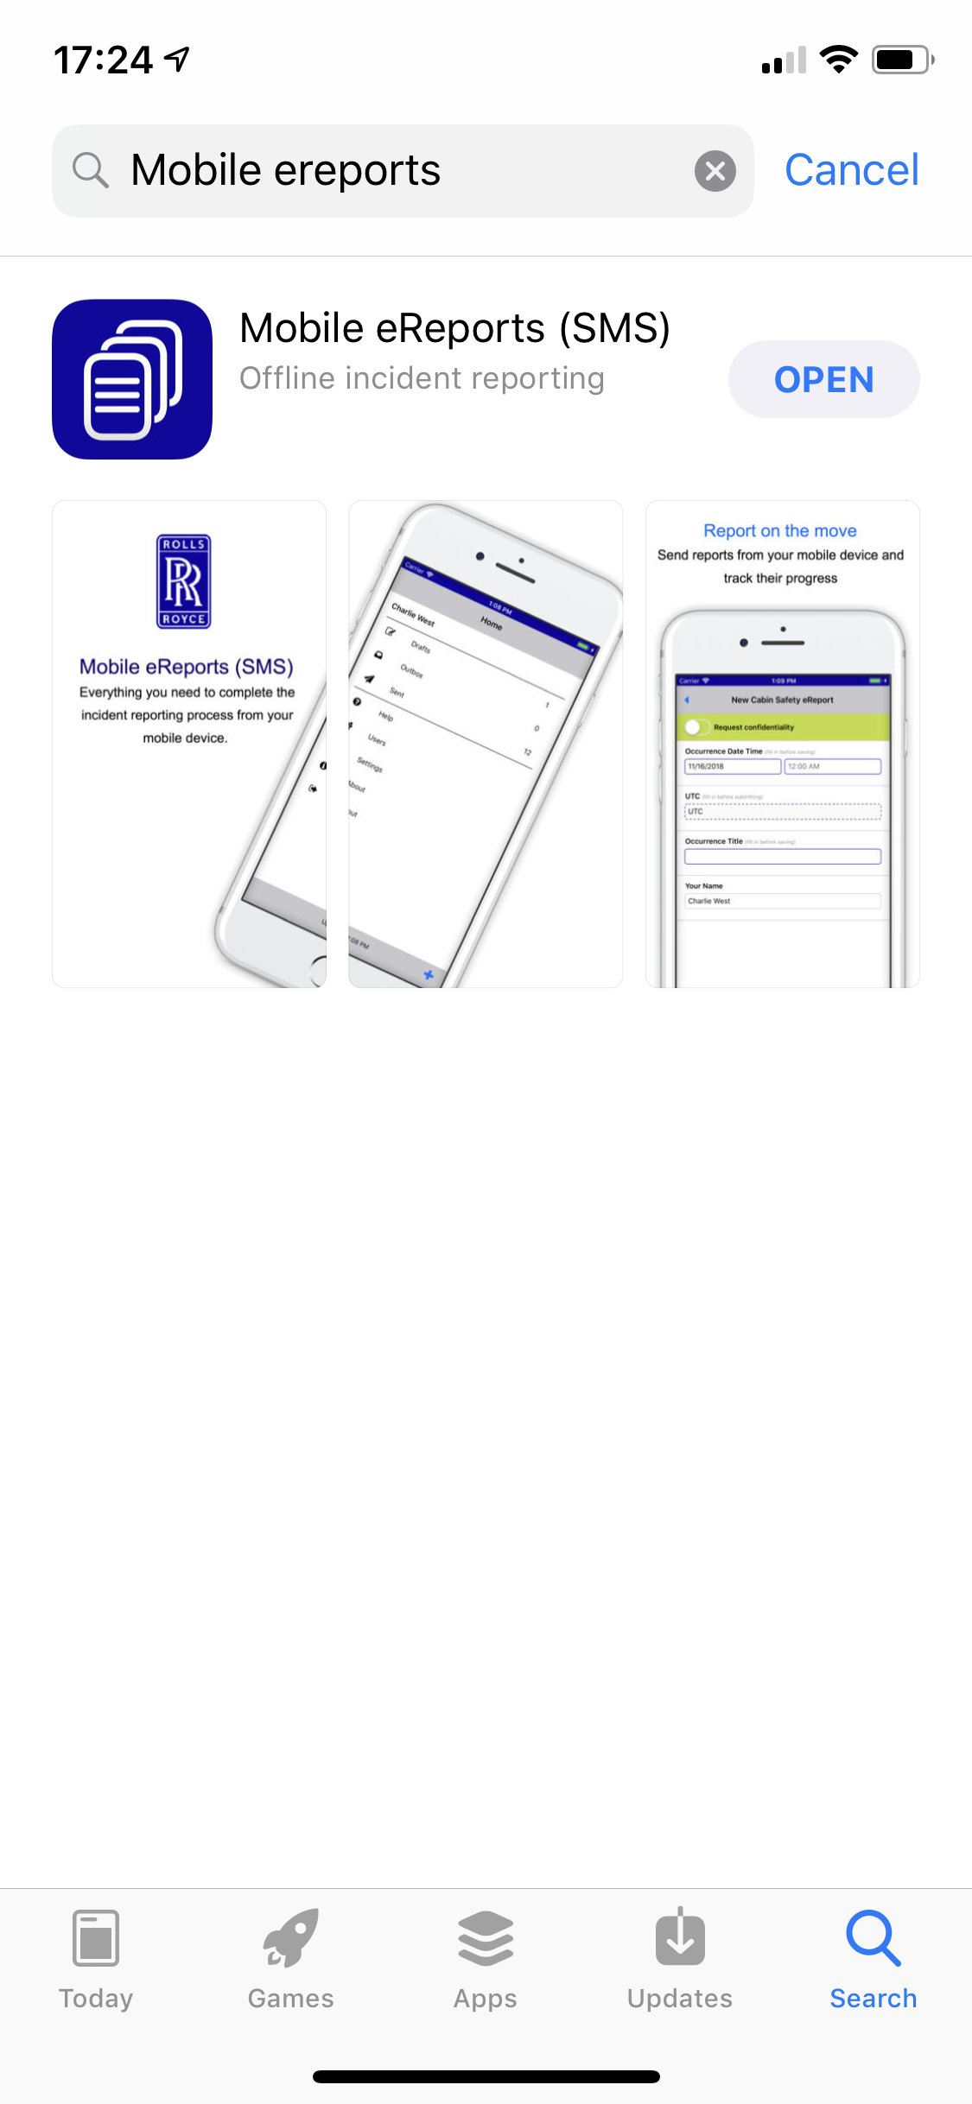
Mobile eReports v3.0.10
Mobile eReports v3.0.10.
The latest update to Mobile eReports is available from the Apple and Google Play stores from 19/01/2021
There is a new Home Page experience available
Unlock Mobile eReports with a PIN, or biometrics (Fingerprint or Face ID) if supported by the device
A full list of fixes can be viewed on the release notes for this version

Slide 4
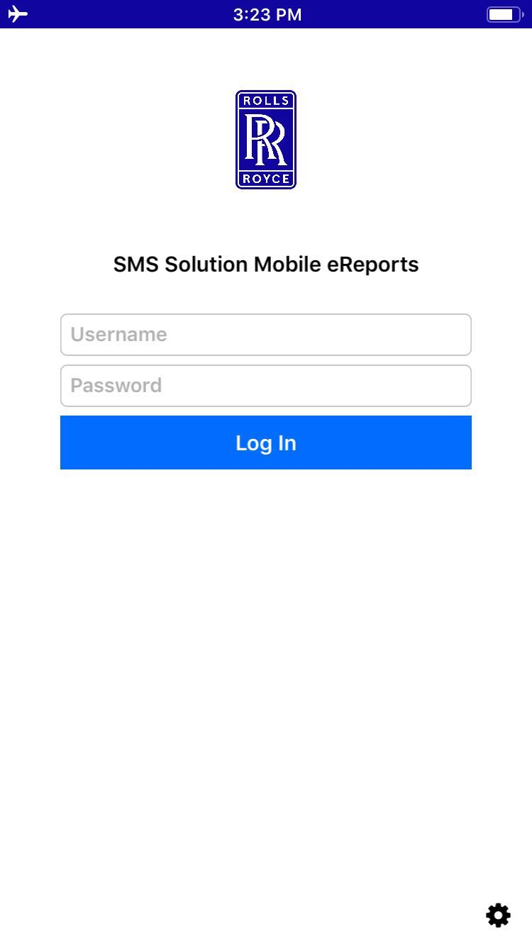
Log in
Settings Overview
Download Mobile eReports v3.0.10 from the relevant store
Log into the app using your SMS Solution Username and Password. You will be taken to the Home Page

Slide 5
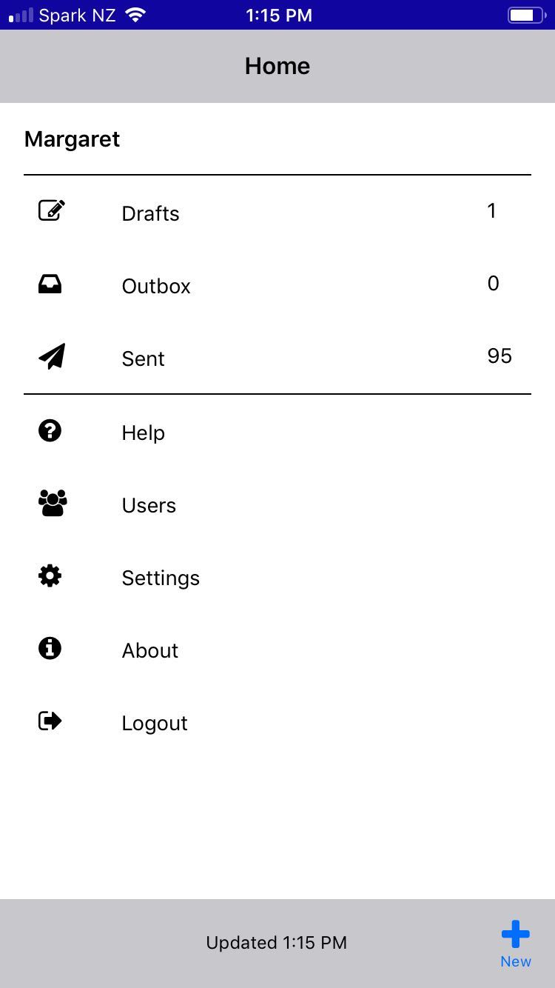
Log in – The Home Page
Settings Overview
The Home Page will initially look the same
Select Settings

Slide 6
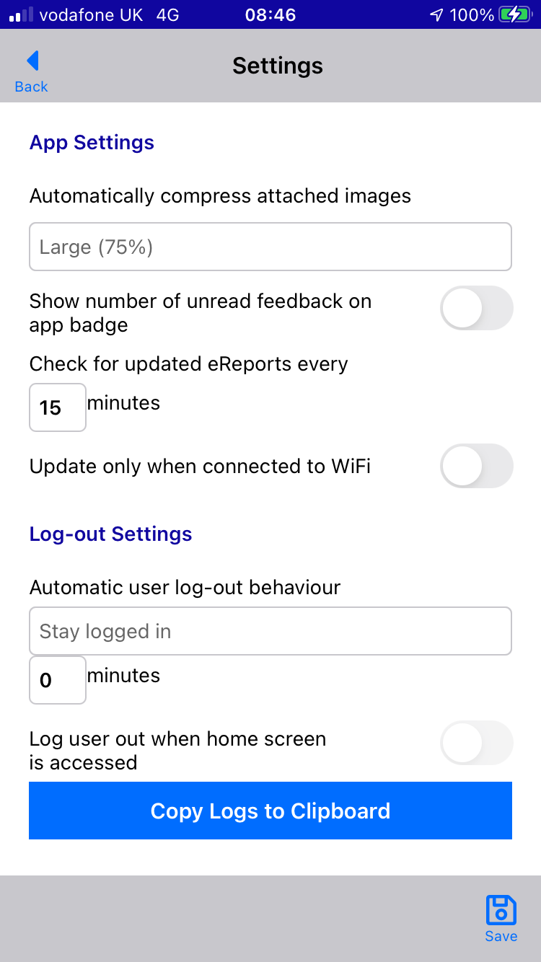
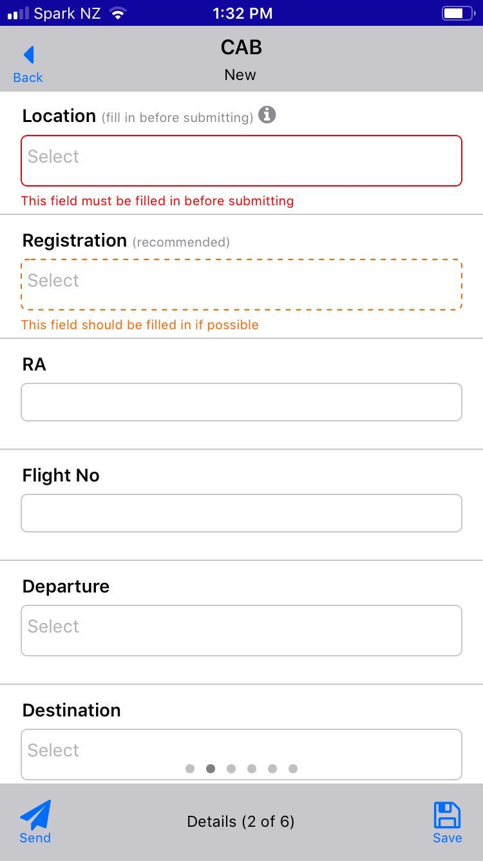
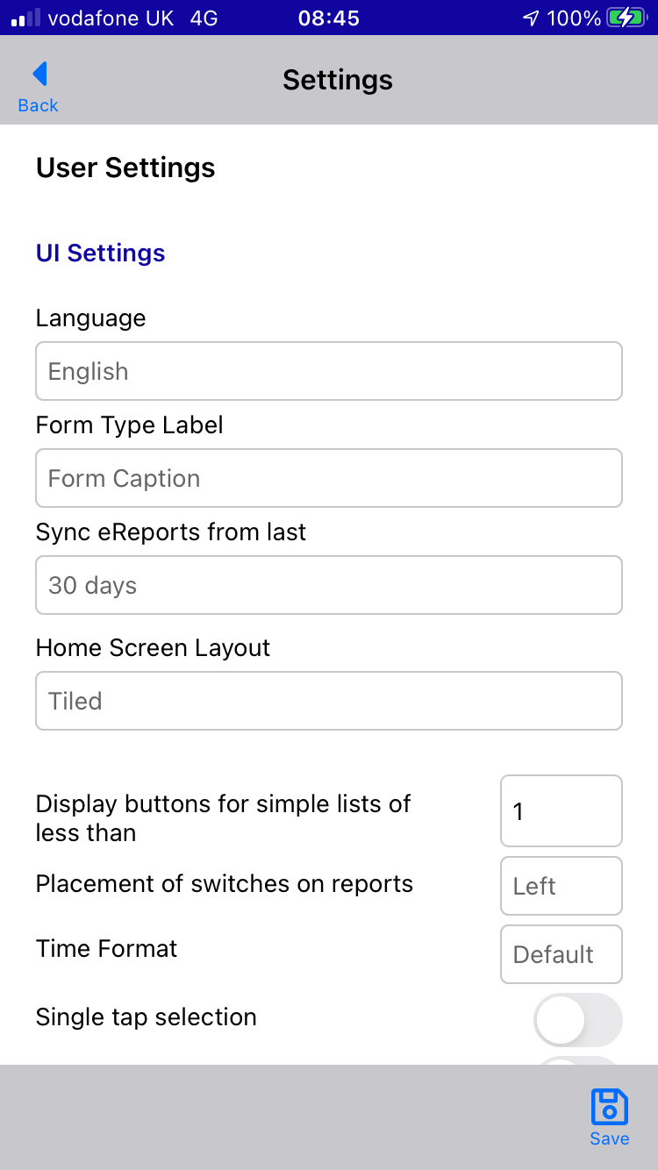
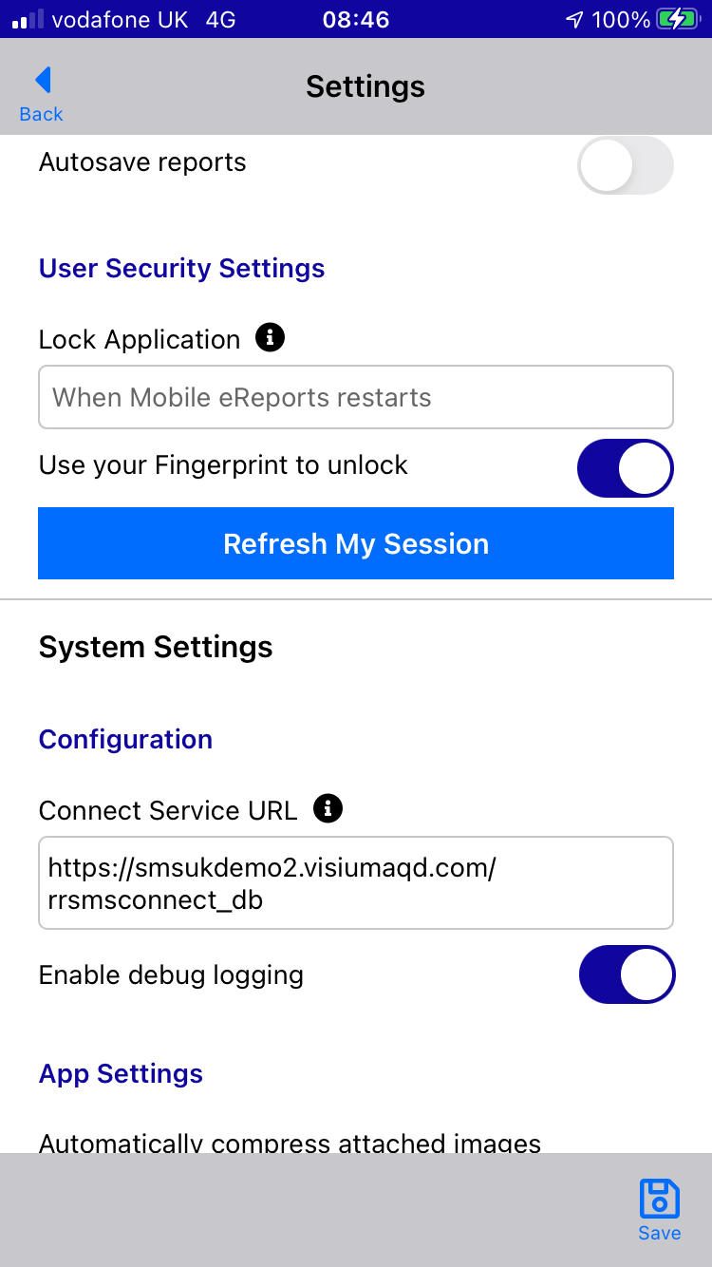
Updated Settings Pages
Settings Overview
The screenshots outline the settings available within Mobile eReport v3.0.10

Slide 7
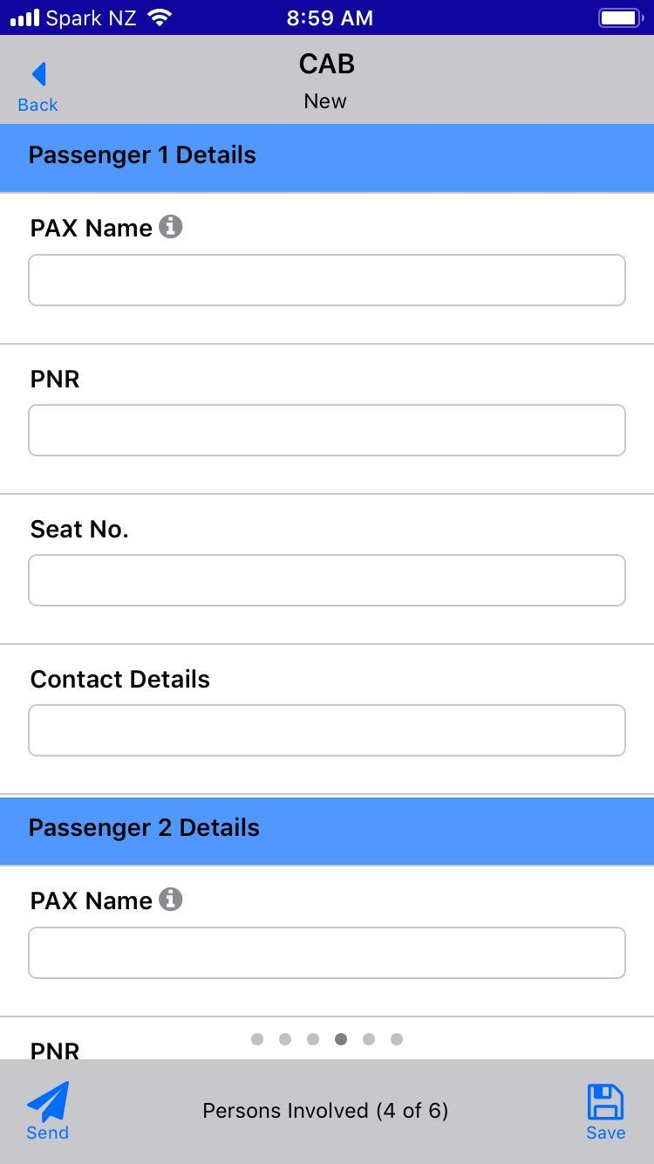
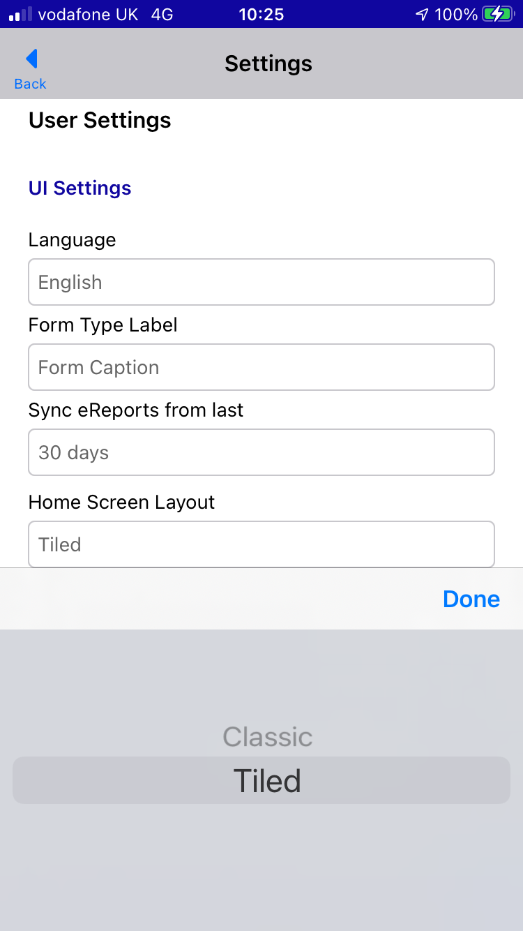
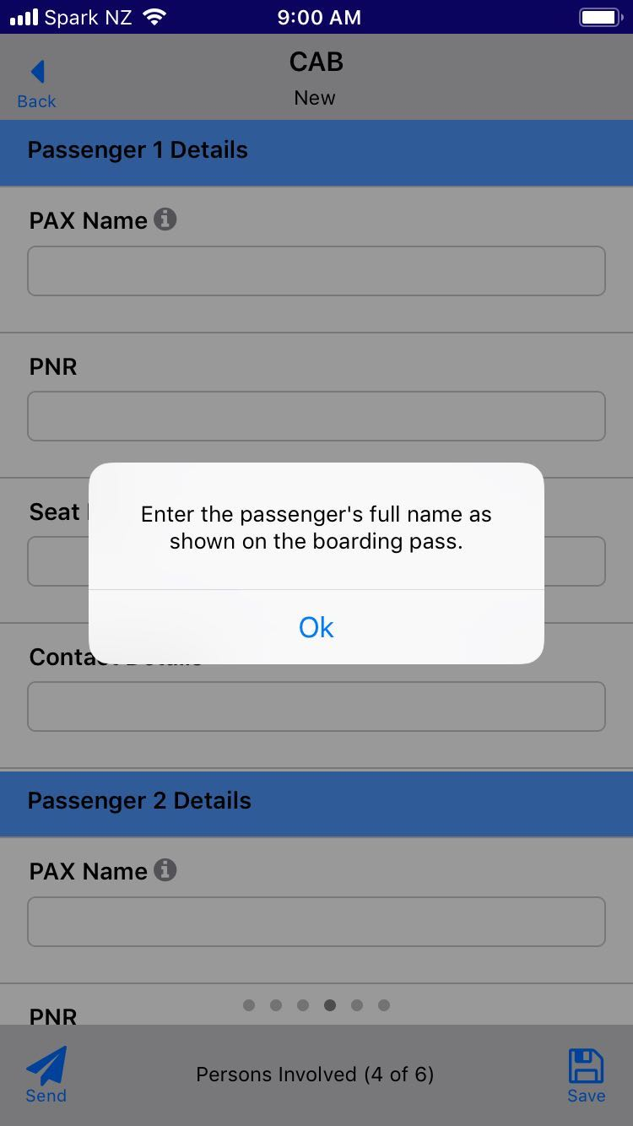
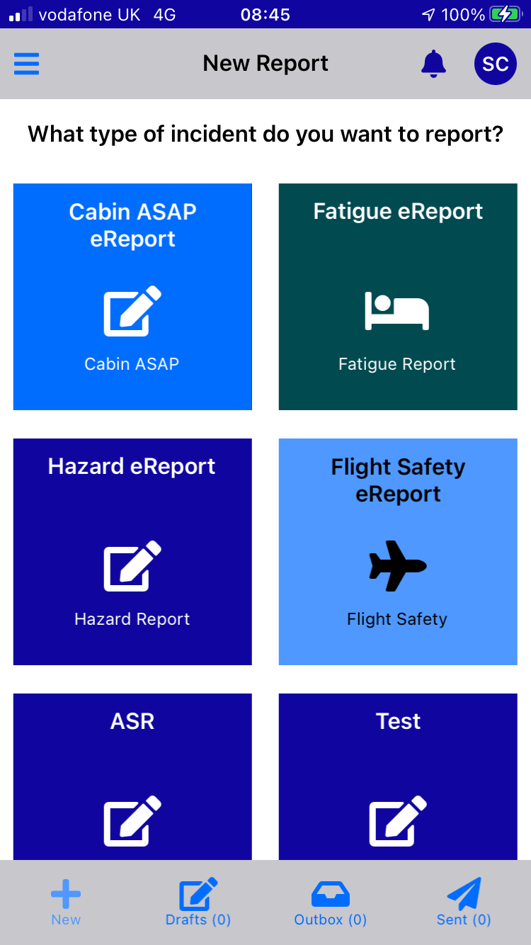
Setting a Tiled Home
Page
Settings Overview
Select Home Screen Layout
Select ‘Tiled’ and then Done, then Save
If you select Back the Home Page will set as the tiled option

Slide 8
Tiled Home Page
Settings Overview
Draft, Outbox and Sent icons are now at the bottom of the Home Page
The New+ option at the bottom of the page is disabled with the Tile option as reports are created from the tiles.
Tile colours and icons are not configurable at this point but that functionality will be included in the next major release of the RR SMS Solution

Slide 9
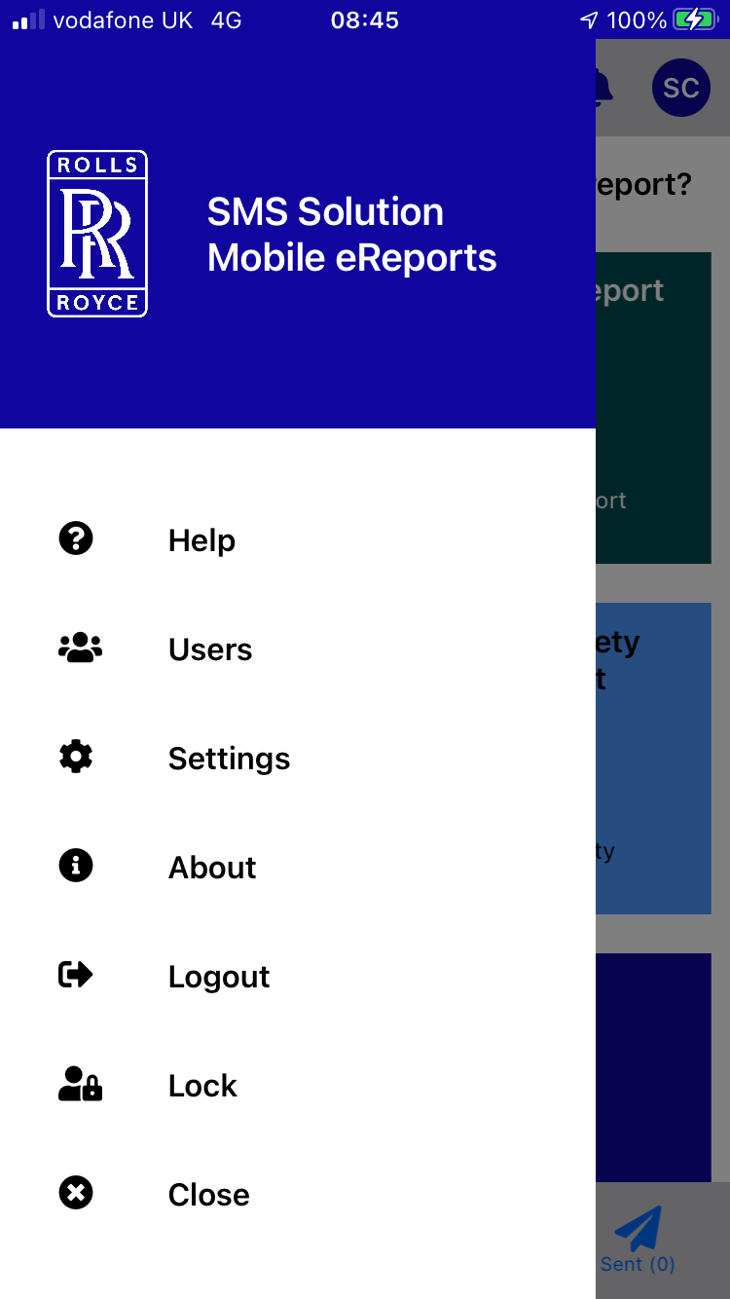
Tiled Home Page
Settings Overview
The Settings Menu has now been moved to the top left of the page and can be accessed by selecting

Slide 10
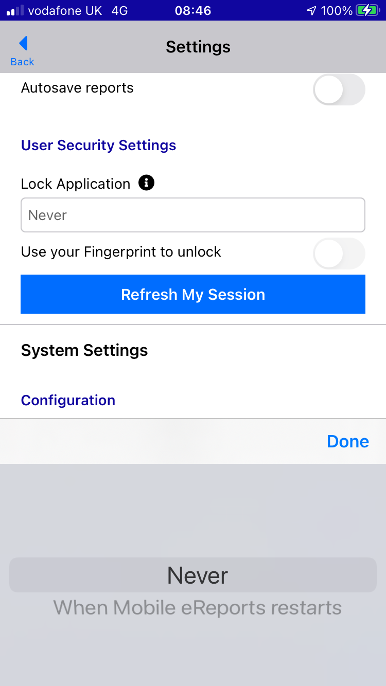
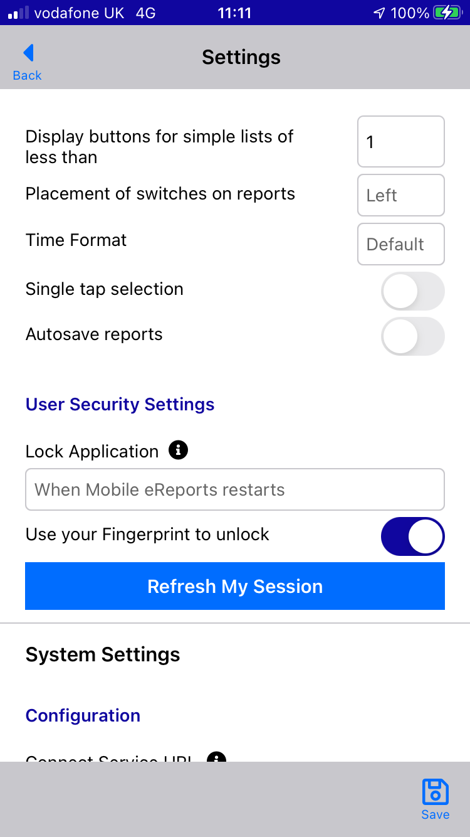
Setting PIN, Fingerprint or Face ID
Settings Overview
New user security options that can be set within User Security Settings
Change the Lock Application field from ‘Never’ to ‘When Mobile eReports restarts’
Enable the option for ‘Use your Fingerprint to unlock’ or ‘Use Face ID to unlock’
Select Save
Note: Face ID or Fingerprint capability will depend on the device.

Slide 11
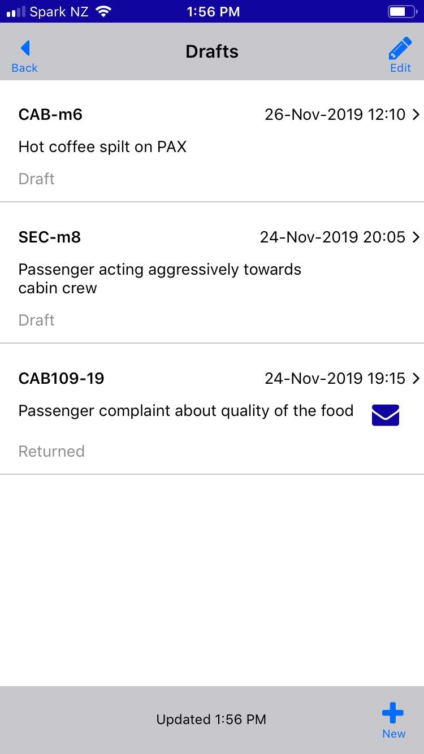
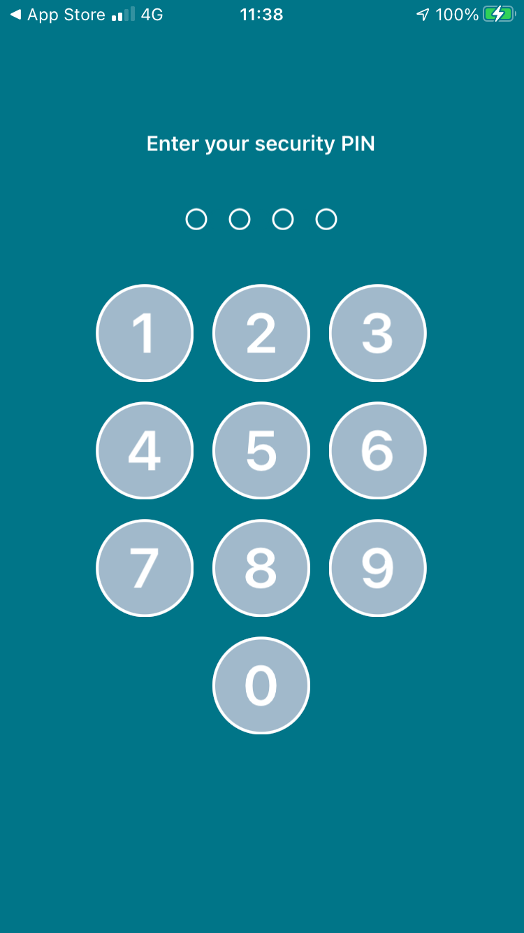
Setting PIN, Fingerprint or Face ID
Settings Overview
Once saved, the device will request a PIN and then confirmation of that PIN. This is personal to you and allows access should Face ID or Fingerprint recognition fail

Slide 12
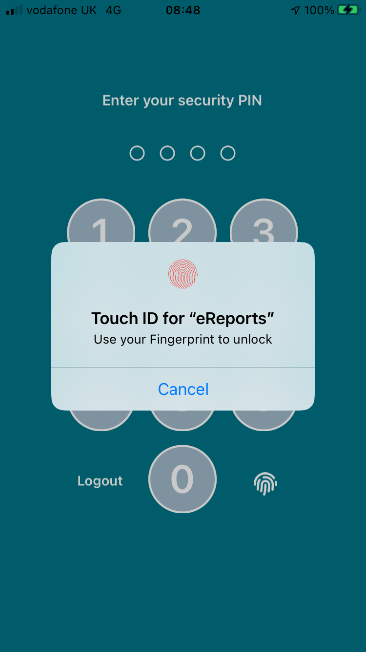
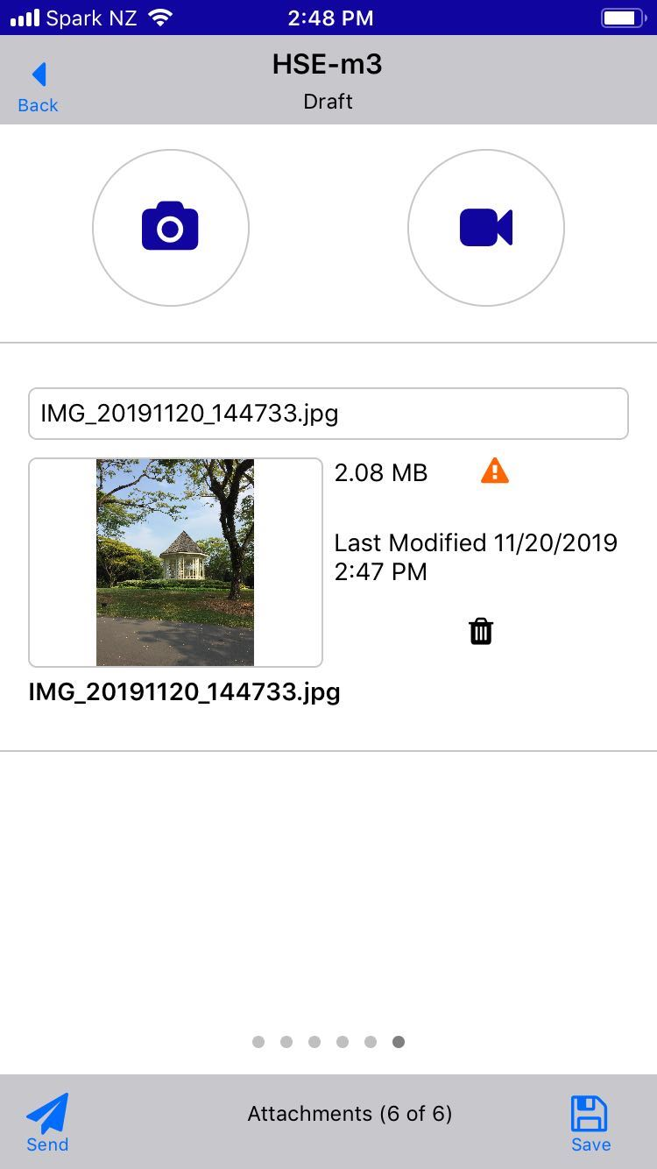
Setting Pin, Fingerprint or Face ID
Settings Overview
When Face ID or Fingerprint recognition has been set, Mobile eReports v3.0.10 can be accessed
Note - Example outlines the Fingerprint option.

Slide 13
Thank you

