Slide 1
Mobile eReports v3
Overview
Document ID: RRNZ-1395612623-442
Revision: 2
© 2019 Rolls-Royce plc and/or its subsidiaries
The information in this document is the property of Rolls-Royce plc and/or its subsidiaries and may not be copied or communicated to a third party, or used for any purpose other than that for which it is supplied without the express written consent of Rolls-Royce plc and/or its subsidiaries.
This information is given in good faith based upon the latest information available to Rolls-Royce plc and/or its subsidiaries, no warranty or representation is given concerning such information, which must not be taken as establishing any contractual or other commitment binding upon Rolls-Royce plc and/or its subsidiaries.

Slide 2
 | Name. | Date
Author | Margaret Gascoine | 27 Nov 2019
Reviewed by | Stuart Gould | 29 Nov 2019
Editorial check by | Ross Thomas | 10 Dec 2019
Approved by | Ross Thomas | 10 Dec 2019
Document Information
Revision History:
Date | Revision No. | Description of Revision
28 Feb 2019 | 1 | Approved for release
27 Nov 2019 | 1.1 | Updated for v3.0.5 by Margaret Gascoine
29 Nov 2019 | 1.2 | Reviewed by Stuart Gould
10 Dec 2019 | 2 | Approved for release
Liability Disclaimer
This information is given in good faith based upon the latest information available to Rolls-Royce Controls and Data Services (NZ) Limited, no warranty or representation is given concerning such information, which must not be taken as establishing any contractual or other commitment binding upon Rolls-Royce Controls and Data Services (NZ) Limited or any of its subsidiary or associated companies.
Confidentiality
The information in this document is the property of Rolls-Royce Controls and Data Services (NZ) Limited and may not be copied, or communicated to a third party, or used for any purpose other than that for which it is supplied, without the express written consent of Rolls-Royce Controls and Data Services (NZ) Limited.

Slide 3
01
Overview

Slide 4
Overview
Mobile eReports (MER) is an app which can be installed on an iPad or iPhone, or Android tablet or phone.
It allows you to create eReports even when not connected to the network (for example, during a flight).
When an eReport is submitted offline using the app, it will be held in an Outbox and sent when connectivity is restored.

Slide 5
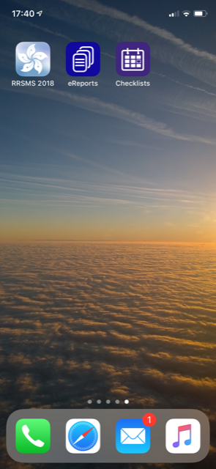
Multiple users
Overview
Multiple users can sign in at different times on a single device and create and send their own eReports.
Each user’s eReports will not be visible to other users.




Slide 6
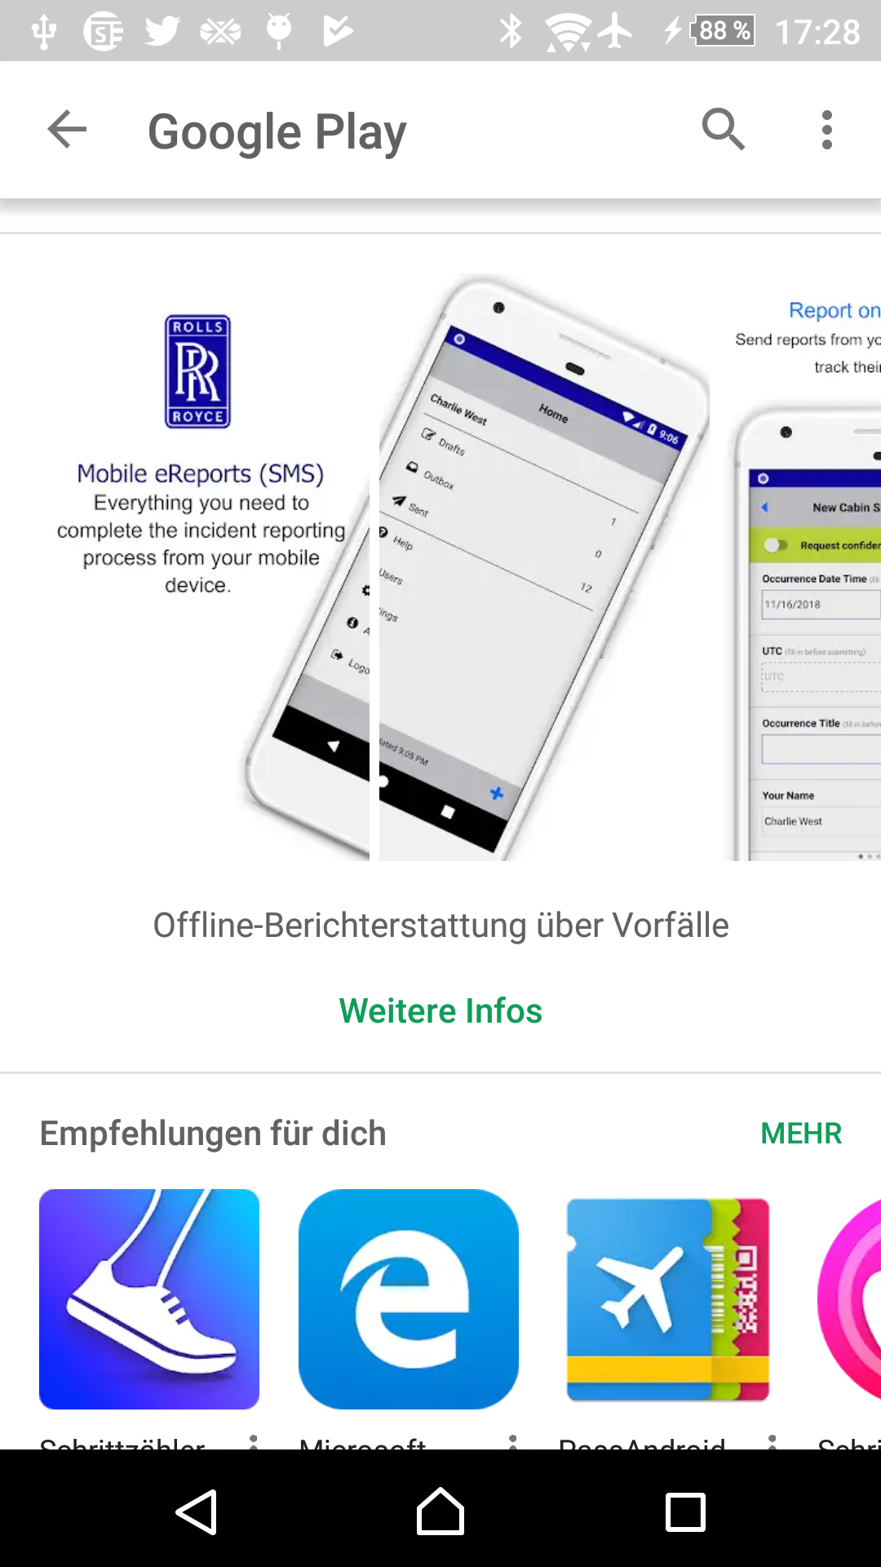
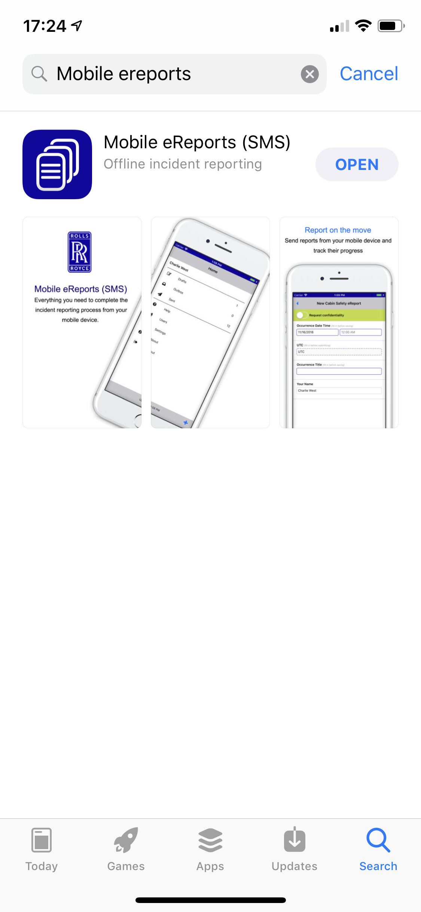
Mobile eReports v3
Overview
This app is a cross platform rewrite of Mobile eReports v2.4 that includes many improvements and changes which address a number of historical issues and enhancements from Mobile eReports v2.4.
This app is designed to be used on both smartphones and tablets
This app is available as a separate download from the App Stores (Google Play / Apple App Store).
The app supports Active Directory, OAuth2, and SMS Solution database accounts when configured via the Connect Service.

Slide 7
Prerequisites
Overview
MER3 will not function until SMS Solution (including the Connect Service) has been updated to either 2017.2 HF9 or 2018.2 HF1 or later.
Scripts to insert sample draft form definitions configured for MER3 based on standard Occurrence Types and field definitions are available on request.
To move to using MER3 the existing iPad forms/layouts will need to be copied and updated to comply with the new layout in MER3. This will not affect the operation of MER2.4.x.
MER2.4.x will no longer be supported from 1 Jan 2020

Slide 8
Changes in Mobile eReports v3
Overview
Standard lookups that were previously populated using queries will now use the built-in search functions in MERv3. These include any queries that selected data from the following tables:
  Staff Member
  Location
  Organisation Structure
  Aircraft
  Bird Species
Additional filtering options for these lookups will be available in the 2020 Safety Refresh for SMS.
MER2.4.x will no longer be supported from 1 Jan 2020

Slide 9
02
How it works

Slide 10
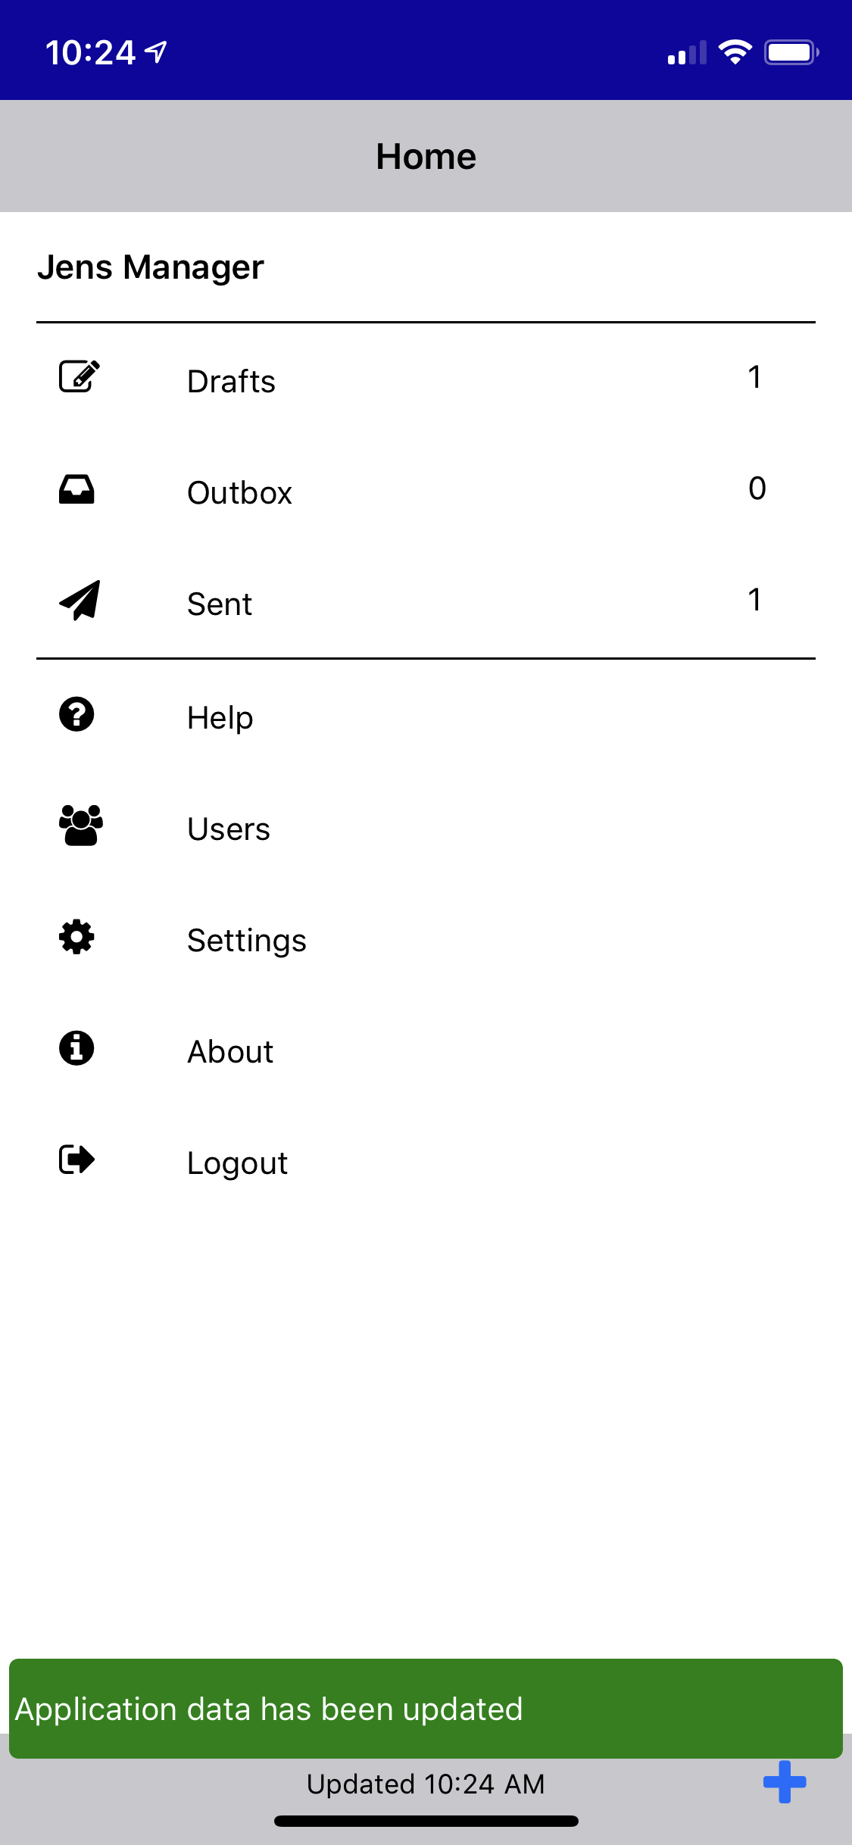

Reference data
How it works
When the application is running and the mobile device is connected to the network, it takes an up-to-date copy of reference data (look-up values, Event Descriptors, Location Codes etc.) using the Connect Service.
After the initial copy, only updates to the reference data are synchronised.
RR SMS Database
Connect Service

Slide 11
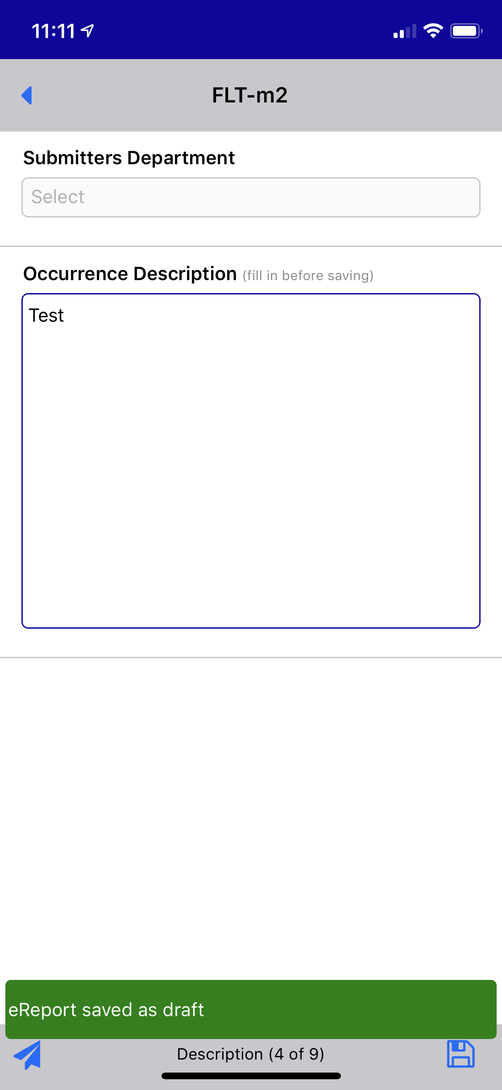
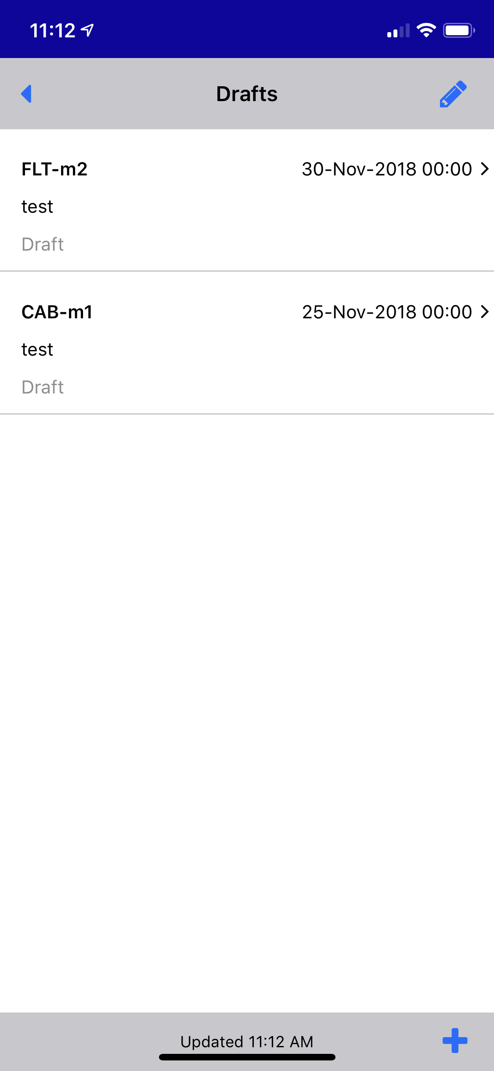
Local data
How it works
Even when the device is not connected to the network, you can create eReports by using this copy of the reference data. The eReports are stored in a local database on the device.
Local Data

Slide 12
Synchronise data
How it works
The next time the device is connected to the network and MER3 is running, any eReports on the device are automatically uploaded (“synchronised”) to the RR SMS database via the Connect Service.
Any updates to previously submitted eReports are downloaded so you can track their progress and respond to returned eReports if necessary.
RR SMS Database
Local Data
Connect Service

Slide 13
03
Mobile eReports
Step by Step
(all screenshots that follow are as the app would appear on an iPhone 6)

Slide 14
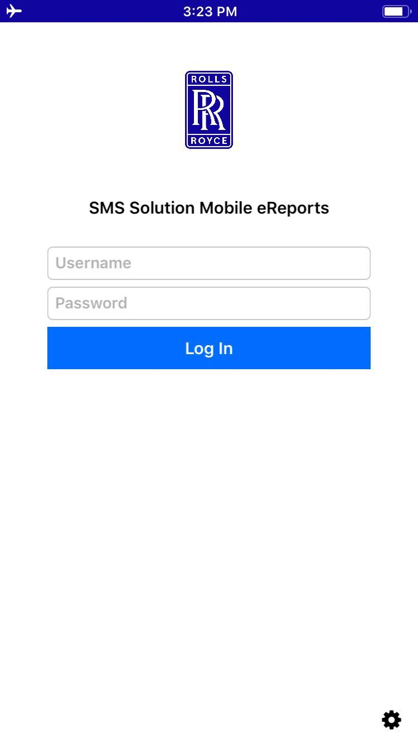
1. Log in
Mobile eReports – Step by Step
Log into the app using your SMS Solution username and password. You will be taken to the ‘Home’ screen.

Slide 15
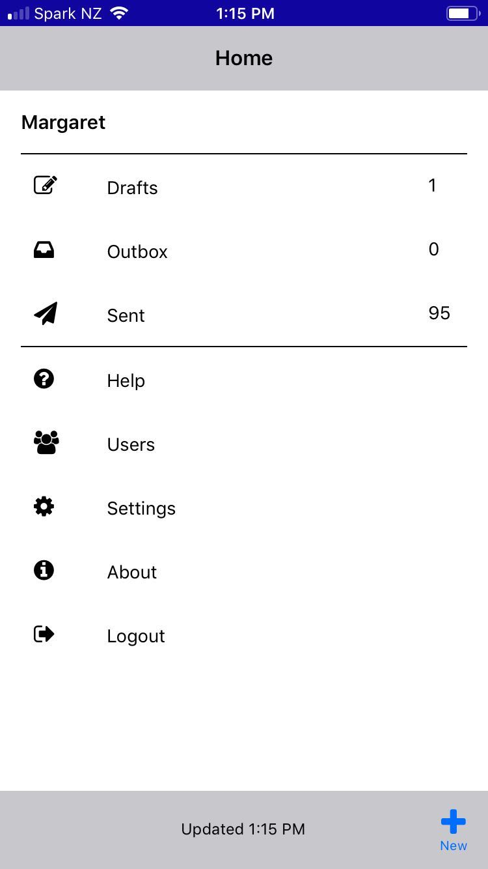
1. Log in – The Home screen
Mobile eReports – Step by Step
The Home screen provides access to ‘Drafts’, ‘Outbox’ and ‘Sent’ lists and ‘Settings’.
There is a ‘Help’ section which provides a list of instructions on how to perform basic activities in the app.
The ‘Users’ page lists the names of users who have drafts on the device, and the number of drafts they have.
The ‘About’ page displays the app version, the SMS Solution sync version and the time when reference data was last updated. You can also email support or force an update to the application data from this page.

Slide 16
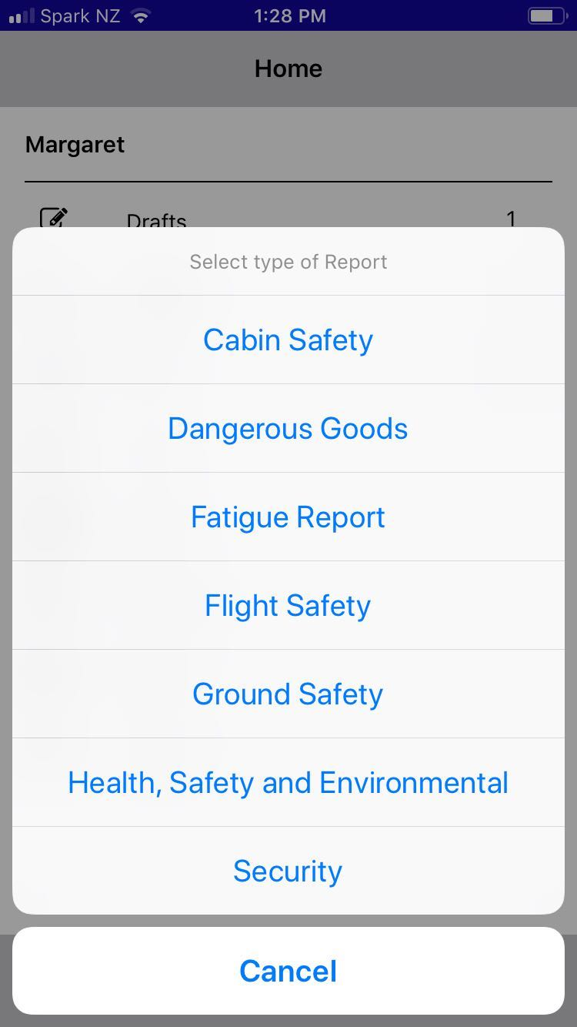
2. New eReport
Mobile eReports – Step by Step
From the Home Page, tap + in the bottom-right corner, and select the type of eReport you wish to submit.
This can also be done from the Drafts, Outbox or Sent screens.
Available types will be determined by your security access.

Slide 17
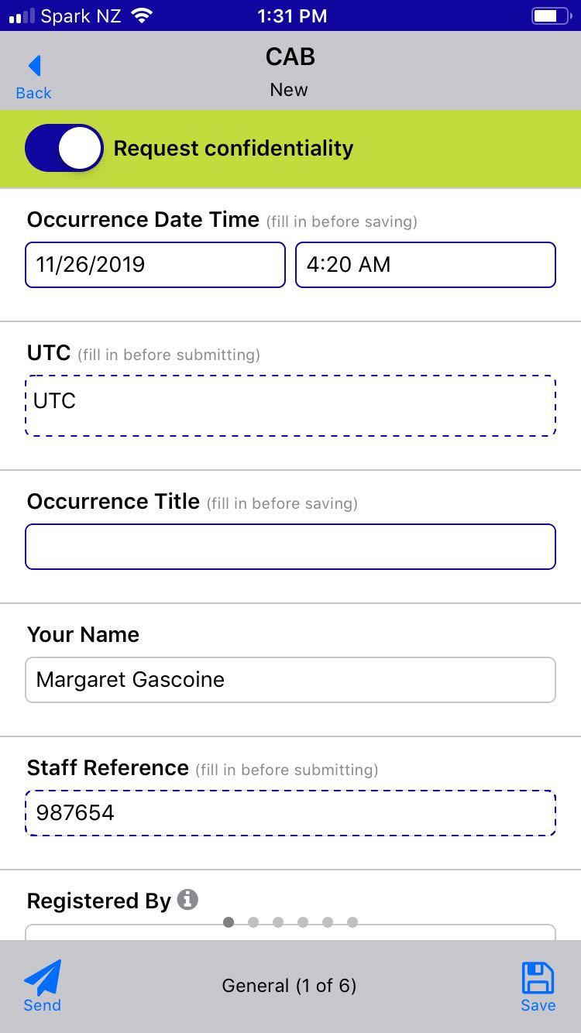
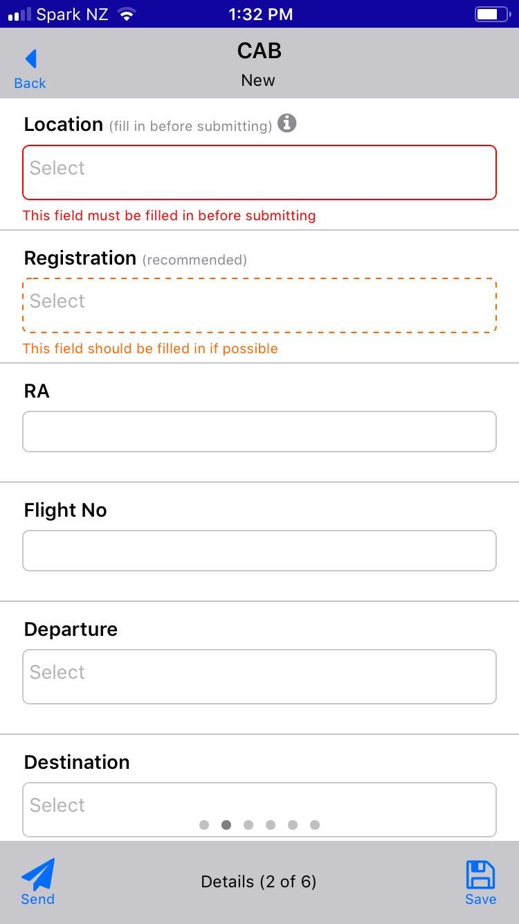
3. Filling in the eReport
- Fields
Mobile eReports – Step by Step
Use the form to enter data about the event.
Fields on the report form are displayed in a single column scrollable list for a consistent appearance across a range of devices. The height of each field is determined by the form design.
Required and mandatory fields are highlighted with a solid blue outline which turns red on save or submit if not completed.
Recommended fields are highlighted with a dashed blue line which turns orange on submitting the eReport if not completed. Confirmation is required to continue.

Slide 18
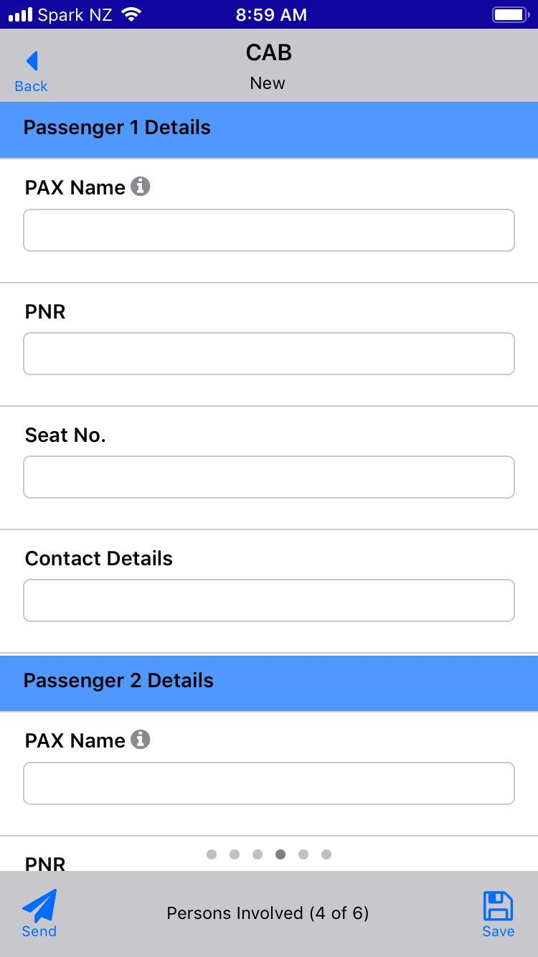
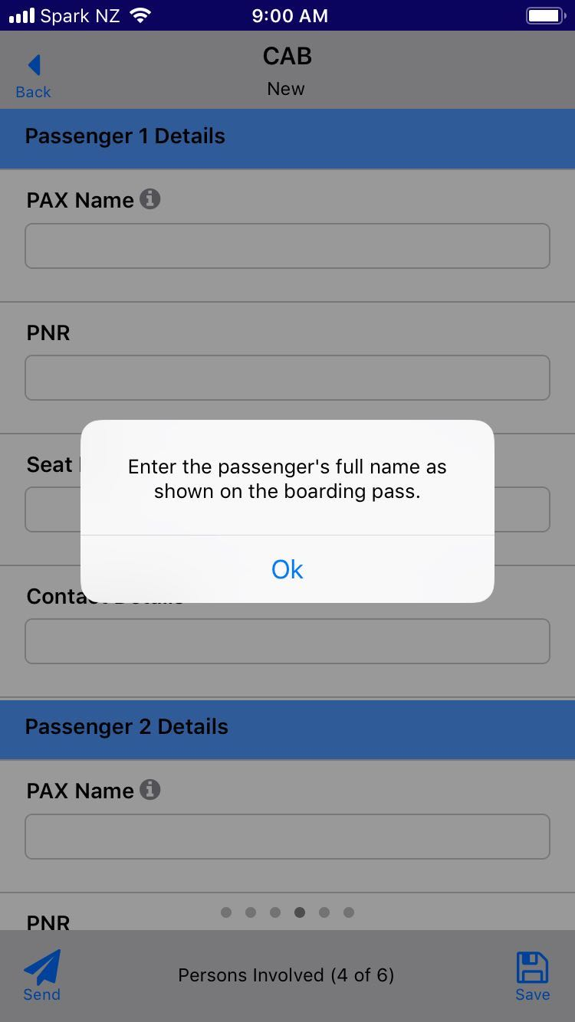
3. Filling in the eReport
– Labels and Tooltips
Mobile eReports – Step by Step
Labels are styled in bold with a blue background and help to divide fields on a tab into logical sections.
Tooltips are available to view for fields which have one specified in the form design.

Slide 19
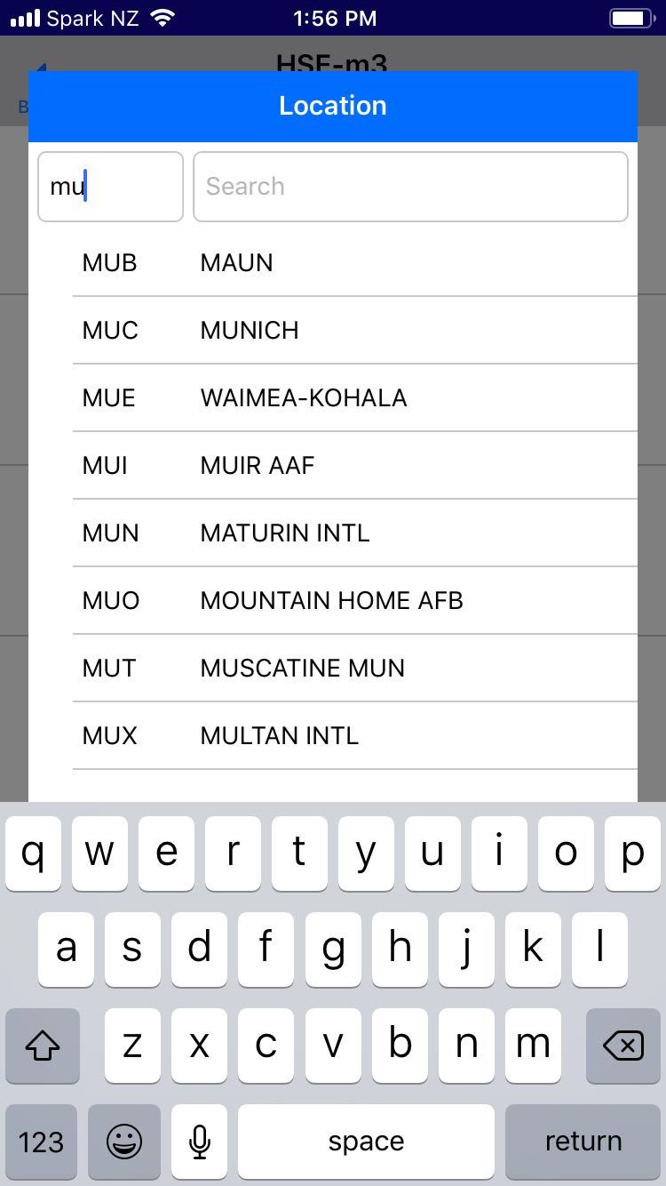
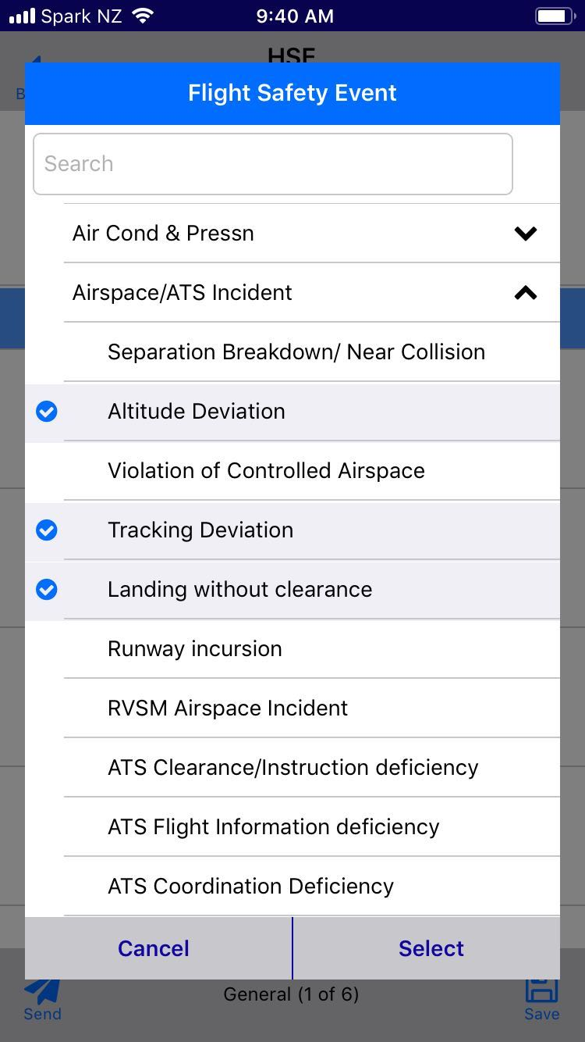
3. Filling in the eReport
- Selecting from a List
Mobile eReports – Step by Step
Search functionality is available for all fields with a list of items to select.
There are buttons to expand or collapse items which have items below them.
Multiple items can be selected if multi-select has been enabled on the field.

Slide 20
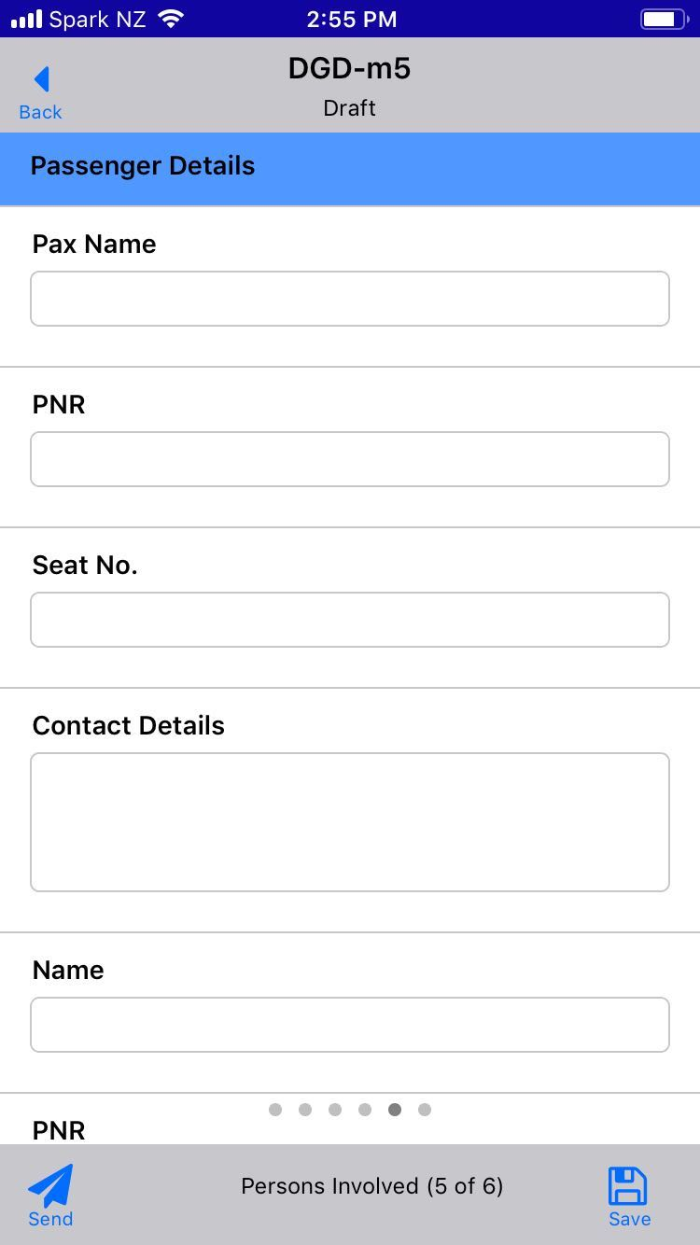

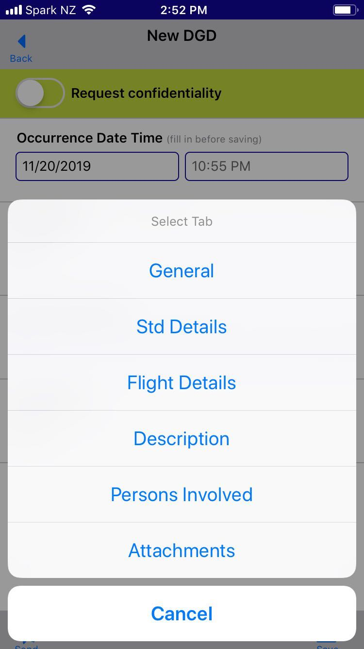

3. Filling in the eReport
- Move to the next tab
Mobile eReports – Step by Step
The name and number of the tab are displayed at the bottom of the screen to help when navigating between tabs.
Move between tabs on an eReport by swiping left or right or by tapping on the tab name and selecting a tab.

Slide 21
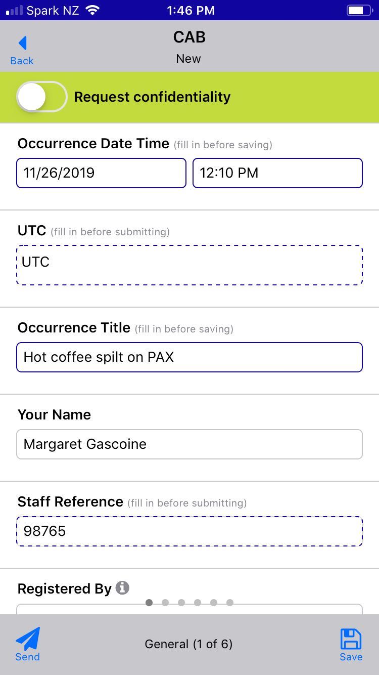
4. Save as Draft
Mobile eReports – Step by Step
To save the eReport, tap the Save icon in the lower right-hand corner.
Your draft eReports will appear on the Drafts page.

Slide 22
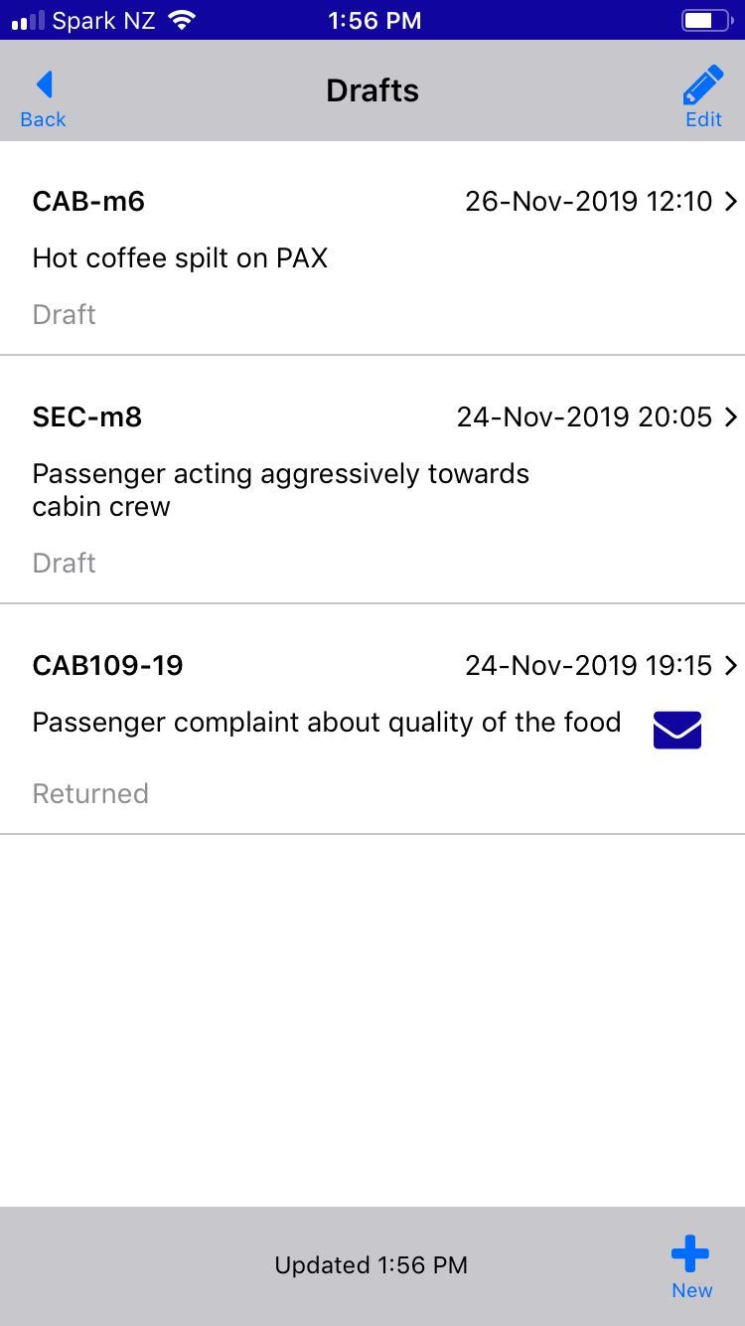
4. Save as Draft
- The Drafts list
Mobile eReports – Step by Step
Displays Drafts and eReports which have been returned so that you can continue to work on it before submitting it again.
Allows you to send more than one eReport at once.
Allows you to delete one or more eReports at once.
NOTE: An eReport in this list will not be synchronised to the main database until it has been sent.

Slide 23
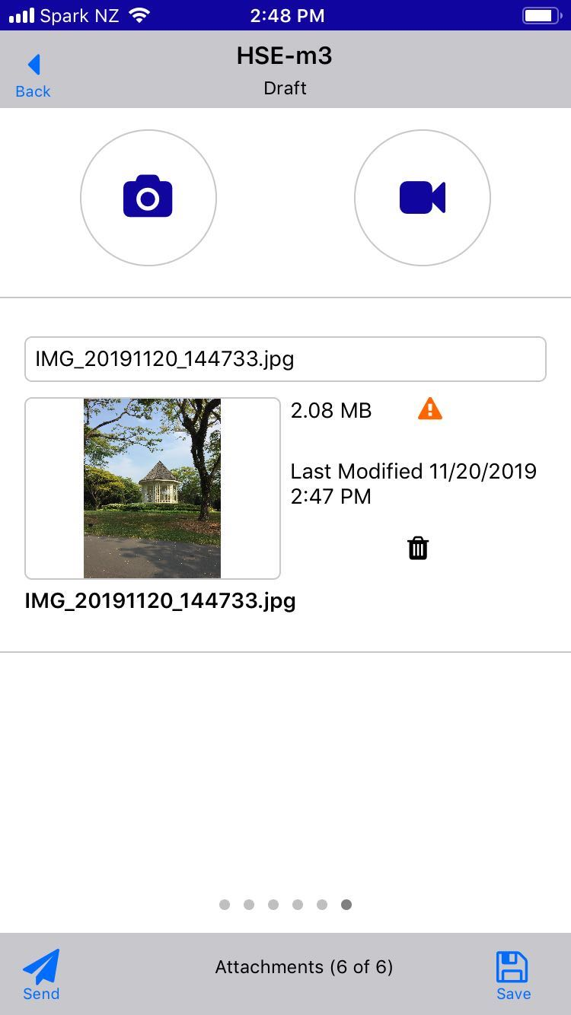
5. Add Attachments
Mobile eReports – Step by Step
Add photos or videos to the eReport from your device’s gallery. Photos can also be added using the camera.
Files are attached with the file name, size and the date modified.
The file description is automatically filled in with the file name but can be edited.
Thumbnails of attached images are displayed in the app.

Slide 24

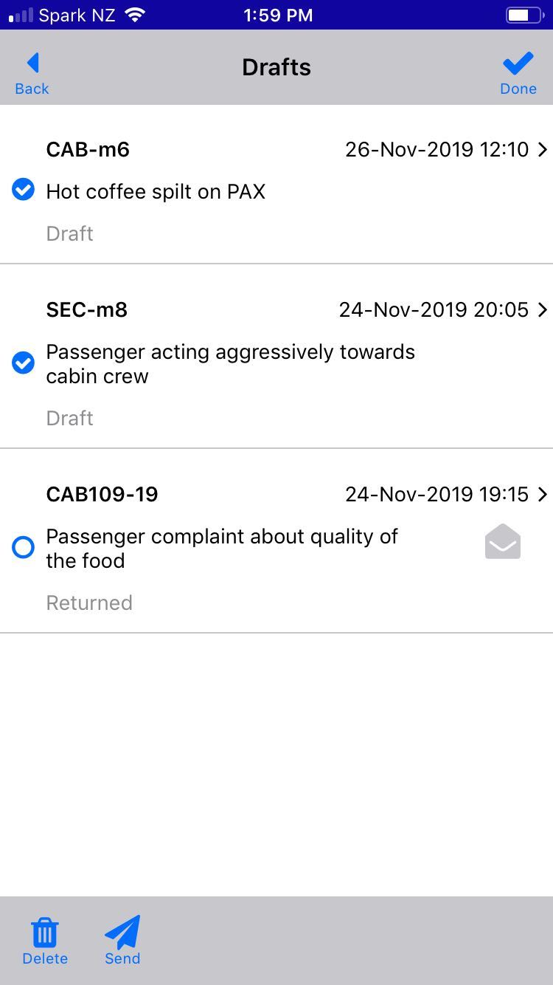
6. Send eReport
Mobile eReports – Step by Step
eReports can be submitted from the form by clicking on the Send icon.
Alternatively, eReports can be submitted in bulk from the Drafts page.
The eReports will be moved to the Outbox page.

Slide 25
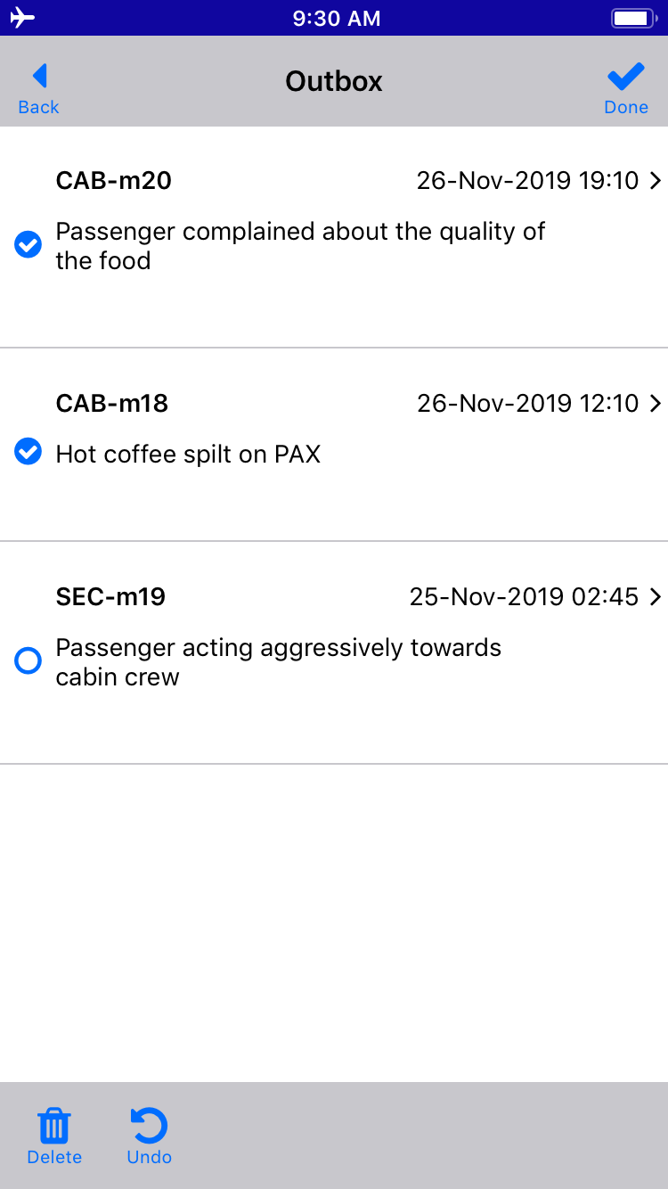
6. Send eReport
– The Outbox
Mobile eReports – Step by Step
Submitted eReports are held in the Outbox if you are not connected to the network.
The Outbox can be viewed at any time from the Home screen.
Reports in the Outbox can be viewed read-only.
The list displays the ID, Occurrence Date, Title of your sent reports.
Allows you to delete one or more eReports at once.
Allows you to revert one or more eReports in the Outbox back to draft.

Slide 26
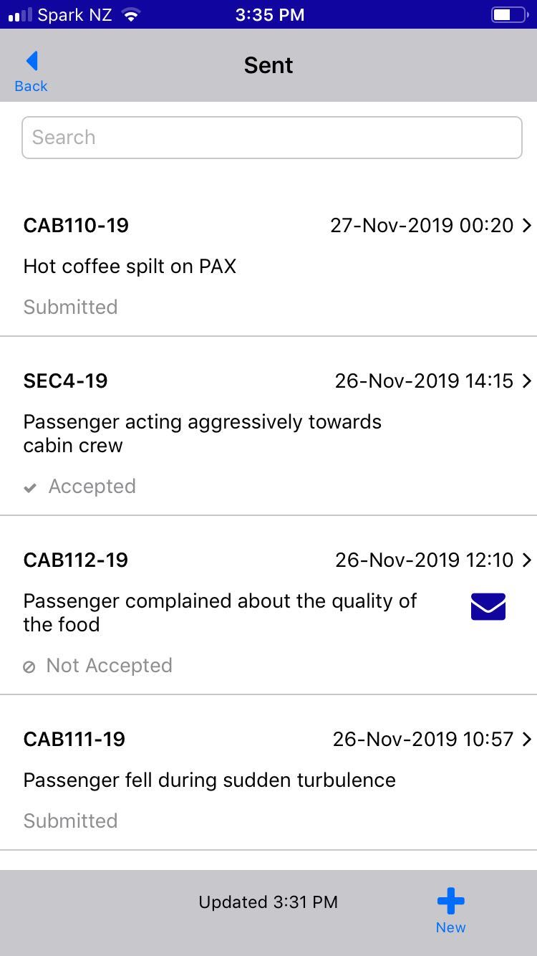
6. Send eReport
– The Sent list
Mobile eReports – Step by Step
Sent eReports are added to the Sent list which can be viewed at any time from the Home screen.
Reports in this list can be viewed read-only.
The list displays the ID, Occurrence Date, Title and Status of your sent reports:
      Submitted: eReports which have only just been sent.
      Accepted eReports which have been accepted by the eReport Coordinator.
      Not Accepted: eReports which have been rejected by the eReport Coordinator.
  Any reports you may have sent using SMS Solution are also included in the list, so that you can manage all of your sent reports from the app.
  There is a Search field to help you find a Sent report you might be looking for.

Slide 27
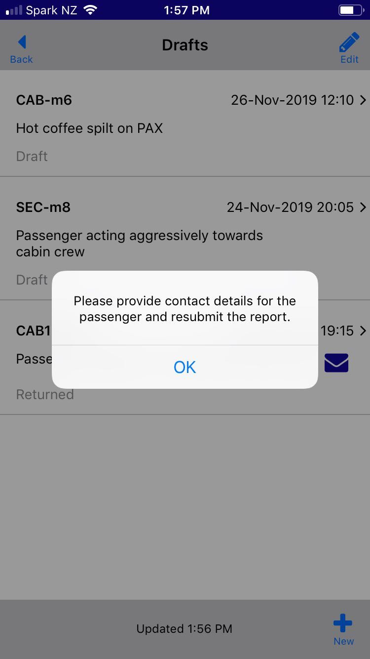


7. View Feedback
Mobile eReports – Step by Step
View feedback on sent eReports that have been returned or rejected, or when there is published feedback on an Investigation that your report is linked to.
  An envelope shows next to eReports which have unread feedback.
  An open envelope shows next to eReports which have feedback that has been read.
NOTE: Feedback on returned reports reverts to unread once the report is resubmitted.

Slide 28
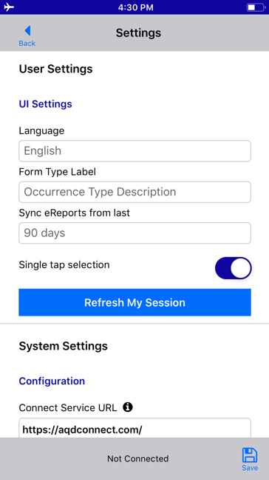
User Settings
Settings
Choose the language you want displayed in the app.
Change the label that is used for the list of new eReports to ‘Occurrence Title’, ‘Occurrence Type’ or both, or ‘Occurrence Description’.
Limit the number of eReports that are shown in the Sent list.
Enable ‘Single tap selection’ to allow you to select items in a list without having to tap ‘Select’ as well.
‘Refresh My Session’ to recover from a corrupt or expired token.

Slide 29
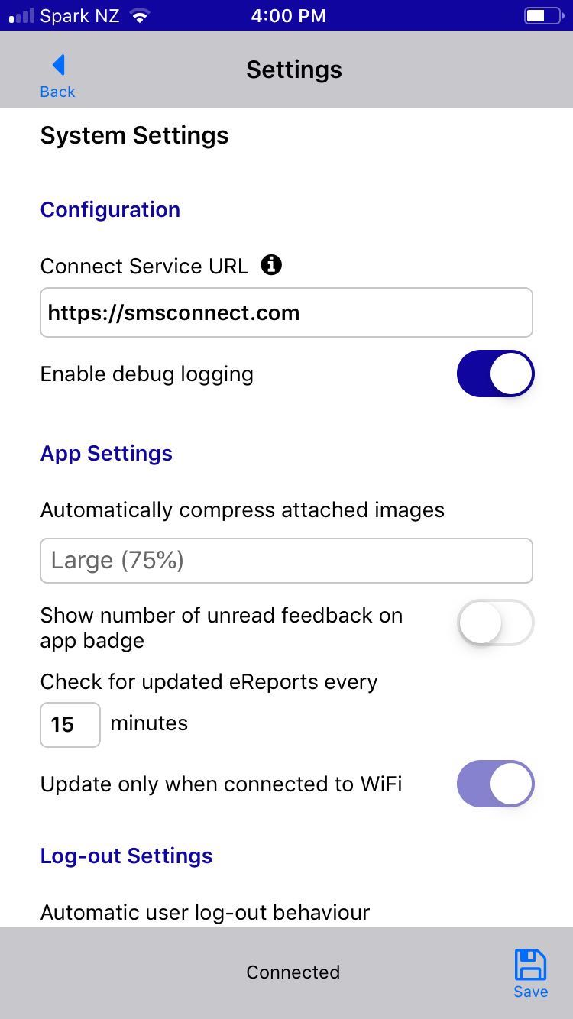
System Settings
Settings
Change Connect Service URL (only possible when logged out)
Enable debug logging to create log files to email support when troubleshooting.
Automatically compress attached images to small, medium or large.
Enable the app badge to display the number of unread feedback.
Control how often the app checks for updated eReports and if this should only occur only when connected to WiFi.
Choose to remain logged in or when you should be automatically logged out of the app.

Slide 30
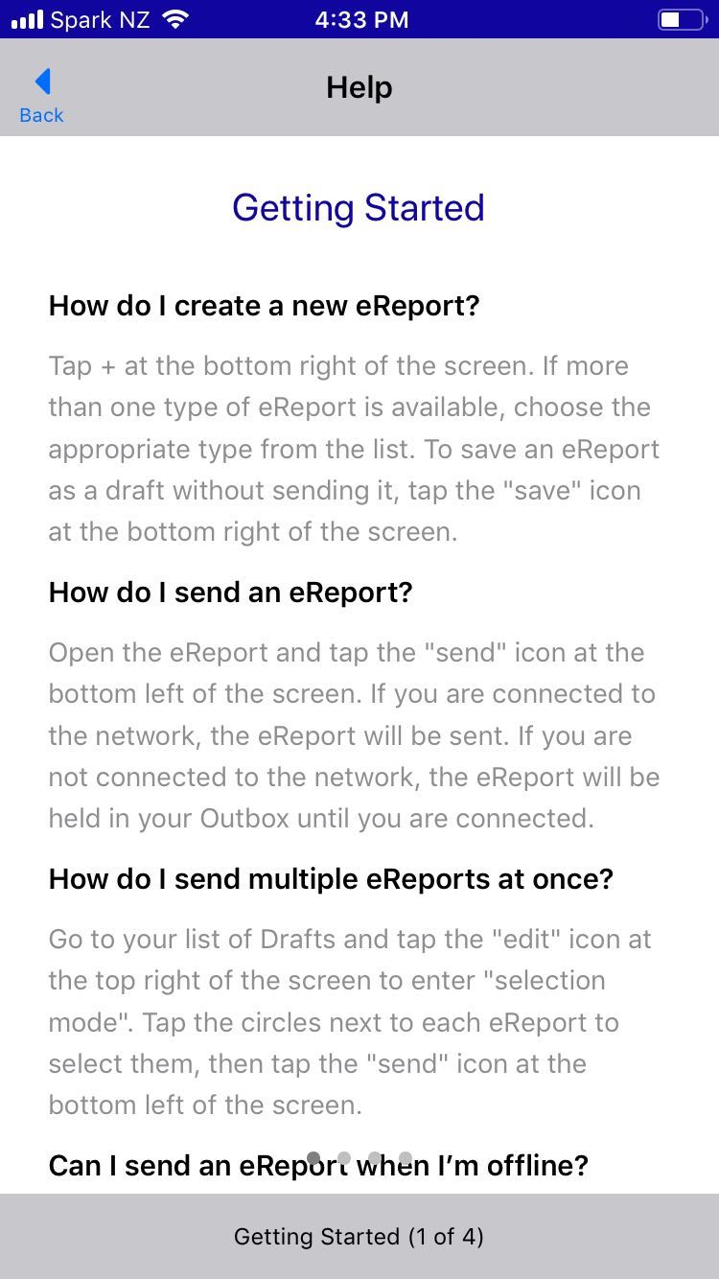
Get Help
Help
Access Help from the Home screen
Detailed instructions on a single page divided up into 4 tabs

Slide 31
Thank you

